Slide 1
Welcome to our Buddy
Collective Worship
Thursday 3rd November

Slide 2
The Lord be with you
And also with you

Slide 3
Psalm 118: 24
This is the day the Lord has made;
We will rejoice and be glad in it.

Slide 4
We are gathered here today for a very special service, to welcome all our new children in Reception. We celebrate their arrival to school by singing one of our favourite worship songs.

Slide 5
When we join a new school, we can sometimes feel like strangers. We hope that, with God’s blessing, all our Reception children will soon feel that they belong here. We remember how Jesus welcomed strangers. The Bible tells us that he said:
“I was hungry and you gave me food, I was thirsty and you gave me drink, I was a stranger and you welcomed me”.

Slide 6
I promise to guide you and be there whenever you need me.

Slide 7
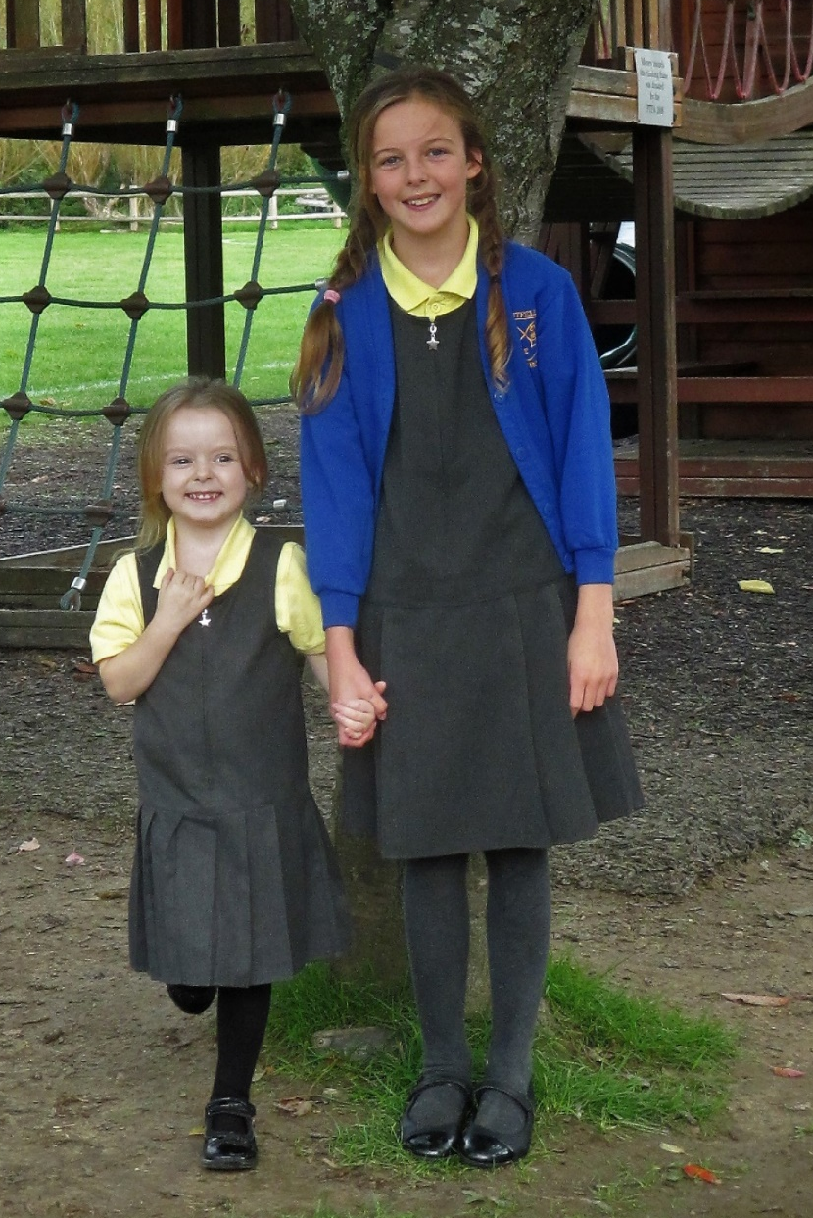
I promise to encourage you and help you enjoy your first year at Nutfield Church Primary school.

Slide 8
Ayah and Orla
I promise to protect you and we will grow together – your first year and my last year.

Slide 9
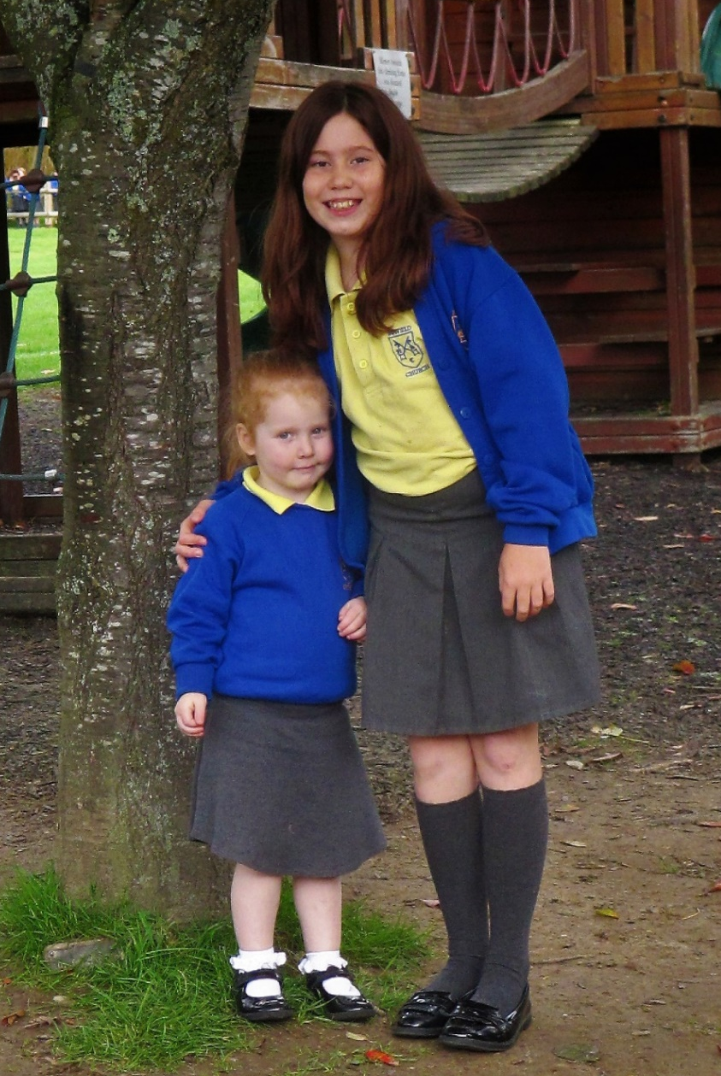
I promise to help you to try your best; look after you when you are sad and help you throughout the year.

Slide 10
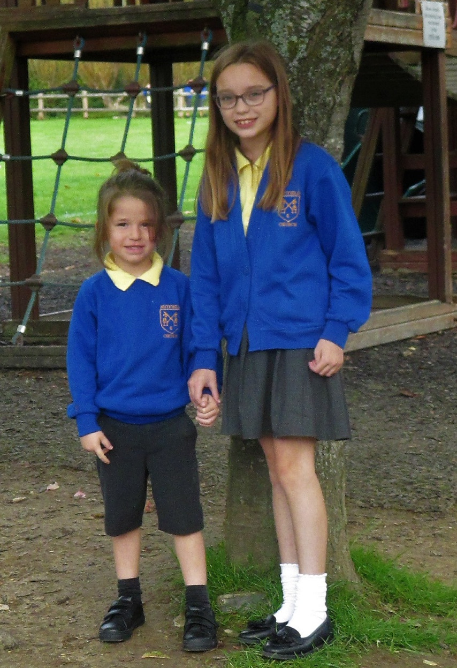
I promise that I will always be kind and helpful. I will care for you if you feel sad.

Slide 11
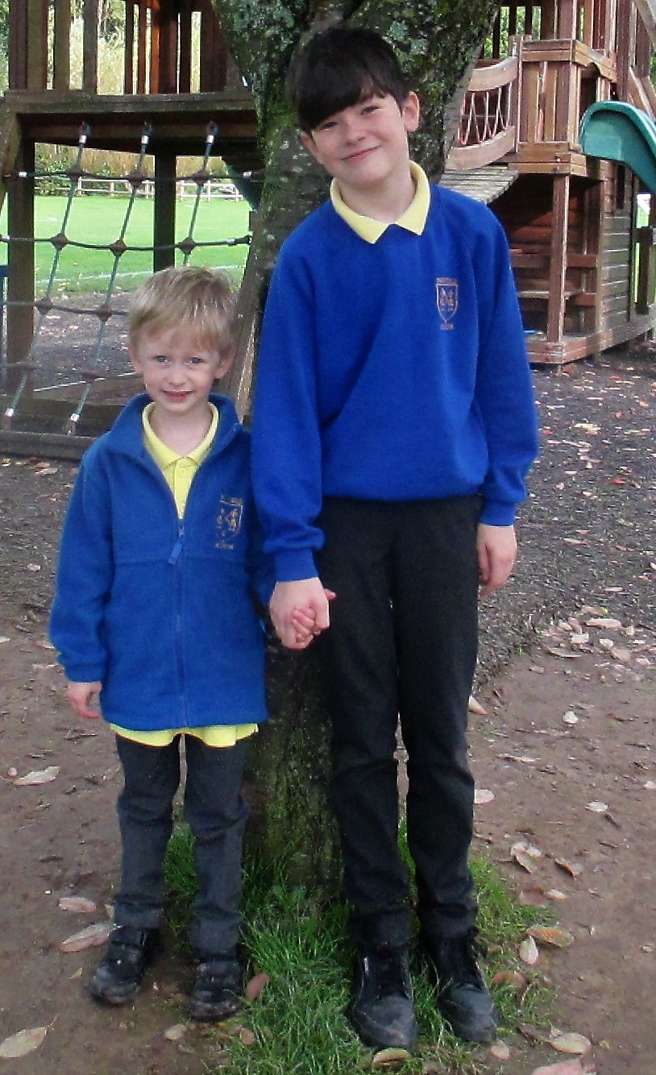
I promise to keep you safe and to be always there for you.

Slide 12
I promise to always make you happy. We will laugh, play and smile together.

Slide 13
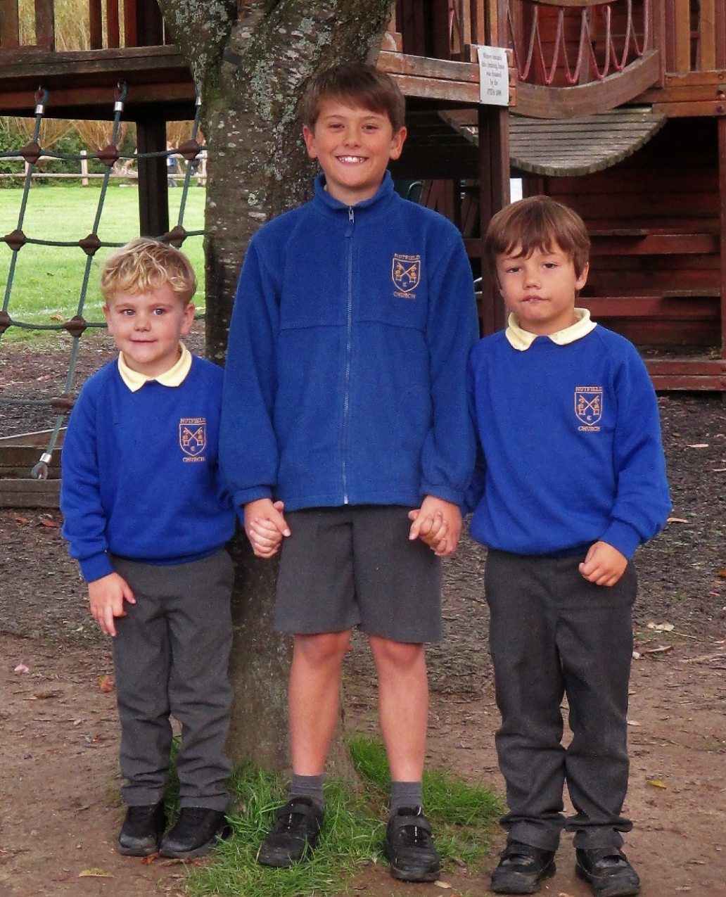
I promise to try my best to look after you both and help you as you go through the year.

Slide 14
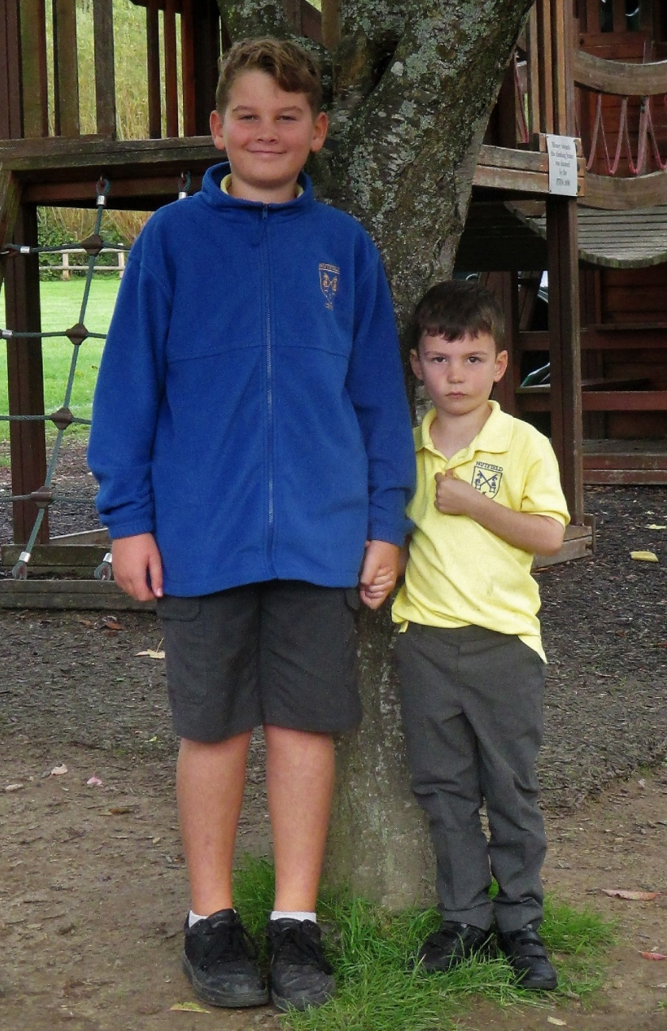
I promise to be your friend. I will play your games and you can play mine too!

Slide 15
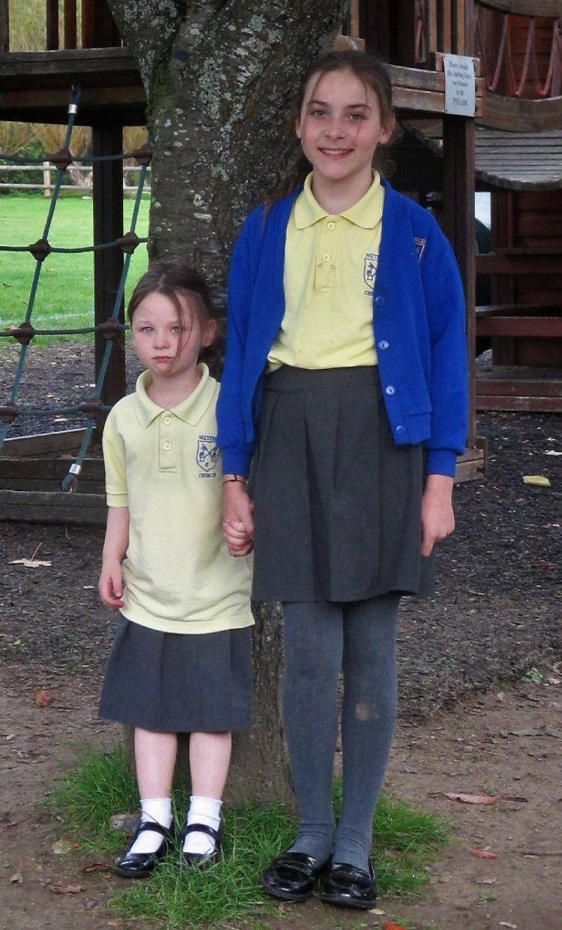
I promise to make sure you are happy. I will wipe away your tears if you are sad.

Slide 16
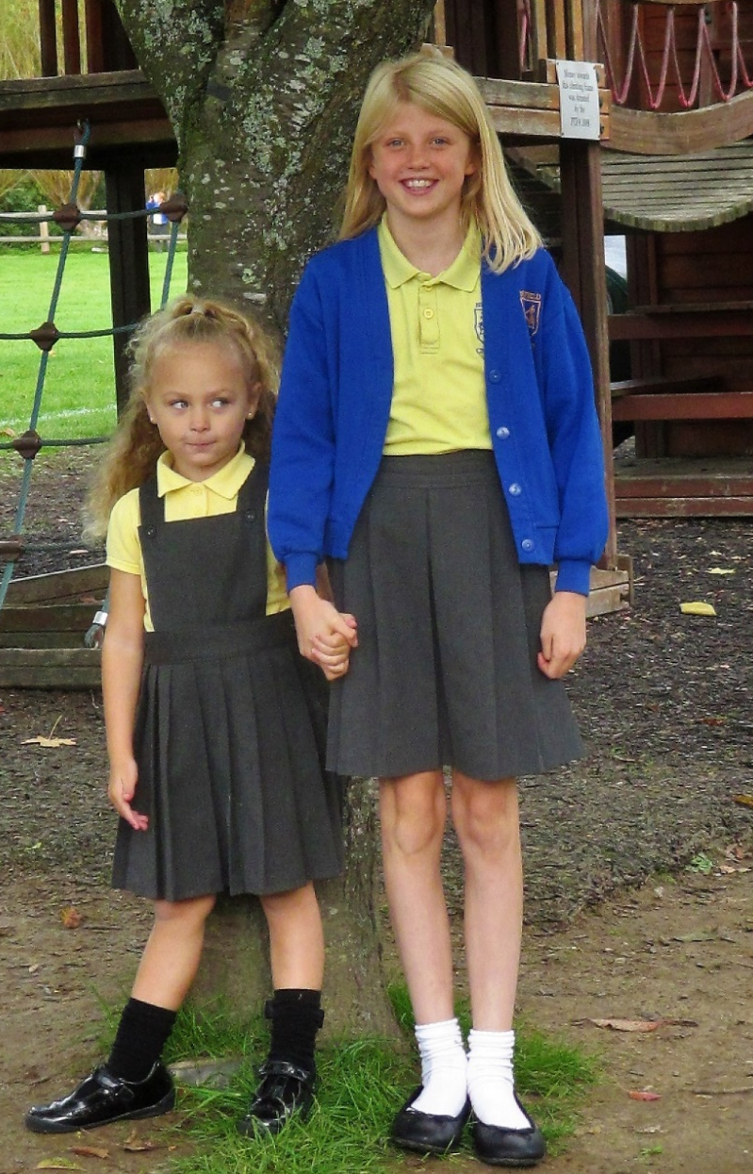
I promise to always look after you; to keep you safe and hold you in my heart.

Slide 17
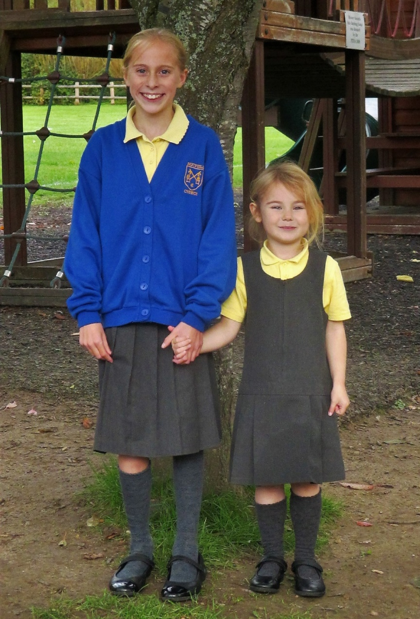
I promise to guide you. I promise to support you. I promise to care for you.

Slide 18
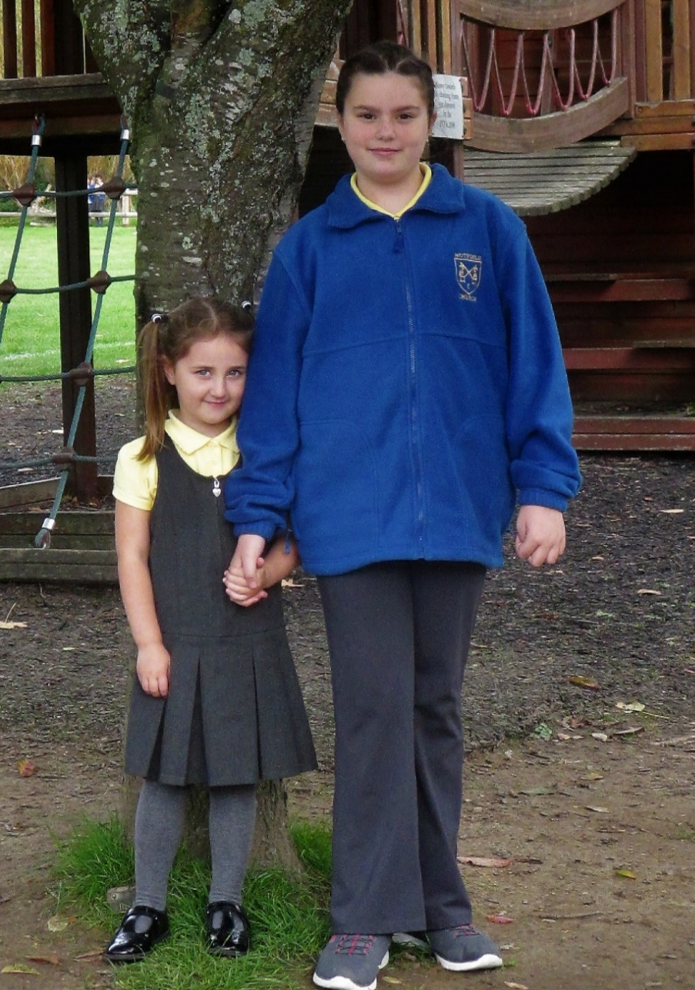
I promise to always keep you safe and happy. I promise to become a good friend.

Slide 19
I promise to protect you; keep you safe in school; and always be there for you.

Slide 20
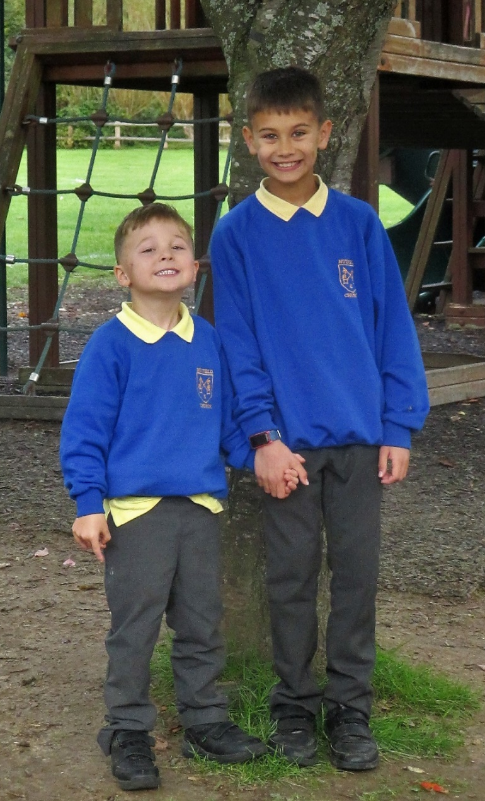
I promise to hug you every time I see you and to make sure I comfort you if you feel sad.

Slide 21
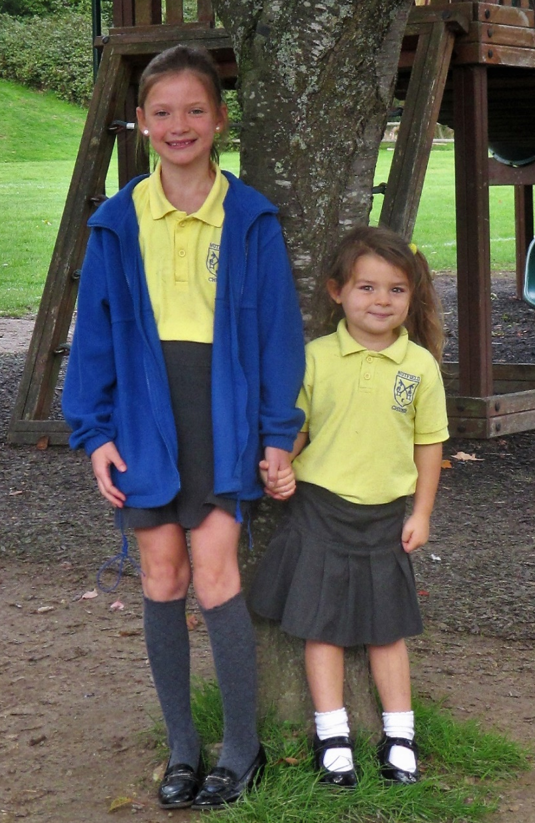
I promise that we will always be friends. I will play your games and help you make lots of happy memories.

Slide 22
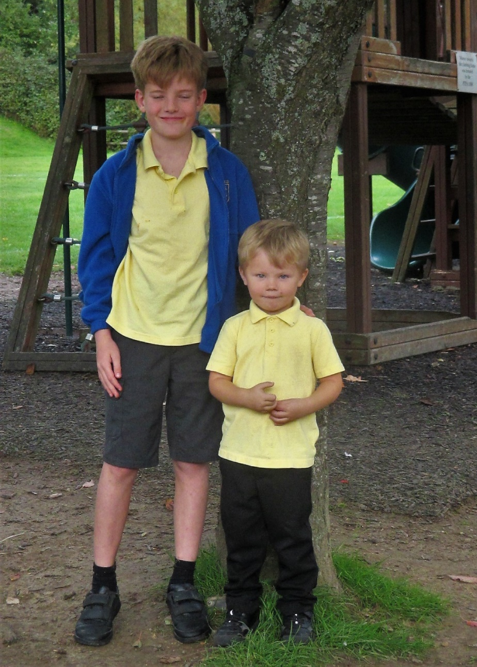
I promise to help you and be your friend the rest of the year.

Slide 23
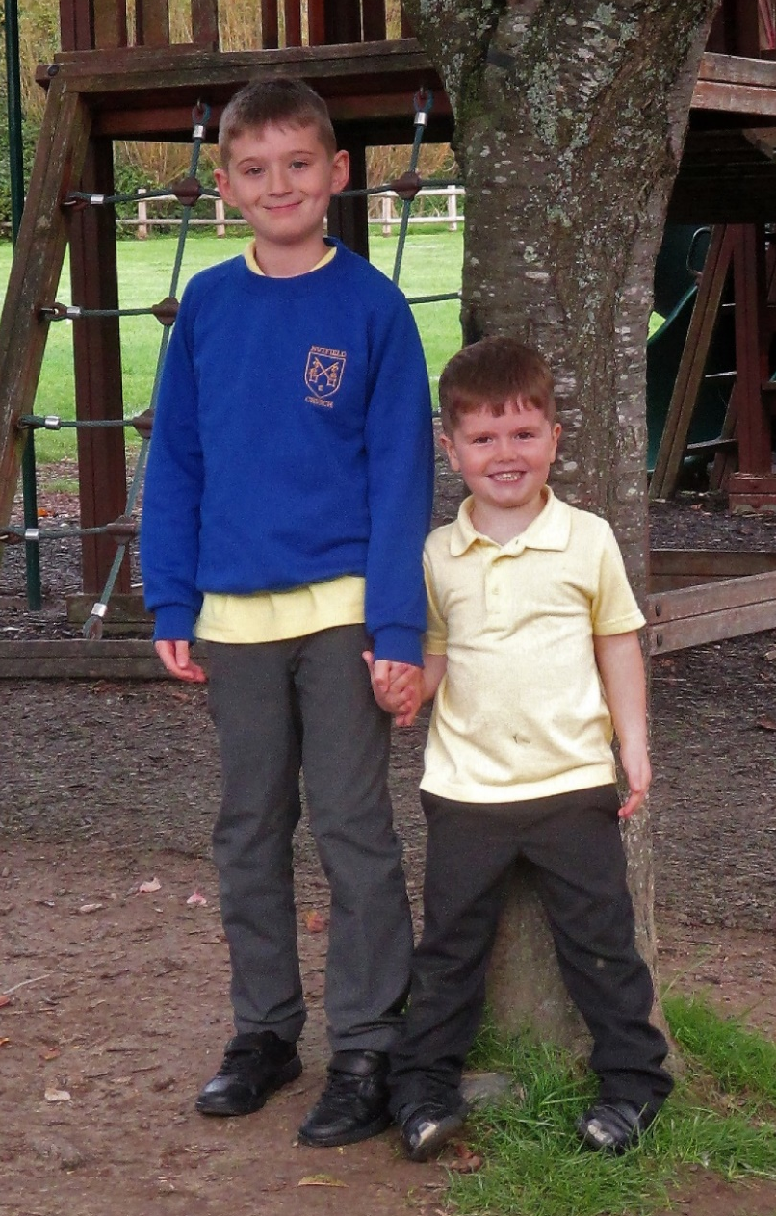
I promise to read with you; to protect you and to try to keep you safe from being hurt.

Slide 24
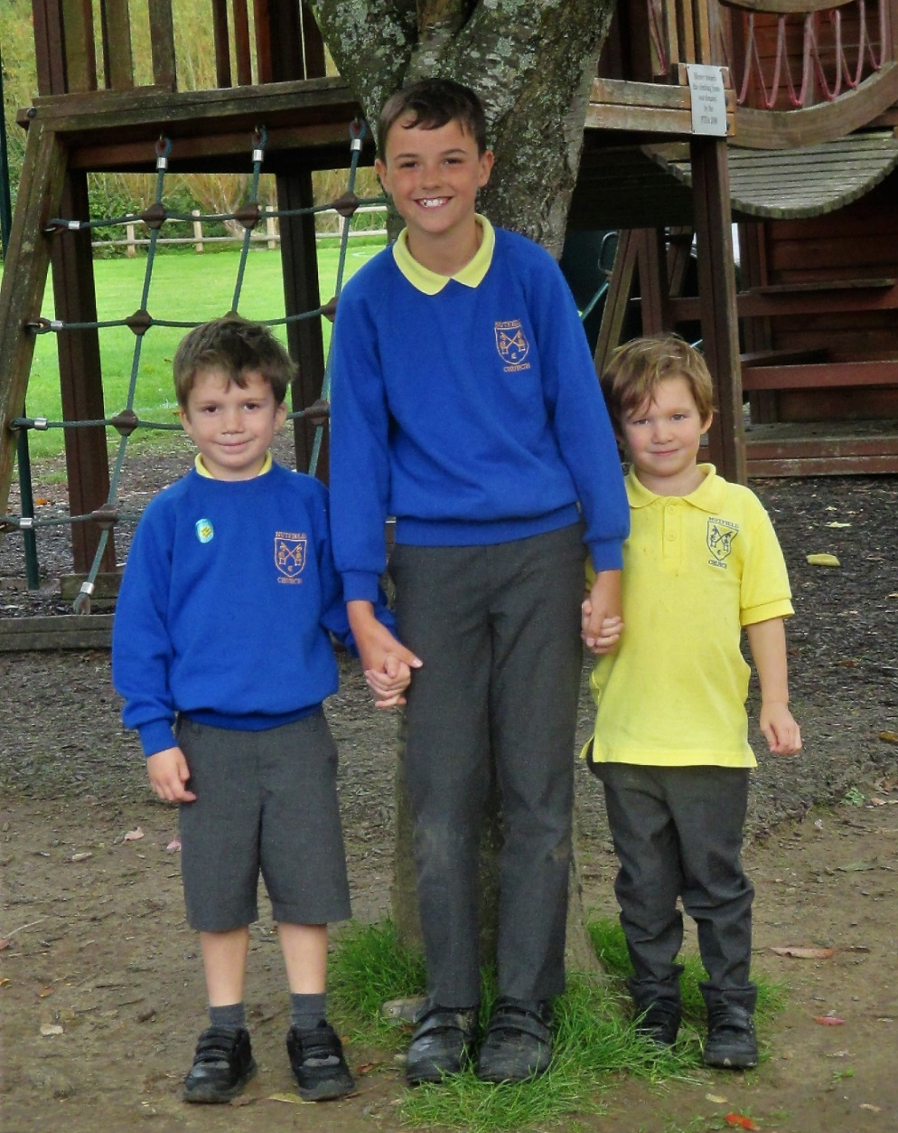
I promise to always play with you both and to check if you are happy.

Slide 25
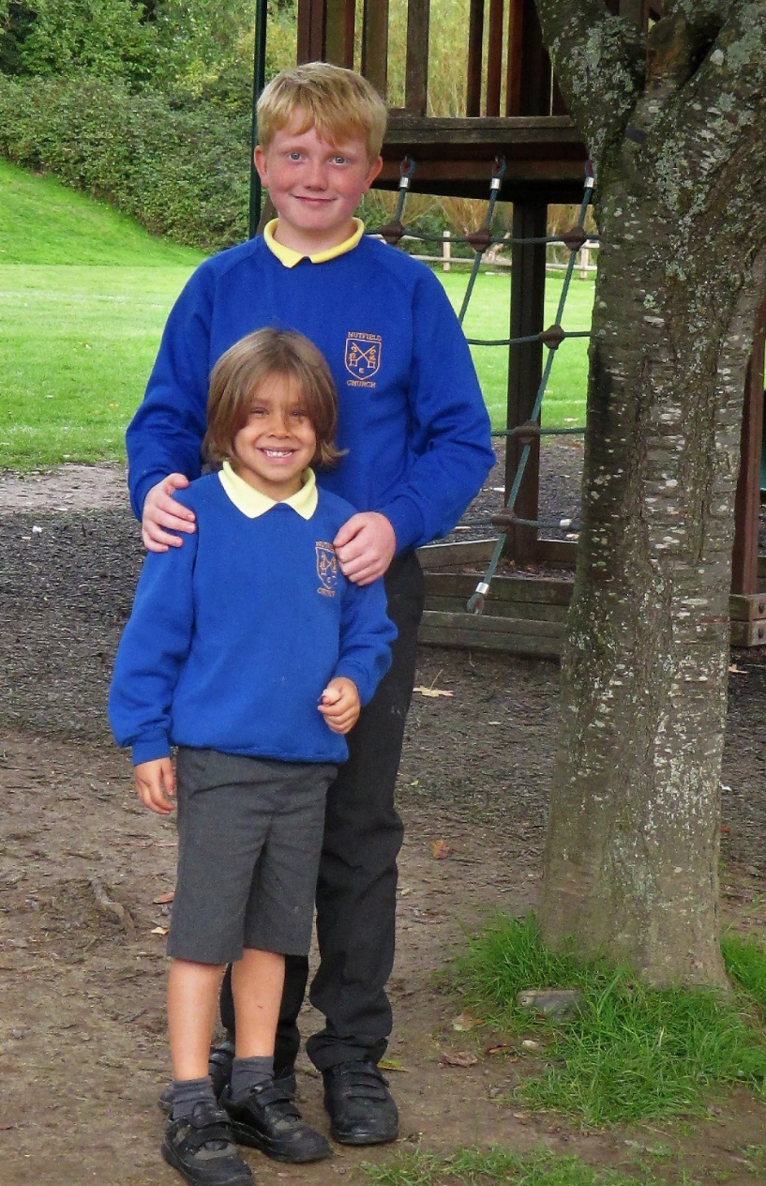
I promise that we will have lots of fun together. I will protect you and make sure I am there to guide you.

Slide 26
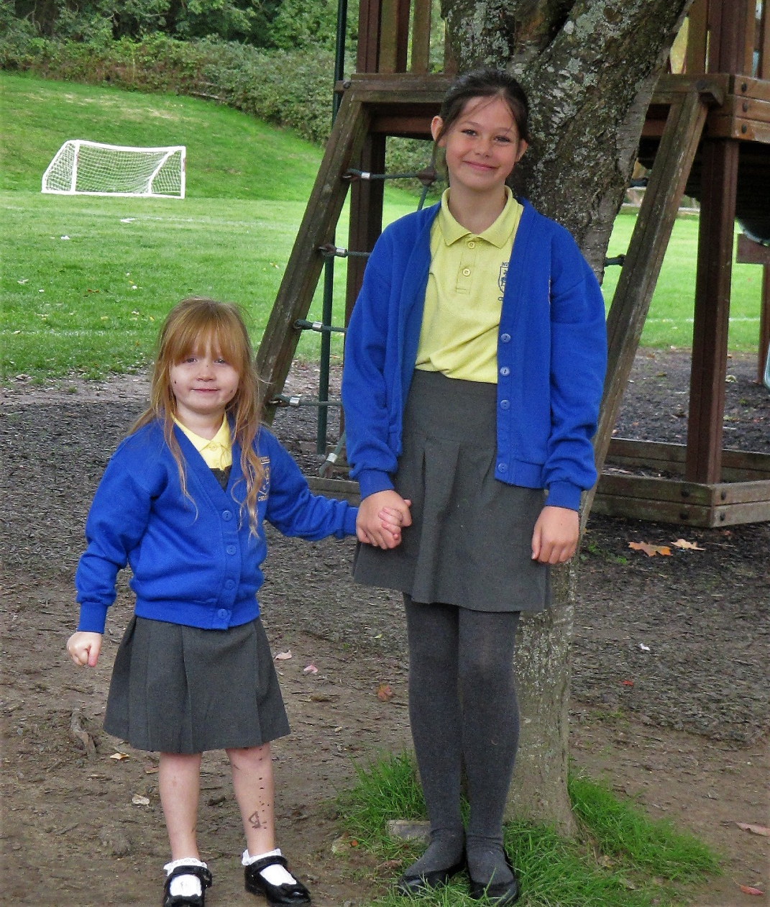
I promise I will listen to your stories and I hope you will listen to mine too.

Slide 27
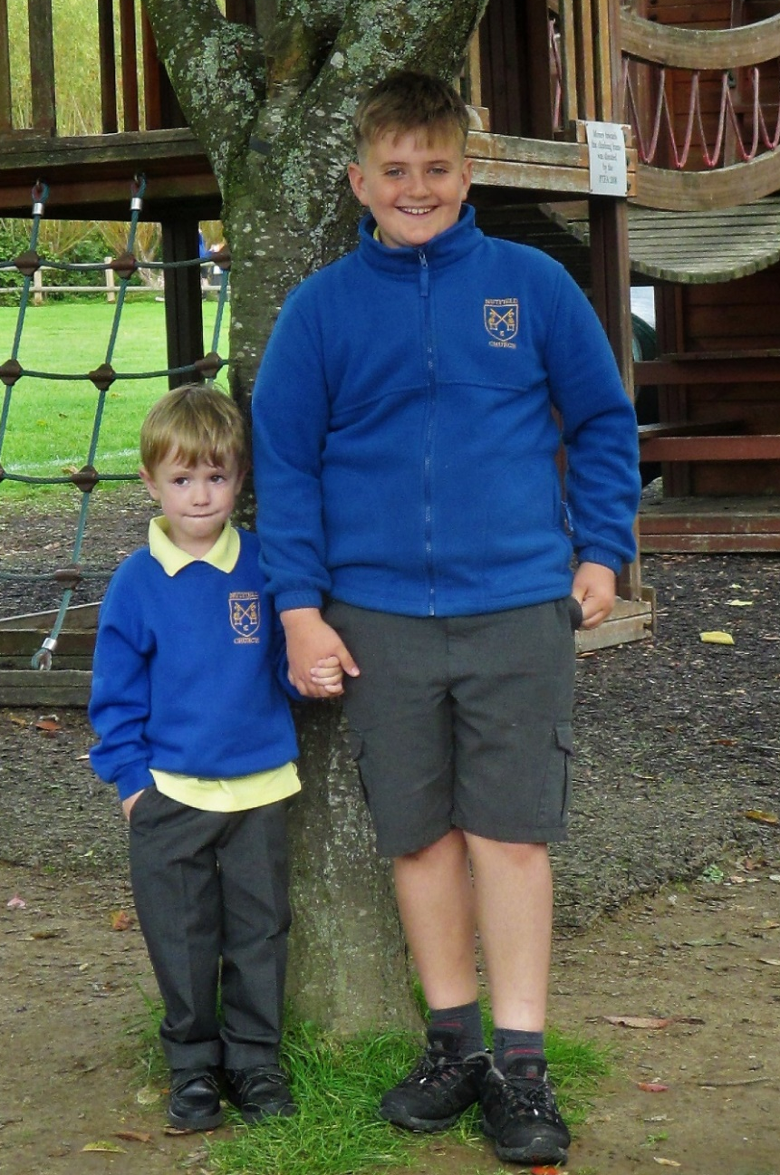
I promise to be your friend. You can always count on me to look out for you.

Slide 28
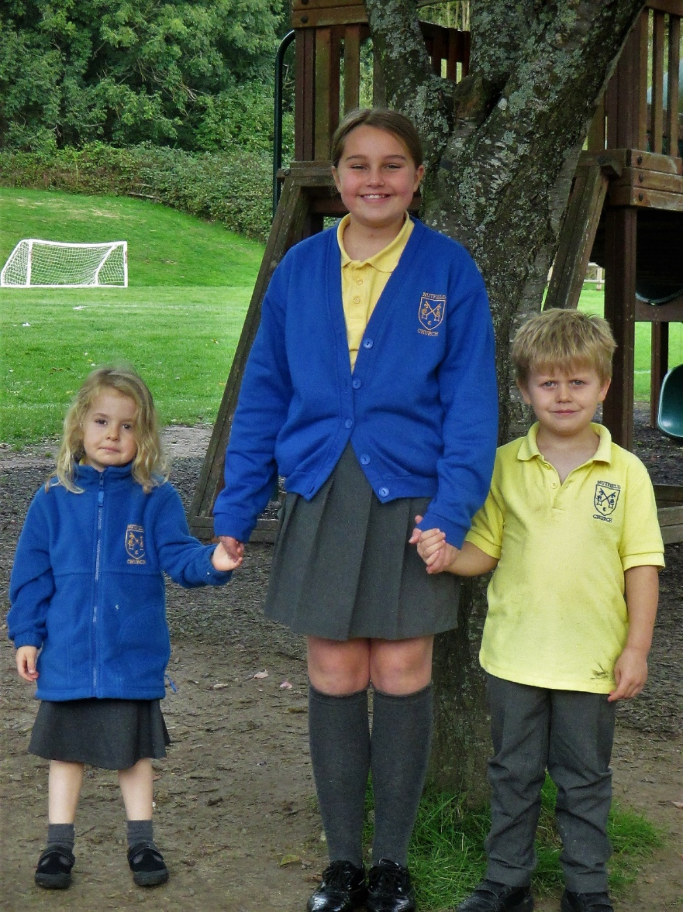
I promise to help you when you are sad and to keep you safe and happy.

Slide 29
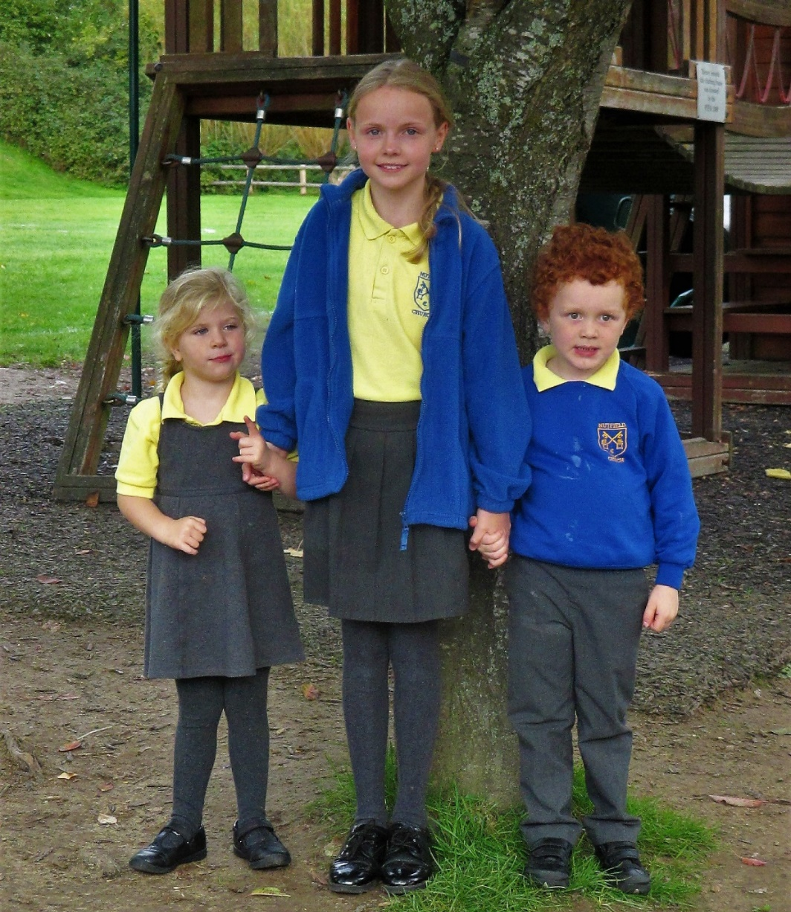
I promise to always look after you and to make sure you don’t get hurt. I will always keep you safe.

Slide 30
Mathilde and Emmy
I promise to care for you through out the year. I will pick you up if you fall and wipe away your tears. I will encourage you to always do your best.

Slide 31
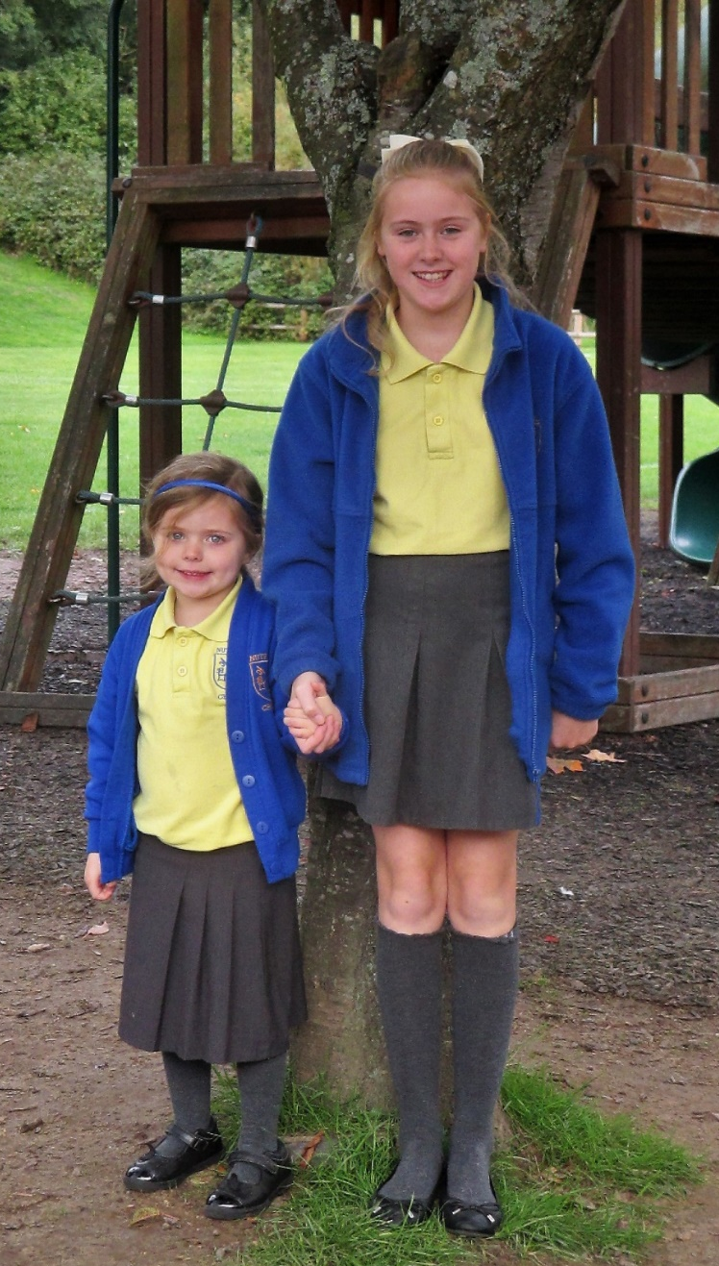
I promise to make sure that you are happy and safe. I promise I will make you smile everyday.

Slide 32
Sowing the Seeds of Friendship
We've joined Reception as classmates
As we start the autumn term.
A new school to get used to
And lots of things to learn.
We'll share and show our kindness
As we work and play together
We’ll plant the seeds of friendship
To grow and last forever.

Slide 33
May God keep you in all your days.
May Christ shield you in all your ways.
May the Spirit bring you healing and peace.
May God the Holy Trinity drive all darkness from you.
And pour upon you your blessing and light.
Amen

Slide 34
The Grace Prayer
May the grace of our Lord Jesus Christ, and the love of God, and the fellowship of the Holy Spirit be with us all, now and evermore. Amen.

Slide 35
The Lord’s Prayer
Our Father, who art in heaven,
hallowed be thy name;
thy kingdom come;
thy will be done;
on earth as it is in heaven.
Give us this day our daily bread.
And forgive us our trespasses,
as we forgive those who trespass against us.
And lead us not into temptation;
but deliver us from evil.
For thine is the kingdom,
the power and the glory,
for ever and ever.
Amen.

Slide 36
Go in Peace to love and serve the Lord.
In the name of Christ we will.

