Slide 1
Welcome to the
Phonics information
Meeting for Parents

Slide 2
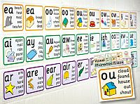
The Science..!

Slide 3
The Alphabetic Code
English is an alphabetic language
There are 26 letters in the English language
There are approximately 44 sounds (phonemes) in the English language
Combined they make in excess of 140 letter combinations (graphemes)
https://home.oxfordowl.co.uk/reading/reading-schemes-oxford-levels/essential-letters-and-sounds/

Slide 4
Terminology 1
Phoneme – the smallest unit of sound in a word.
Grapheme – a letter or group of letters that represent a phoneme.
Blending – merging the individual phonemes together to read a word all the way through. Children should sound out each phoneme, not letter when reading unfamiliar words.
Segmenting – hearing and saying the individual phonemes within words. In order to spell, children need to segment a word into its component phonemes and choose a grapheme to represent each phoneme.

Slide 5
Terminology 2
Digraphs – two letters representing one phoneme
Consonant digraphs: ll ss ff zz ng
Vowel digraphs: ai ee ew oa ar
Split Vowel digraphs: a-e e-e i-e o-e u-e

Slide 6
Terminology 3
Trigraphs: three letters making one phoneme:
ear air ure tch dge igh

Slide 7
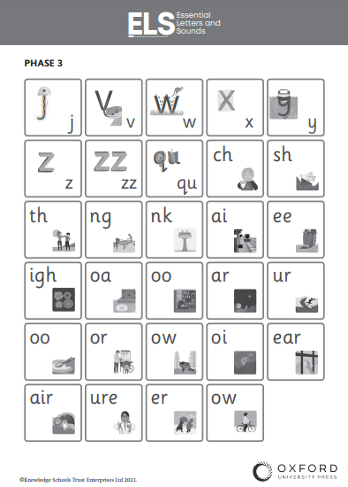
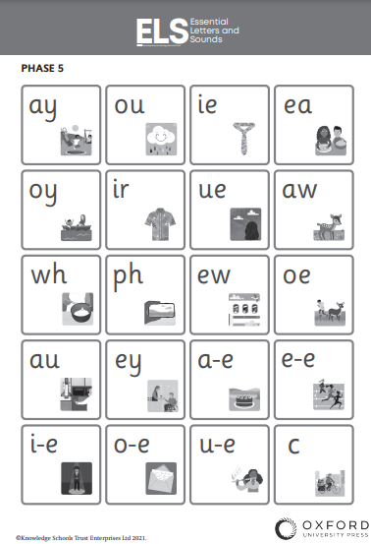

Slide 8
Identifying Phonemes
jump book
catch surfer
August midnight
shopping sleep

Slide 9
The Journey… Simple to complex…
SIMPLE…
Concept 1: sounds/phonemes are represented by letters/graphemes
Concept 2: a phoneme can be represented by one or more letters
COMPLEX…
Concept 3: The same phoneme can be represented in more than one way.
Concept 4: The same grapheme may represent more than one phoneme.

Slide 10
The National Year One Phonics Screening Check was
introduced in 2012.
The test is administered in June.
This check is statutory for all maintained schools.
All pupils in our current Year One at
Nutfield Church Primary School will take the
Screening Check.

Slide 11
The Phonics Screening Check is designed to
show how well your child can use the phonics
skills they have learned up to the end of Year One, and to identify pupils who need extra phonics help.
The screening check assesses whether your child is able to read/decode at an appropriate standard.
The Department for Education defines the checks as “short, light-touch assessments” that take about four to nine minutes to complete.

Slide 12
What does the
Phonics Screening Check consist of?
The check consists of 40 words that
your child will be asked to read
one-on-one with Mrs Matthews.
There will be 20 ‘real’ words and
20 ‘pseudo-words’ (non-words).

Slide 13
Non-words (nonsense words, pseudo words) are a collection of letters that will follow phonics rules your child has been taught, but don’t mean anything.
Each of the non-words is presented with a picture of a monster/alien.
Your child will need to apply their knowledge of phonemes to read these correctly, showing that they understand the phonics rules behind them.

Slide 14
tox
jound
fape

Slide 15
ulf
thazz
quemp

Slide 16
The 40 words and non-words are divided
into two sections –
simple word structures of three or four letters
more complex word structures of five or six letters.
Mrs Matthews will give your child a few practise words to read first.

Slide 17
shin
newt
best

Slide 18
slide
phone
midnight

Slide 19
Marking the Phonics Screening Check.
The check will be marked by Mrs Matthews.
The check will be administered in accordance with the Standards and Testing Agency’s check administration guidance.
Schools are monitored by unannounced monitoring visitors from local authorities in order to ensure that administration of the checks are accurate.

Slide 20
All schools will report their pupil-level
phonics screening check data to their
Local Authority.
The threshold mark is communicated to schools
by the start of July, after the test has been taken and all schools have submitted their pupils’ scores.
Your child will be scored against a national standard, and their result will indicate whether or not they fall below or within this standard.

Slide 21
Threshold Mark.
In the last three years, the "pass threshold" was 32,
which meant that children had to read at
least 32 words out of 40 correctly.
At Nutfield Church Primary School we pride ourselves on our phonics teaching. Results in the Year 1 phonics screening check are above the national average”.

Slide 22
How can I help my child prepare?
revising the phonics the children have already
learned in Reception and Year One
weekly phonics homework
read new books/stories with your child
Stay calm and be positive! The children do this everyday!

Slide 23
Useful links/websites www.phonicsplay.co.uk/ www.phonicsbloom.com/ www.oxfordowl.co.uk/ www.topmarks.co.uk/

Slide 24
Any questions?

