Slide 1
Staff
Welcome to Year 2!
Miss Mitchell
Miss Murray
Mr Tsang

Slide 2
School Values
Community and Peace – Autumn
Wisdom and Hope - Spring
Dignity and Joy - Summer

Slide 3
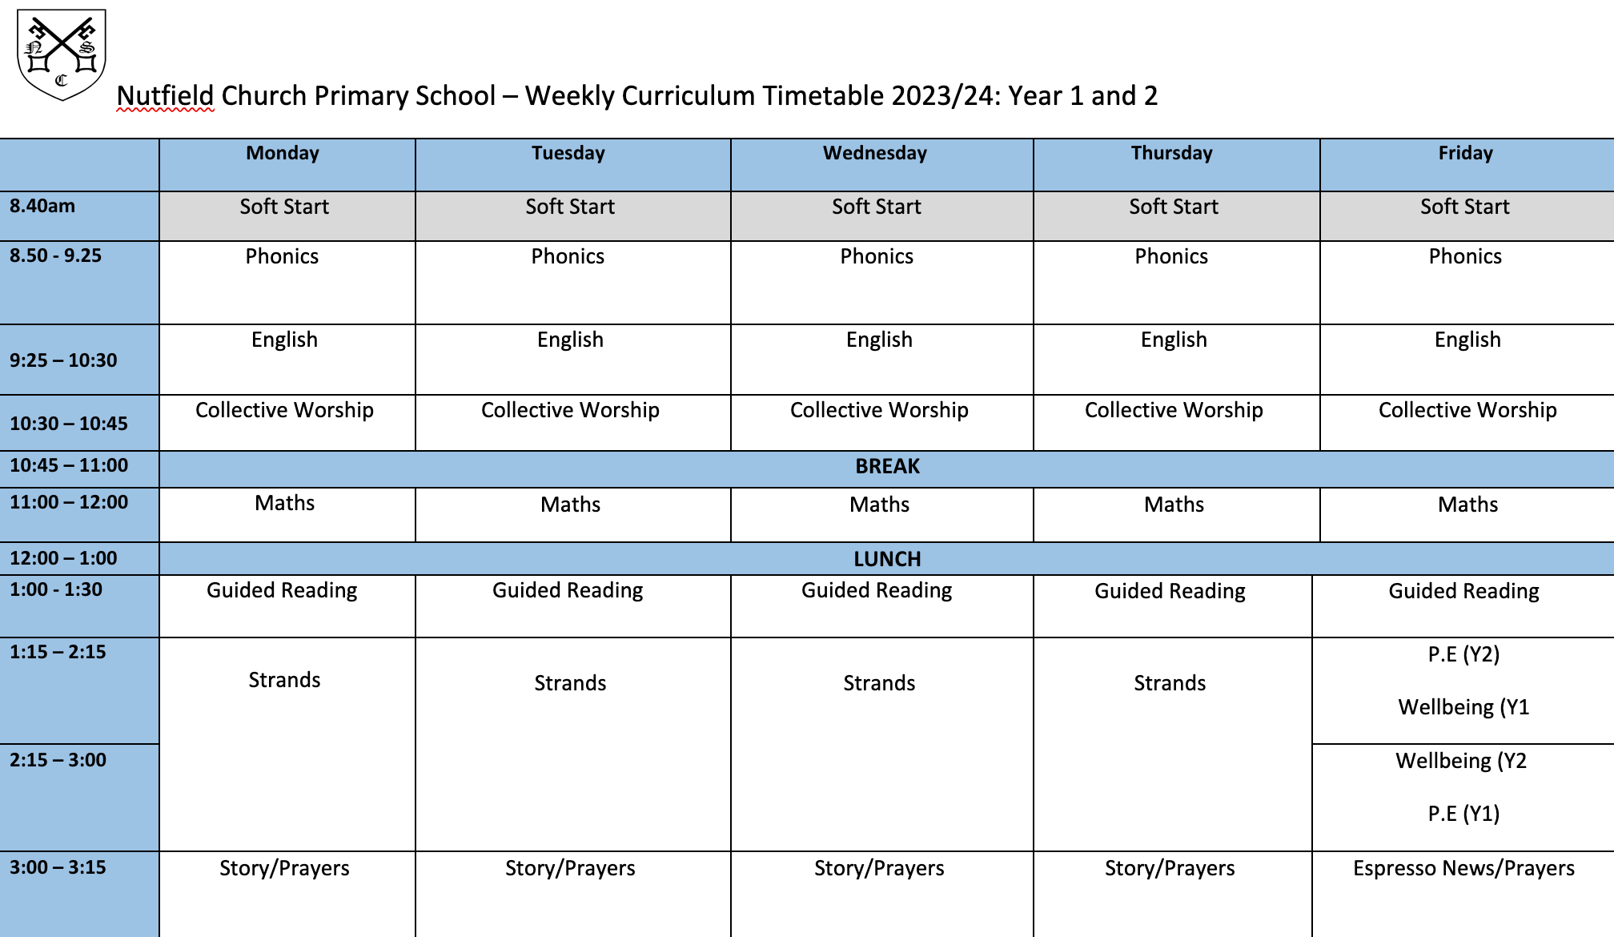
Our Timetable

Slide 4
English
Every term we study a different book and this half term our book is “Jim and the Beanstalk”
This year we are studying a variety of different books that explore different concepts and genre.
Grammar and punctuation focus in both reading and writing.
Lots of drama, role play and art.
Notes:
Our English lessons will centre around a variety of high quality texts, which will enable the children to explore a vast range of genres and concepts. We study a different book every half term.
I must stress that you don’t go and buy or read the books once it is revealed what they are – the scheme of work revolves around mystery and as a class we work through the book to enable the children to be creative as possible. For example, until Monday, we had only read 1 paragraph of The Pied Piper.
In addition to reading and writing, English will be taught through a range of different medias (drama, art and role play). There will be many an opportunity for the children to perform! The picture is of the children being told their was a rat running under their feet.
In addition, there will also be a focus on grammar and punctuation and applying this to reading and writing, this will be done during English lessons and through Guided Reading sessions.

Slide 5
Reading
Please read with your child every night and record this in their reading record.
Reading records will be checked daily and books changed if needed.
We will listen to the children read every week. This will also happen in our Guided Reading sessions.
Once a child becomes a ‘Independent Reader’ they may bring in suitable books in from home, or choose from the selection we have in the classroom.
Notes:
Our English lessons will centre around a variety of high quality texts, which will enable the children to explore a vast range of genres and concepts. We study a different book every half term.
I must stress that you don’t go and buy or read the books once it is revealed what they are – the scheme of work revolves around mystery and as a class we work through the book to enable the children to be creative as possible. For example, until Monday, we had only read 1 paragraph of The Pied Piper.
In addition to reading and writing, English will be taught through a range of different medias (drama, art and role play). There will be many an opportunity for the children to perform! The picture is of the children being told their was a rat running under their feet.
In addition, there will also be a focus on grammar and punctuation and applying this to reading and writing, this will be done during English lessons and through Guided Reading sessions.

Slide 6
Helping with Reading
Literal Questions:
These are simple questions where children are asked a fact from within the story (i.e., the information is literally within the text). For example:
“What was the pirate’s name?”
“Can you remember who was on the boat?”
“What happened after they got off the boat?”
Inference Questions
Inference questions need children to look beyond the text and give information that was not specifically provided, but which was implied (i.e., children need to ‘read between the lines’). For example:
“What do you think happened next?”
“Why do you think he did that?”
“How do you think the pirate felt when he was left behind?”
Notes:
Our English lessons will centre around a variety of high quality texts, which will enable the children to explore a vast range of genres and concepts. We study a different book every half term.
I must stress that you don’t go and buy or read the books once it is revealed what they are – the scheme of work revolves around mystery and as a class we work through the book to enable the children to be creative as possible. For example, until Monday, we had only read 1 paragraph of The Pied Piper.
In addition to reading and writing, English will be taught through a range of different medias (drama, art and role play). There will be many an opportunity for the children to perform! The picture is of the children being told their was a rat running under their feet.
In addition, there will also be a focus on grammar and punctuation and applying this to reading and writing, this will be done during English lessons and through Guided Reading sessions.

Slide 7
Helping with Reading
Evaluative Questions:
Evaluative questions require children to read behind and beyond the lines. For example:
“Do you think he should have done that?”
“Do you think the Pirates were very different from each other?”
Take time to think about the questions and discussions that you have with your child as you read with them, but most importantly, enjoy sharing these stories together.
Notes:
Our English lessons will centre around a variety of high quality texts, which will enable the children to explore a vast range of genres and concepts. We study a different book every half term.
I must stress that you don’t go and buy or read the books once it is revealed what they are – the scheme of work revolves around mystery and as a class we work through the book to enable the children to be creative as possible. For example, until Monday, we had only read 1 paragraph of The Pied Piper.
In addition to reading and writing, English will be taught through a range of different medias (drama, art and role play). There will be many an opportunity for the children to perform! The picture is of the children being told their was a rat running under their feet.
In addition, there will also be a focus on grammar and punctuation and applying this to reading and writing, this will be done during English lessons and through Guided Reading sessions.

Slide 8
Spelling and Handwriting
Weekly spelling homework and spelling tests
It is important for the children to be able to spell fluently for writing activities during lessons.
Use the diagonal and horizontal strokes that are needed to join letters and increase the legibility, consistency and quality of their handwriting. Handwriting practice every day this term.
Notes:
This term, our focus will be improving our confidence with spelling and using a wider range of vocabulary to ensure that our writing is the best it can be!
Every week, a set of spellings will be sent home and tested on a Friday
These spellings with either be from the 200 high frequency words, words from the Year3/4 curriculum or words that we are using during our topics.
The Year3/4 curriculum list all contain words the children need to be able to spell by the end of Y4, so do not worry too much if the children are struggling with these, there are 2 years for them to learn – but its nice to get a head start.
More importantly though is the childrens ability to spell these words during writing activities and especially when it comes to being fluent in writing.
We are also having a big push on handwriting this year. By the end of the year the children need to be using horizontal and diagonal strokes to join letters, we are having handwriting practise in our guided reading sesions and 2/3 times during the week.

Slide 9
Writing

Slide 10
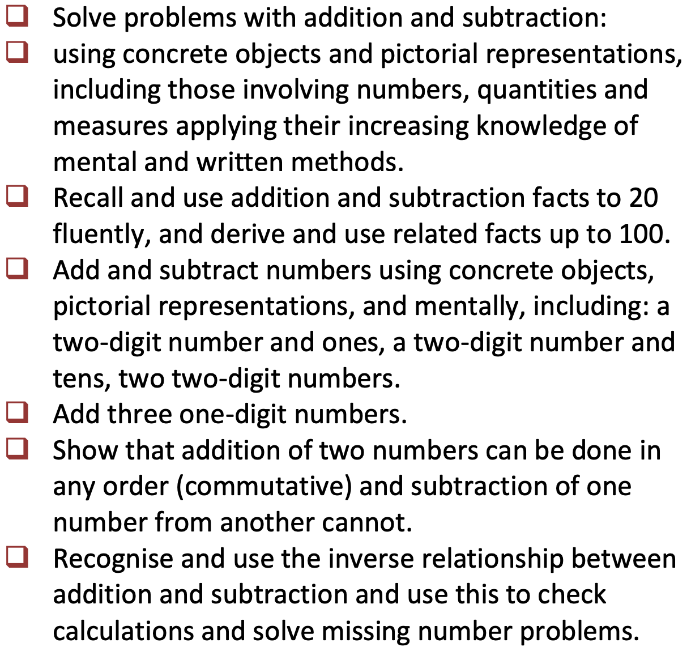
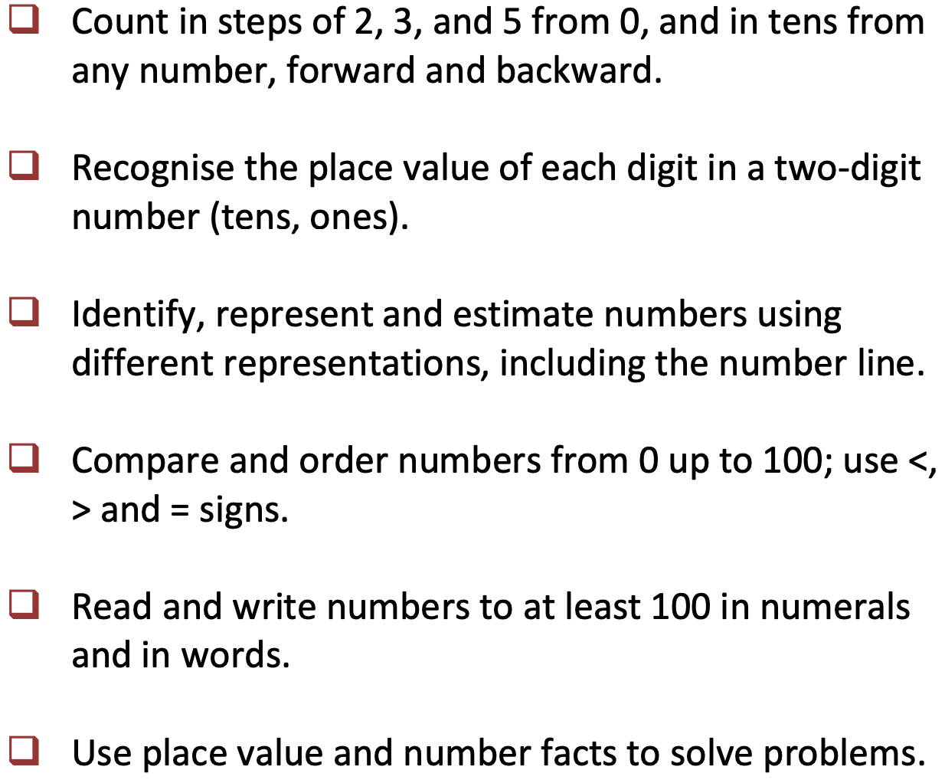
Maths
Notes:
We will start the term by extending our knowledge and recapping place value and our number bonds. Understanding place value – the value of each digit in a number.
These are a key mathematical skill and plays an extremely important role in helping the children to understand and progress in other areas of number.
We will also be focusing on adding and subtracting numbers up to 200 mentally and using the inverse to check our answers.
Through the year, the children will continue to recap their 2, 5 and 10 times tables and will begin to learn their 3, 4 and 8 times tables. Please practise these at home. A multiplication grid will be stuck into the children’s homework books for their use.
New curriculum means there is a focus on applying the knowledge and methods taught during maths lessons, using word problems, challenges and setting up role plays; the children will be able to apply their learning to real life examples and explain how they know an answer is correct.
Fractions – looking at fractions are part of a number, adding and subtracting fractions and ordering fractions.

Slide 11
Notes:
We will start the term by extending our knowledge and recapping place value and our number bonds. Understanding place value – the value of each digit in a number.
These are a key mathematical skill and plays an extremely important role in helping the children to understand and progress in other areas of number.
We will also be focusing on adding and subtracting numbers up to 200 mentally and using the inverse to check our answers.
Through the year, the children will continue to recap their 2, 5 and 10 times tables and will begin to learn their 3, 4 and 8 times tables. Please practise these at home. A multiplication grid will be stuck into the children’s homework books for their use.
New curriculum means there is a focus on applying the knowledge and methods taught during maths lessons, using word problems, challenges and setting up role plays; the children will be able to apply their learning to real life examples and explain how they know an answer is correct.
Fractions – looking at fractions are part of a number, adding and subtracting fractions and ordering fractions.

Slide 12
RE
Judaism - Why are they having a Jewish party ?
What are God’s rules for living?
Where is the light of Christmas?
Why did Jesus teach the Lord’s Prayer as the way to pray?
The School’s own Saint Day – St Peter.
How do Easter symbols help us to understand the true meaning of Easter?
Christian baptism and marriage.
What does it mean to be a Muslim?

Slide 13
Wellbeing
We encourage our children to listen and respond with thoughtfulness and respect.
Through our weekly Wellbeing lessons, we will continue to teach Philosophy for Children (P4C)
These wellbeing lessons will also include PSHE, Friendships, PE and The British Values.
Notes:
Through RE lessons, we will continue to teach Philosophy for Children to facilitate critical and deeper thinking and provide opportunities for children to practise these skills across the curriculum.

Slide 14
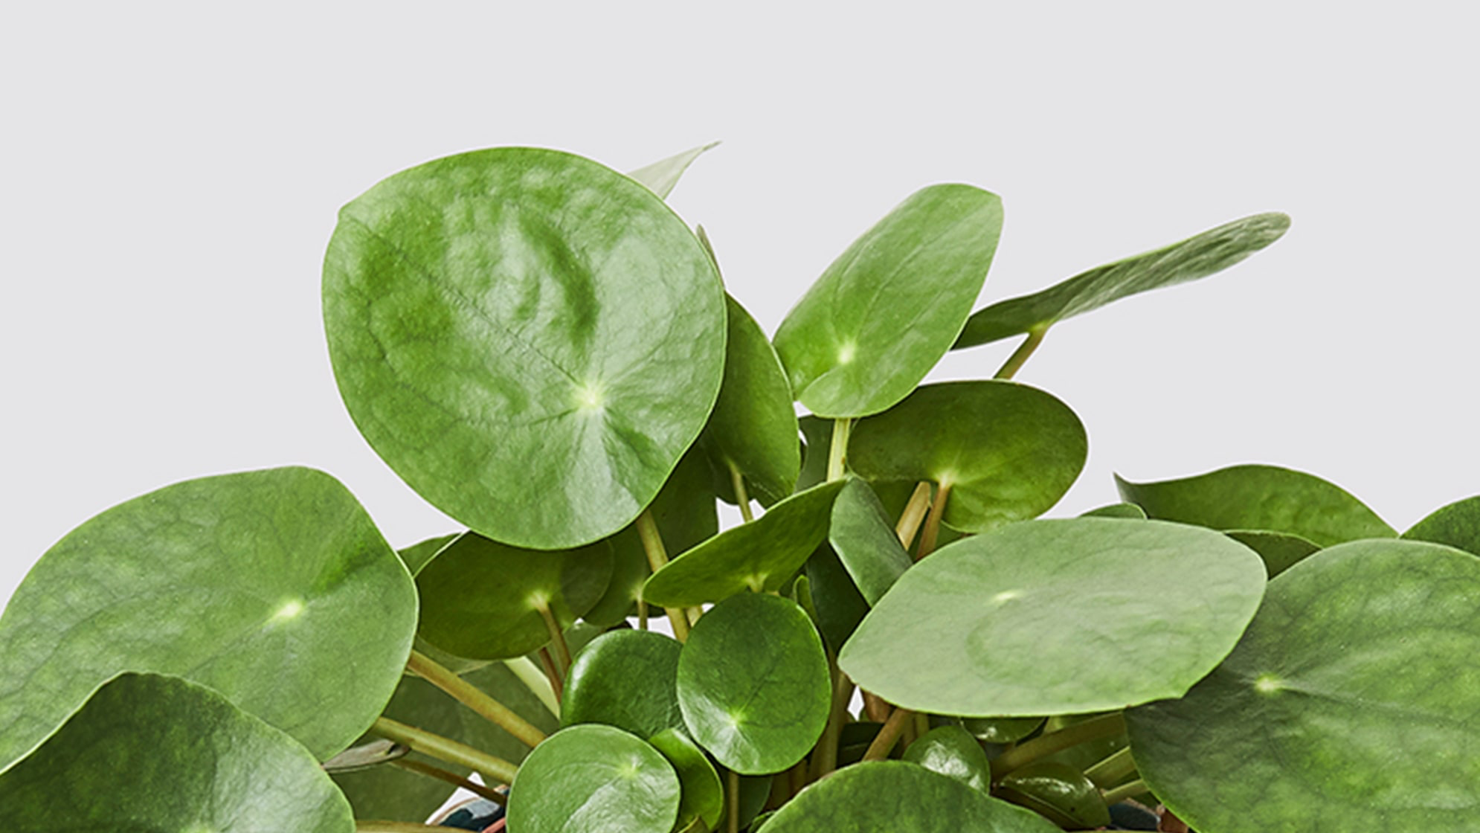
Wellbeing
We are in charge of the planting and growing this year!
The children will learn how to grow herbs, vegetables and possibly some fruits.
We ask that a spare pair of old trainers or wellies are kept in school – please do name them!
Notes:
Through RE lessons, we will continue to teach Philosophy for Children to facilitate critical and deeper thinking and provide opportunities for children to practise these skills across the curriculum.

Slide 15
PE
P.E is on Friday afternoon.
It is very important your child has a full P.E. kit in school with them. P.E is compulsory and if a child doesn’t have the correct kit, it means they will have to borrow kit from another child in the school or have to wear the spare class kit.
In addition to shorts and the yellow t-shirt, please could children also have tracksuit bottoms or leggings and a jumper or hoodie (for the winter months) and trainers in their P.E. bags.
Earrings must be removed before the PE lesson. Teachers cannot remove earrings.
Notes:
Mr smith - I will hand over and collect the children at the end of the day on Wednesday.
All chidlren will get the oppourtunity to participate in district sport events if they want to – so don’t worry if your child isnt picked for something right away. Mr Smith is in charge of picking the children for this.

Slide 16
PE Kit
Earrings (studs only)
Hair tied back for PE
Navy blue shorts (cotton or nylon)
Yellow t-shirts with logo on
White, black or blue socks
Black or blue trainers
Notes:
Navy/blue tracksuit bottoms - important for the winter months
Trainers – not plimpsoles for outdoor PE
Spare socks – girls will not be allowed to do PE in their tights
Earrings – please encourage the girls to learn to take their earrings out on their own as much as possible, we advise that children do not do PE in their earrings, although we know this isnt always possible.
If anyone has any spare or old PE that they don’t need anymore, could they please bring it in to have as a class spare.

Slide 17
Science
Animals including Humans
Living Things and Their Habitats
Plants
Use of Everyday Materials
Famous Scientists
Notes:
Animals inc - children have designed a character who doesn’t eat – but gets their energy and food from other sources.

Slide 18
Science, Computing and D&T
Computing this year will be taught primarily through Science. However, there will be opportunities to use Computing throughout the curriculum.
Children will be able to use Purple Mash throughout the year for homework and in lessons.
Passwords for Purple Mash and MyMaths have not changed – all this information will be sent home and stuck in the children's’ reading logs - ASAP.
We will focus on:
Basic Skills - Learn how to save and retrieve own work.
Learn how to change font style, size and colour.
Use technology safely and respectfully
Recognise common uses of information technology beyond school
MyMaths
School login – nutfield
School password – compass 86

Slide 19
Science, Computing and D&T
Autumn – Bird Houses/Animal Habitats
Design purposeful, functional, appealing products for themselves and other users based on design criteria.
Build structures, exploring how they can be made stronger, stiffer and more stable.
Spring
use the basic principles of a healthy and varied diet to prepare dishes.
Understand where food comes from.
Plan and create a healthy savoury meal so that they are able to feed themselves and others a healthy and varied diet.
Summer - Make own instruments out of different materials
Design purposeful, functional, appealing products for themselves and other users based on design criteria.
Build structures, exploring how they can be made stronger, stiffer and more stable.

Slide 20
Online Safety – KS1
The children will be accessing Purple Mash, Times Table Rock Stars and MyMaths in school. On these accounts they do not have access to any text, voice or note chat amongst themselves or other people.
At Nutfield Church Primary School we have a filtering service, which filters the internet when children or adults search online. This is provided by our school internet provider..
We encourage all children to protect themselves in school online in their first Computing lessons. We do this by teaching the children what to do if something does come up on the iPads: turn their screen off and tell an adult. This is then investigated and reported.
Please do visit our Online Safety page on our school website, which is updated frequently, for helpful tips and links.

Slide 21
Geography and History
We will be teaching Geography at the start of each term. After half term, we will be teaching History.
 | Autumn 1 | Autumn 2 | Spring 1 | Spring 2 | Summer 1 | Summer 2
Geography | Is it really round? |  | A visit to China |  | Where shall we go?
History |  | Gunpowder Plot |  | Women who made a difference |  | What it was like to be a child during WWII
It is our aim to make learning fun for your children.
We want to create a buzz for learning.
We will create this through theme days, trips and exciting lessons.
Please help us to nurture this excitement.
Notes:
If you have any special knowledge or expertise in any of these topics, please feel free to let me know!
They will also be learning about the discovery of Tutankhamun, creating their own version of his Death Mask and will learn to write sentences in Hieroglyphics.
In the next few weeks the children will be bringing home their own mummified apple, which we have started to mummify using similar techniques to the Egyptians. We will also be making bread using an Ancient Egyptian recipe.

Slide 22
Expressive Arts
Our Art will be linked to our curriculum but also to specific artists such as Clarice Cliff.
We will be looking at:
Mixing colours
Use of colour
Drawing and sketching techniques
Clay sculpturing
African animals
African landscapes
We use a programme called ‘Charanga.’ This allows children to explore music through voice, recorders and percussion instruments.
In Autumn 2 we will start to learn the songs for the KS1 Nativity.
Notes:
This year at Nutfield Church, our expressive arts program will be linked with our KUW topic. So this term we will be:
We will also be focusing on scultpure, collage, printing and textiles this year.

Slide 23
Last few notices

Slide 24
SATs (Special Challenges)
First thing you need to remember is…. Don’t worry!
We want the children to be happy, successfully and well-rounded.
SATS assessments will take place in the summer term. Children are assessed in Reading, Writing, EGPS, Maths (reasoning and arithmetic)
More details will come during the school SATS meeting.
There is a SATs meeting for Parents and Carers on Thursday 16th November 2023 at 3.30pm in the Hall.

Slide 25
Groupings
Children have Phonics, Maths and English every morning.
Children may be grouped for these subjects.
If they are, children are initially grouped according to data from the previous year, and this is subject to change as the year progresses.
There are three categories: children working towards the expected standard, children working at the expected standard and children working at greater depth within the expected standard. Independent classwork is differentiated to support the needs and ability of your child.
Groups are flexible – they are reviewed and monitored regularly.

Slide 26
Homework
Times Table Rock Stars
10 Spellings set on Purple Mash
15 minutes of daily Reading
Notes:
Please write comment in reading record book
Responsibitly – children responsible for taking books home – we are reminding them as getting ready to go home

Slide 27
Notes:
Please write comment in reading record book
Responsibitly – children responsible for taking books home – we are reminding them as getting ready to go home

Slide 28
play.ttrockstars.com/

Slide 29
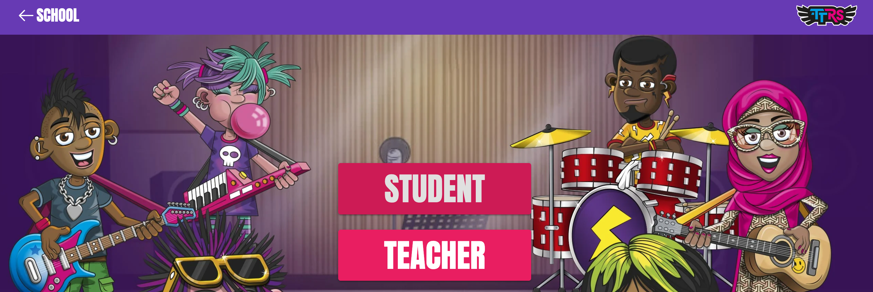
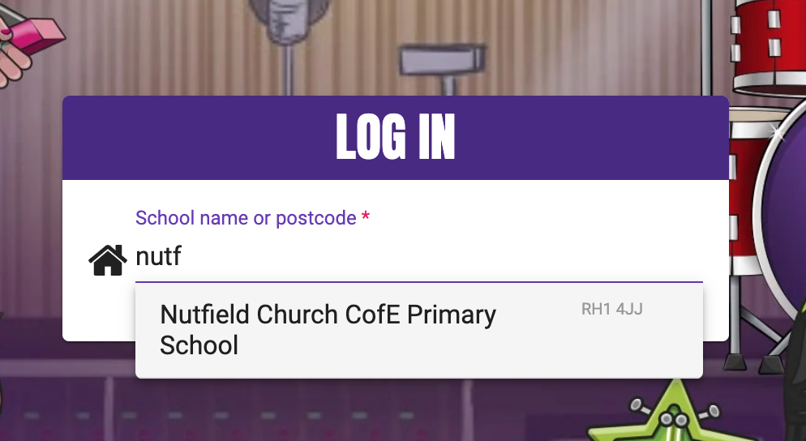

Slide 30
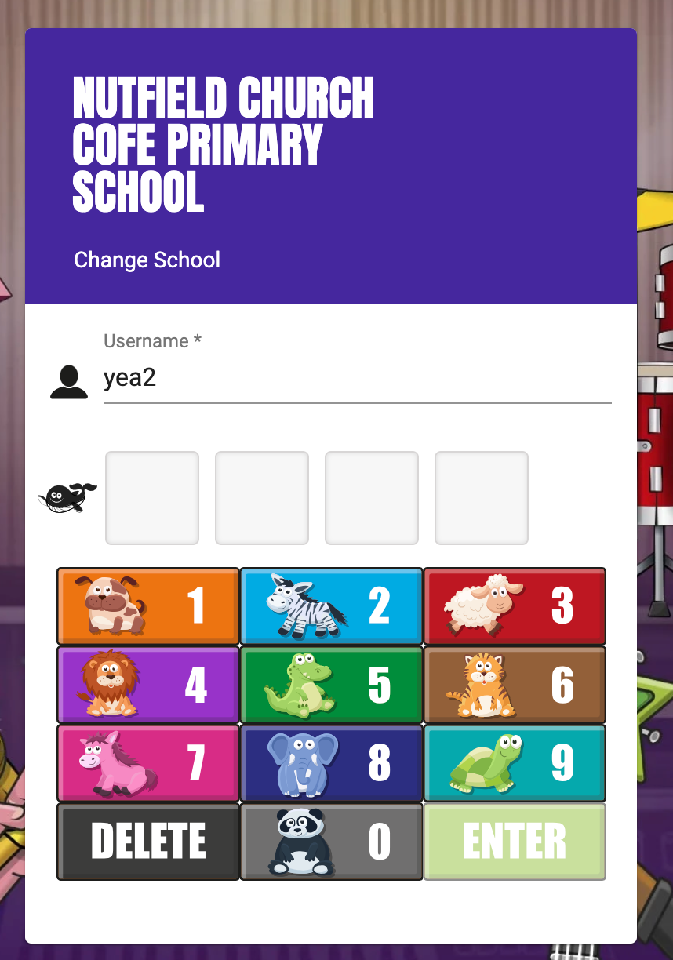
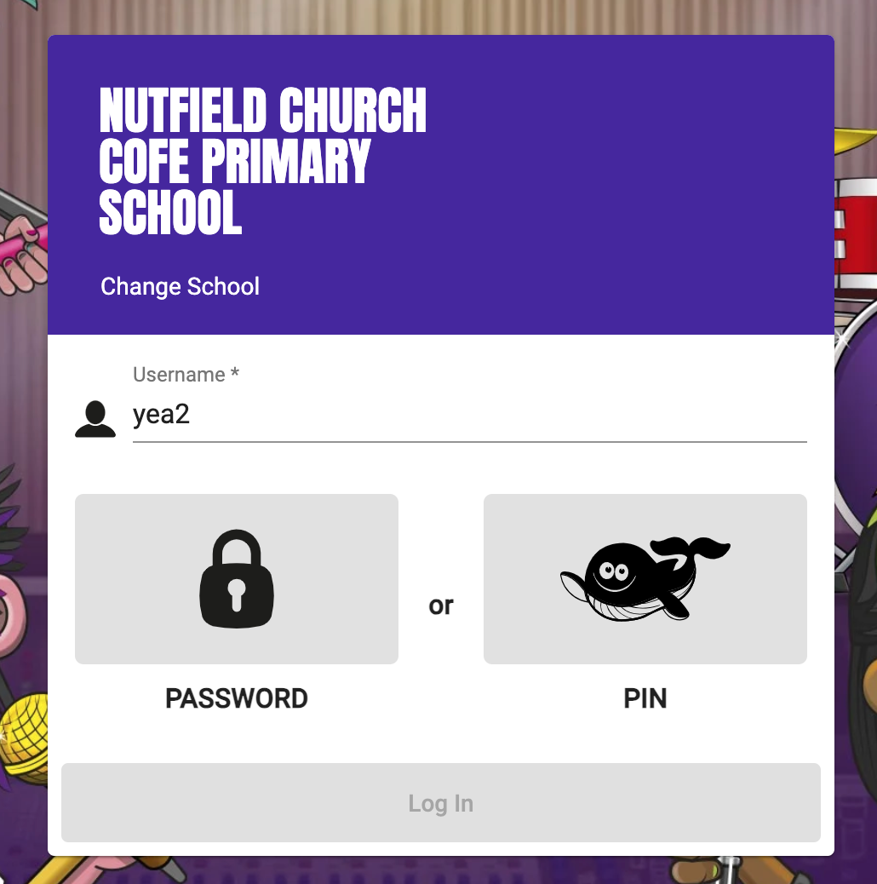

Slide 32
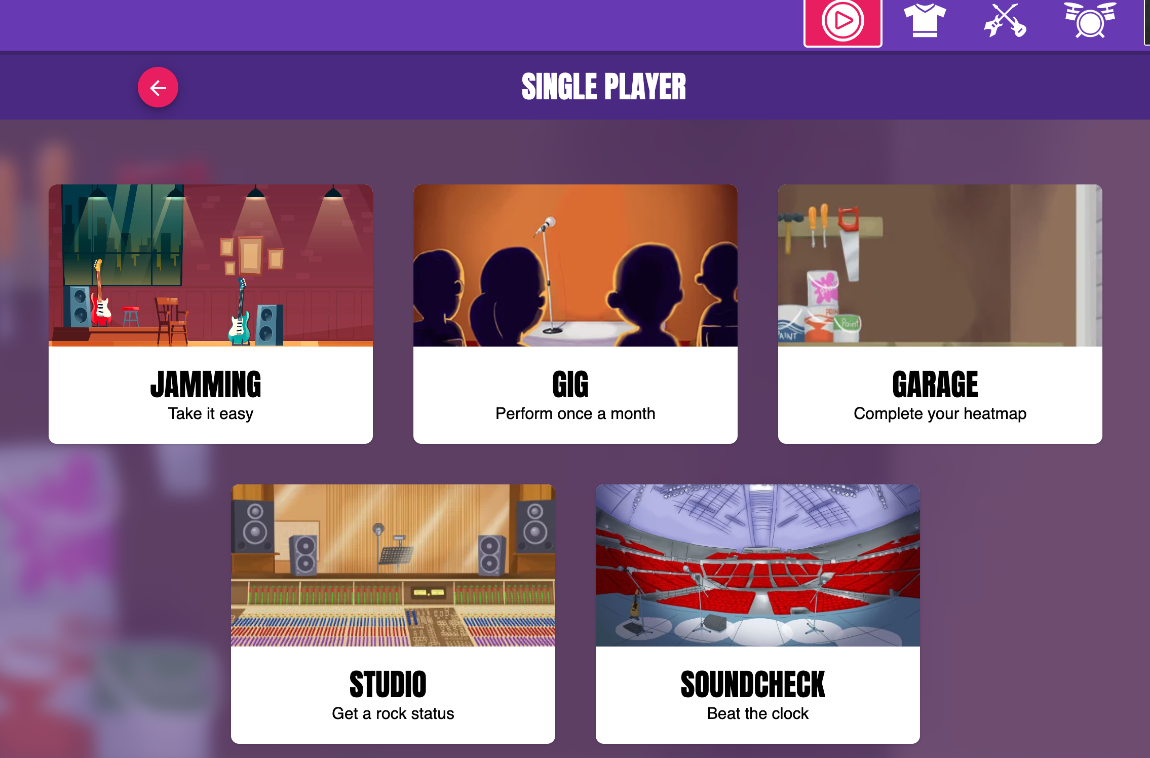

Slide 33
Homework
The initial Gig will give the children all the times tables.
It starts with the 10s, 2s and 5s. It will then generate questions for the 3s and works up to 12 x 12.
If your child gets to the 3s and does not know the answer, they can either leave the timer to run out or put in random answers.
From their results, the algorithm devises a program that suits the child's current ability and helps them progress through their other times tables.
Once the children have completed the Gig, they will not be able to complete another for a month.
Notes:
Please write comment in reading record book
Responsibitly – children responsible for taking books home – we are reminding them as getting ready to go home

Slide 34
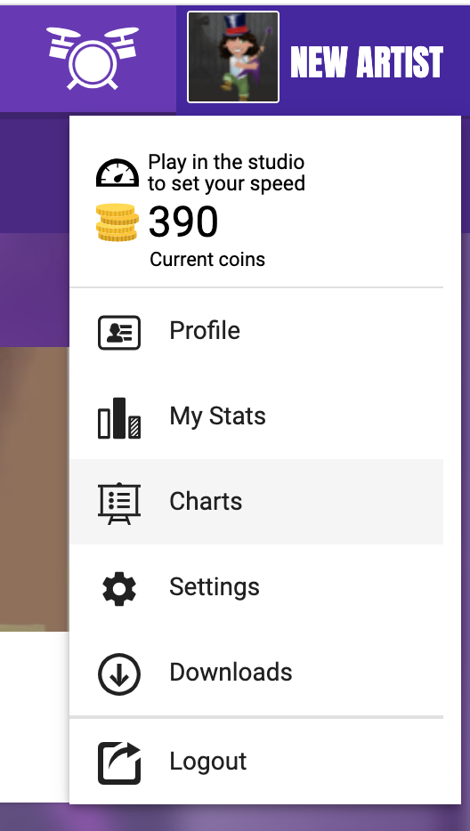
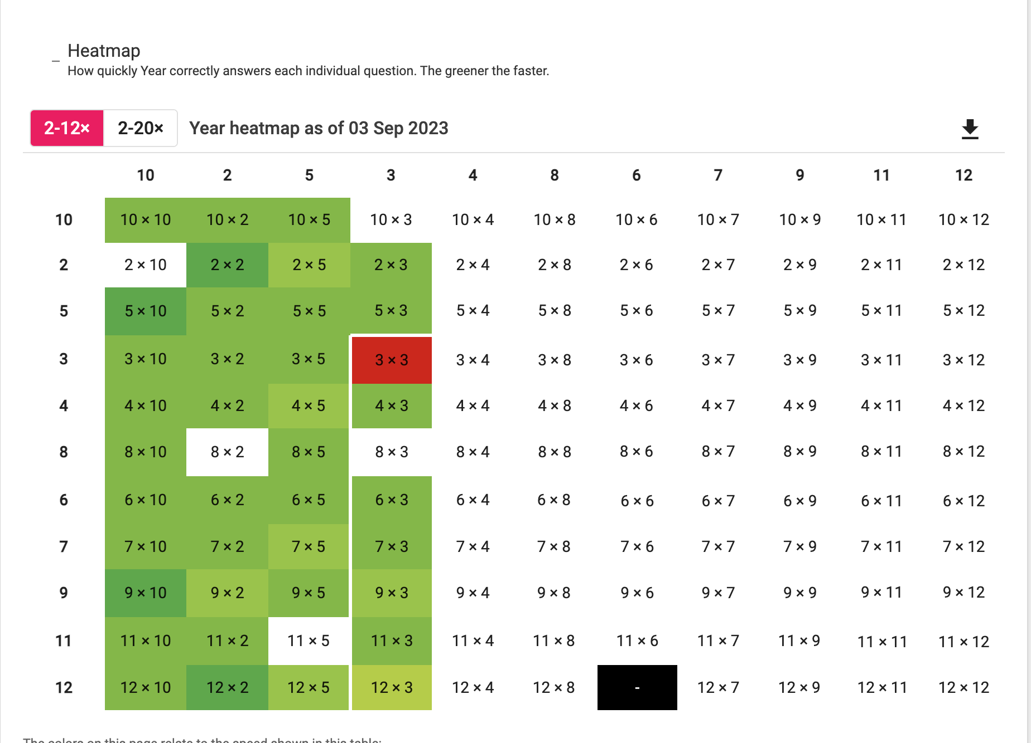
Homework
You can check their progress and attainment by checking their heat maps:
Notes:
Please write comment in reading record book
Responsibitly – children responsible for taking books home – we are reminding them as getting ready to go home

Slide 35
Snacks and Water bottles
Fruit
Children in KS1 are given fruit at snack time. However, the fruit varies from day to day and is not always to everyone’s liking so you may wish to send in your own fruit for snack.
Water
Please ensure pupils have a named water bottle with them.
Notes:
In the Upper School, children are not provided with a snack for breaktime.
Please include a healthy snack for the children in their school bags.
We don’t have a water fountain in the Upper School, so all children will need a named water bottle.
There are a few cups if the children forget in the morning.

Slide 36
Uniform
Blue Nutfield Church jumper/cardigan
Nutfield Church Fleece
Yellow Nutfield Church polo shirt
Grey pinafore, skirt or trousers
Blue summer dress
White, Black or Grey socks
Black shoes
Hair bands and clips must be blue or navy
Spare trainers or wellies for all outdoor learning.

Slide 37
Attendance
It is incredibly important for the children to attend school everyday.
We love seeing the children and teaching them everyday!
If they are unwell, telephone the Office to let us know if your child is unwell and will not be attending school.
Pick up and Drop off
Any information can be send either through a note with your child OR email the office.
Please let us know who is picking up your child if it is not you.
If there is a long-standing arrangement, please let the office know through email and myself know.
Children need to be dropped off 8.40am– 8.50am and picked up at 3.15pm.
We start our learning at 8.50am.

Slide 38
Contact
Please do contact me if you have any questions either through the office or catch me on the playground at the end of the day.
Do keep up to date with Miss Woods’ newsletters and the Homework letters for information regarding changes in the school day.

