Slide 1
Welcome to Year 3 THE Team! MrS CORDEY – CLASS Teacher MRs RUSSELL & MISS LINDSAY – Year 3 CLASS assistantS

Slide 2
School Values
Community and Peace – Autumn
Wisdom and Hope - Spring
Dignity and Joy - Summer

Slide 3
Expectations and communication
This year, we are encouraging the children to begin to take greater responsibility for their own belongings.
Please encourage the children to pack their own bags, remembering their reading logs, reading book and PE kit.
PE will be taught on a Thursday afternoon so please make sure all PE kits are sent in. They will be sent home every other Friday for washing.
Please let us know if your child is going home with someone different by either emailing the office or sending a note in with your child in the morning.

Slide 4
Reading
This year, the children are being encouraged to write in their own reading logs to enable them to take more responsibility for their own learning.
Please continue to encourage them to read every night and remind them to write the date, name of the book, page numbers and a short note about the pages they have read.
On Friday, Mrs Russell will be checking readings logs and awarding team points and stickers to children who regularly read and write in their log.
When listening to your child read, please ask them questions to ensure they have a deeper understanding of the story and the characters.

Slide 5
English and Grammar
This year in English, we will be building upon the grammar and punctuation the children started to learn in Year 2.
The children will be focusing on:
Identifying the different word classes: adjectives, nouns, verbs.
Using adverbs effectively in their work.
Expanded noun phrases
Subordinating conjunctions
Co-ordinating conjunctions
Different types of sentences: statements, commands, questions and exclamations.

Slide 6
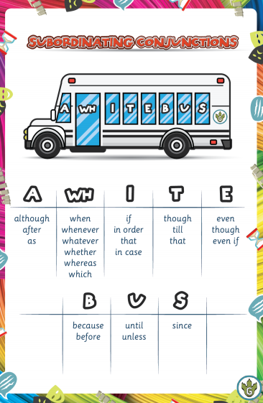
Subordinating and coordinating conjunctions

Slide 7
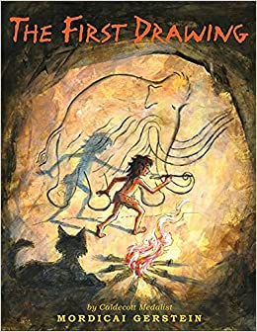
English - Book led learning
The children’s English learning is all book-led and every half term we will have a different book to inspire their writing and model language, punctuation and grammar.

Slide 8
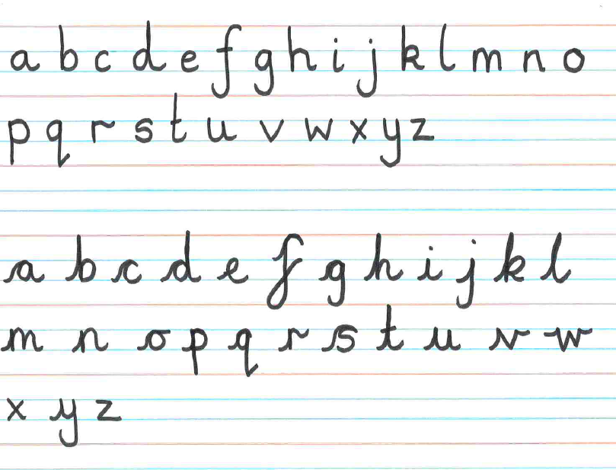
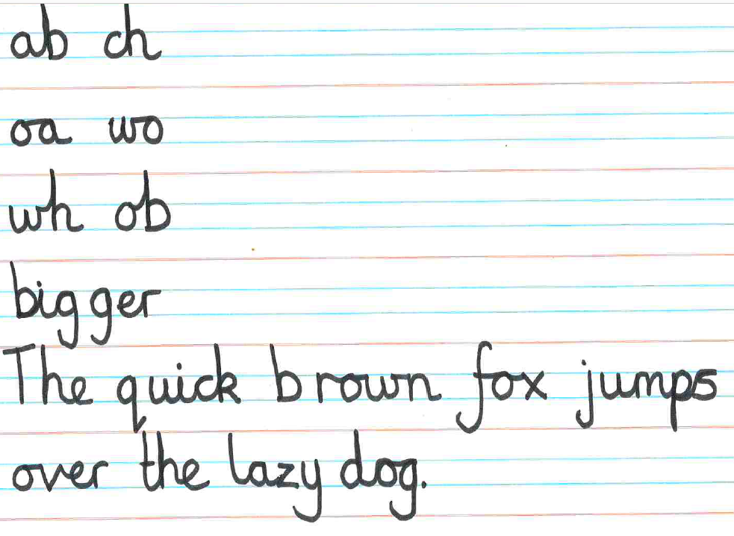
Handwriting
Handwriting is a big part of the curriculum. The children have handwriting sessions each day where we focus on letter formation and lead ins and outs of each letter to ensure that their cursive handwriting is neat and legible.

Slide 9
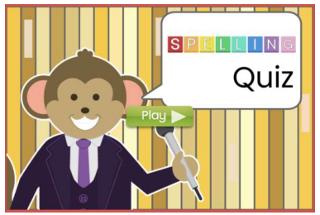
Spelling
We use the Purple Mash spelling scheme which follows the children from Year 1 up to Year 6.
This will be set on Purple Mash each week and the children will then be tested on a Friday.
The quiz set on Purple Mash is a fun and interactive way of learning their spellings and the children are able to re-do this as many times as they like before the Wednesday of the following week.

Slide 10
Maths
The children will be building on their learning from Year 2 and developing this using new techniques and methods.
This term, we will be focusing on place value, addition, subtraction, multiplication and division. These are the five key areas of the children’s learning in Maths.
All of the methods the children will be using throughout the year are found in the White Rose Calculation Policy which is on our website.
.

Slide 11
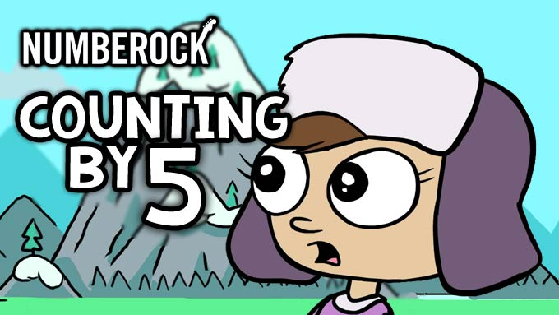
Times tables
The children will be building on their learning from Year 2 and developing this using new techniques and methods.
We will be focusing on times tables as it is expected that by the time the children finish Year 4, they should know all of their times tables to 12 x 12.
By the end of Year 3, the children should all know their 2, 5,10, 3, 4 and 8 times tables including using the inverse to answer questions.
E.g. 45 ÷ 5 = ?
We will be learning this using songs, dances and raps and completing games and activities to help the children use this knowledge in every aspect of their Maths learning.

Slide 12
Speaking of multiplication
Multiplication is very important as the children progress through KS2. By the end, each child should know up to 12 x 12 from memory.
Times table Rockstars is a fun interactive online program the children can learn, practise and have fun with.
This will all build towards the new times table check that is undertaken in Year 4.

Slide 13
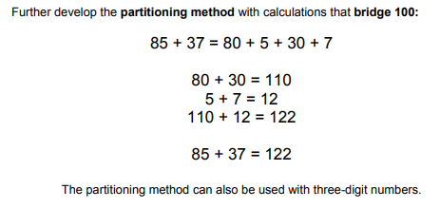
Addition
We will start by using a similar method to the one taught in Year 2 to support them when recapping previous learning.
We will then move onto a more formal method of addition.

Slide 14
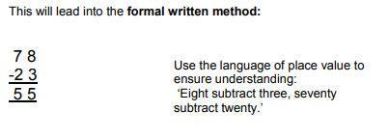
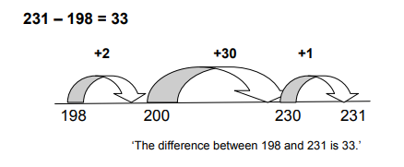
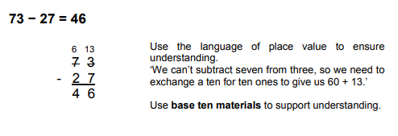
Subtraction
They will then move onto a formal method of subtraction which they will lay out in a column.
The children will start by using a number line and jumping in given amount backwards to find the answer. They should be familiar with this method from Year 2.
Nearer the end of the year, the children will move onto the column method of subtraction where they will need to carry numbers over.

Slide 15
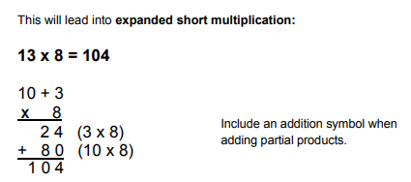
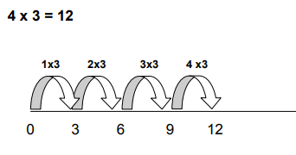
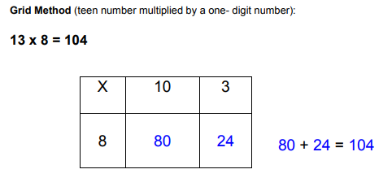
Multiplication
The expanded short method of multiplication shows the children each step of the solution to ensure they spot any mistakes as they work through a problem.
They will start by making simple jumps on a number line. They should be familiar with this from Year 2.
By the end of the year, the children will be able to confidently use the formal short method of multiplication.
The grid method of multiplication is designed to support the children to understand the place value involved in multiplying a 2 digit number by a 1 digit number.

Slide 16
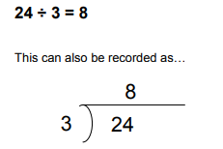
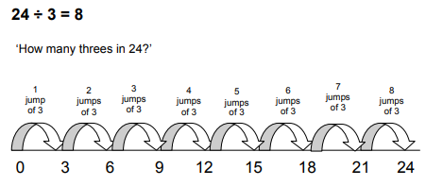
Division
However, they will quickly move onto the ‘bus stop’ method which relies on the children’s times tables knowledge.
The children will start by using a number line and jumping back in groups.

Slide 17
Science, Computing and design and technology
Science, Computing and Design and Technology will be taught on a Thursday afternoon. This will be largely practical learning, with the children taking part in many different experiments and developing their ability to write a well-thought-through conclusion.
The topic this term is Forces and Magnets and the focus skill is to conduct a fair test.

Slide 18
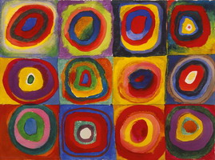
arts
The Arts includes: Art, French and Music and will be taught on Wednesday afternoons.
There are 6 key Art skills that the children will focus on throughout this year. These are: painting, collage, sculpture, textiles, drawing and printing.
Each term, we will focus on one artist and use their art to inspire our leaning. This term, we are looking at Kandinsky.
In French, the children will be learning simple phrases to great each other, count to 10 and the names of the people in their family.
In Music, the children will be building up to playing a simple tune on the glockenspiel.
At Christmas, we will be going to see the Snow Queen at the Theatre.

Slide 19
Wellbeing
Within the Wellbeing curriculum, the children will take part in weekly PE sessions, held on a Monday afternoon. They will also take part in PSHE sessions which will focus on a variety of topics throughout the year. These include: British Values, friendships, emotions and anti-bullying.
Wellbeing +: Last Year as part of our learning in Year 2 we were in charge of the school gardens, learning how to look after and grow plants within the grounds. This year we will be focusing on birds - looking and learning about the flying friends that visit our school grounds.

Slide 20
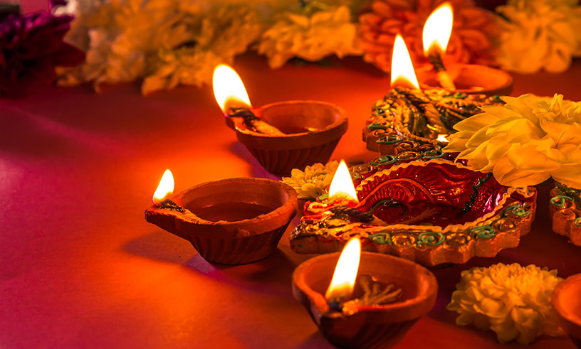
RE
RE will be taught on Tuesday afternoon.
Our topic this half term is Hinduism and as part of this, the children will be learning about their place of worship, some of their beliefs and the festival of Diwali.

Slide 21
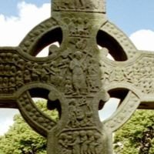
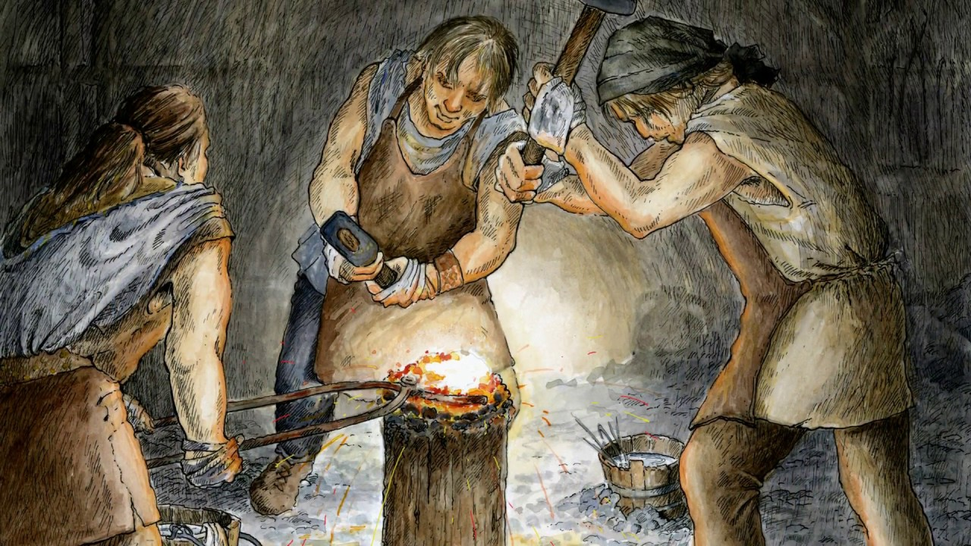
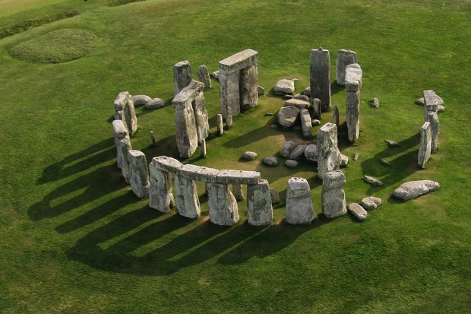
History

Slide 22
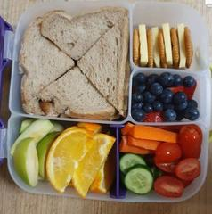
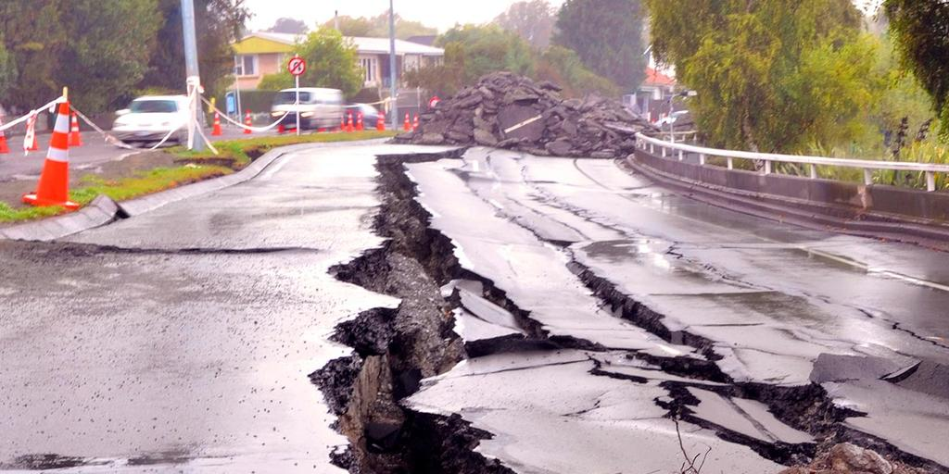
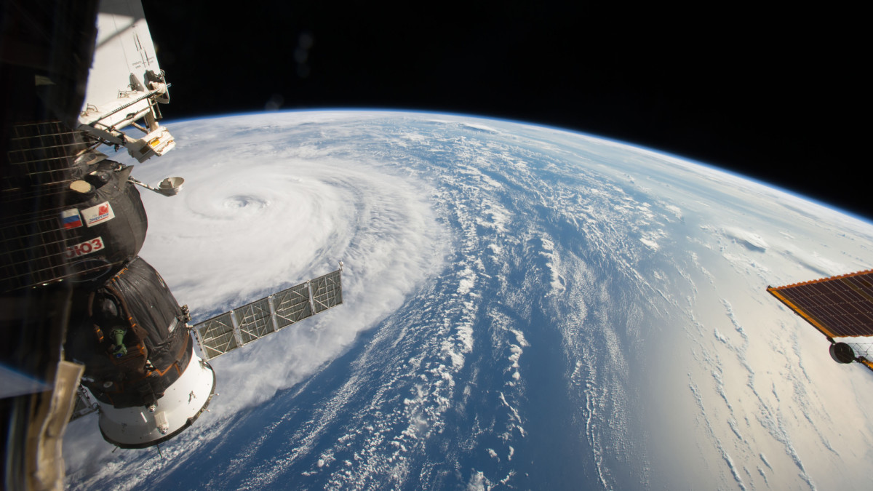
Geography

Slide 23
Snacks and water bottles
Snacks: Snacks are no longer provided in KS2 so please do provide your child with a snack for morning break. Fruit and vegetables only please. Crisps, chocolate bars (cereal bars) and Winders are not allowed.
We are a ‘Nut Free’ School. So if you have a packed lunch please check the labels on the products you pack into them.
All children will need a named water bottle.
These are kept in the classroom during lesson times.

Slide 24
P.E. Kit
Yellow PE top
Navy/blue shorts
Navy/blue tracksuit bottoms - important for the winter months
Navy/blue jumper - important for the winter months
Trainers
Spare socks – girls will not be allowed to do PE in their tights
Earrings – No earrings to do P.E
Long hair tied back
If your child is selected to go on a tournament they will be asked to wear the new Nutfield Church Sports Kit.
This must be washed and returned as soon as possible to ensure the next children have a chance of wearing it.

Slide 25
StationEry
Children will need:
Pencil
Rubber
Ruler
Sharpener
Glue stick
Scissors
Colouring pencils
Please NO toys, fidget toys, games or blue tac unless pre-arranged with me.

Slide 26
Attendance
It is incredibly important for the children to attend school everyday.
We love seeing the children and teaching them everyday!
If they are unwell, telephone the office to let us know if your child is unwell and will not be attending school.

Slide 27
Homework
Some small changes to homework! A letter will still be sent home every Friday.
Homework will include the following: Reading and online there will be times tables and spellings practise.
We will still have a weekly spelling test but instead of communicating this in the homework book, it will be noted in your child’s reading record.

Slide 28
Any questions?
If you have any questions about the curriculum this year, the methods used or a more specific question, please get in touch with the school office to book a phone appointment. I am more than happy to speak with you.
info@nutfield.surrey.sch.uk

