Slide 1
Welcome to Reception 2023/24

Slide 2
Meet the Reception Team:
Mrs Brooks: Class Teacher
Mrs Kendall: Class TA
PPA Cover: Mrs Kendall and Mrs Vaughey (Wednesday morning)

Slide 3
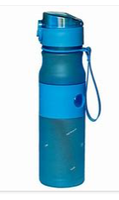
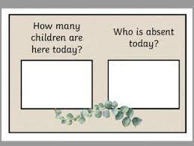
Arrival
Bottle
Bag
Self-Register

Slide 4
Funky Finger Tables
Monday | Tuesday | Wednesday | Thursday | Friday
Writing table | Writing table | Writing table | Writing table | Writing table
Focus table | Focus table | Focus table | Focus table | Focus table
Maths table | Maths table | Maths table | Maths table | Maths table
Carpet | Carpet | Carpet | Carpet | Carpet
Art table | Art table | Art table | Art table | Art table
Examples of activities which develop fine motor skills include: Bead threading, cutting, pencil control, Lego, playdoh.

Slide 5
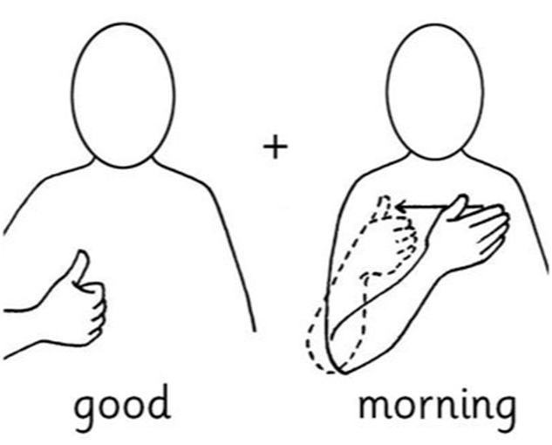
Register
Individually greeted using Makaton sign language
Visual timetable, date, weather
Star of the day

Slide 6
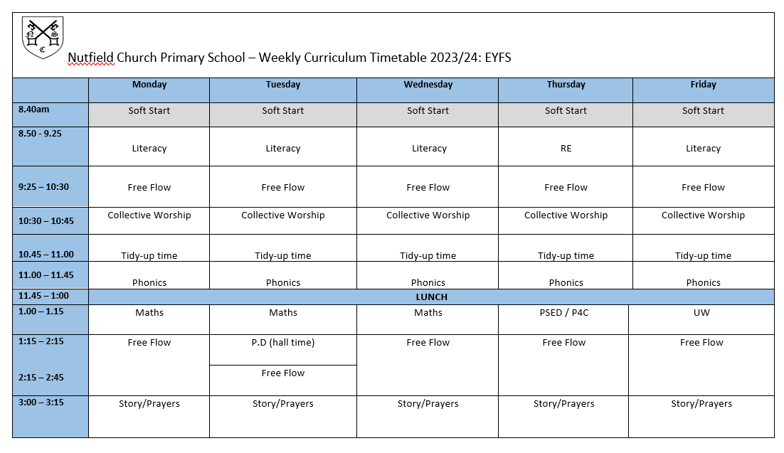
A Day in Reception Class

Slide 7
Collective Worship
Every morning at 10.30 (Reception children will attend with the whole school after half term)
Liturgy (Lighting the candle, Psalm, The Grace, The Lord’s Prayer)
Led by teachers and clergy (Revd Len, Father Paul)
Favourite worship songs
Saddleback Kids animations
Certificates (Friday)
Lunchtime and end of day prayers

Slide 8
Lunchtime
Children go to the hall for their lunch. The class is looked after by Mrs Kendall, the class TA who will feedback to the class teacher any incidents or successes with eating at lunchtime. The children are encouraged to use their knives and forks and try new foods.
After their lunch the children are brought outside to play in the playground and depending on the weather they can go on the climbing wall, trim trail or field. This is a really lovely time for the children as they get to see all the school together and spend time.
Menus can be found on the school website.

Slide 9
Groups

Slide 10
Topic Based Learning
In EYFS our learning is based around topics and we have a different topic each half term.
In the learning environment we have continuous provision – which means resources that are always there to play and learn with such as the reading snug, construction toys, literacy and maths games, role play, small world play, and open access to our arts and crafts room.
We also have enhanced provision which means resources or activities linked to the topic or interest. For example if the topic was ‘Come outside’, the children may investigate bugs as part of their enhanced provision.
Autumn 1 | Autumn 2 | Spring 1 | Spring 2 | Summer 1 | Summer 2
Buddy starts school | In a land far, far away | Tickets please! Transport | Come outside | Sand and sea | People who help us. Superheroes.
Under the Sea
Fairytales
Superheroes
A Bugs Life
5,4,3,2,1 Blast off!

Slide 11
Free-flow
We have long uninterrupted times in the morning and afternoon for the children to explore their learning and their interests. This is a time when the children decide whether they want to go outside or stay in their classroom.
Each area has carefully planned activities which are linked to the theme of the term.
The children are also encouraged to be independent and select when they want their fruit during the morning or afternoon.
Free-flow is a chance for children to explore their own interests but also practice and consolidate learning from their previous inputs. During this time children are observed and assessed against the area of learning or development statements. Then using the children’s interests and their level of development we plan ways to support them further in order to strengthen and deepen their learning. We also observe how children learn and this is through the characteristics of effective learning: playing and exploring, active learning and creating and thinking critically.

Slide 12
Child Initiated Play (CIP)
Continuous provision
For example -
Small world toys
Arts and crafts
Home corner
Construction
Writing
Maths
Library
Mud kitchen
Sand/water
Bikes
Enhanced provision
For example –
Village shop
Using play food to create matching lunchboxes for the teddies
Cutting up coloured spaghetti
Germ experiment with glitter
Matching pairs game.

Slide 13
Early Learning Goals

Slide 14
Personal, Social and Emotional Development
PSED is split into three areas – Self-regulation / Managing Self / Building Relationships
In the Autumn term we largely focus on; how to treat others, helping each other, sharing, making friends, behavioural expectations, recognising and regulating emotions, self-esteem and personal hygiene.
PSED is taught through focused lessons once a week as well as circle times and modelling during child-initiated learning.
Communication and Language
C&L is split into two areas – Listening, Attention and Understanding / Speaking
In the Autumn term we largely focus on; maintaining attention and listening during adult focused learning, understanding instructions and stories, speaking in full sentences and exploring new sounds.
C&L is usually taught discreetly through carpet times, circle times and modelling during child initiated learning.

Slide 15
Physical Development (P.E)
PD is split into two areas – Gross Motor Skills / Fine Motor Skills .
In the Autumn term we largely focus on; different ways of moving and travelling, negotiating space, showing an understanding of good hygiene and health, holding a pencil and beginning to form recognisable letters.
PD is taught explicitly through PE lessons each week. In the first term this is conducted inside, we wear our school uniform and no shoes or socks. We then use PE kits during the second half of the Autumn term - I will remind you through the weekly homework letter.
PD is also taught discreetly through provision in the classroom using resources such as scooters, balancing toys, threading and playdough.
PE Uniform:
Hair tied back for PE
Navy blue shorts (cotton or nylon)
Yellow t-shirts with logo on
White, black or blue socks
Black or blue trainers

Slide 16
Literacy
Literacy is split into three areas – Comprehension / Word Reading / Writing
We have four literacy lessons a week and these can be linked to a story a non-fiction text or a poem. We will also show the children how to use story mapping and innovation to change the story.
Our Literacy lessons are based on a text or our topic that term. Whilst looking at a book, the children will get to explore the characters, plot and setting.
In the first term our writing will be based on our topic ‘Buddy Starts School’ (Buddy is our class bear). This topic allows the children to talk about themselves and their similarities and differences through bears. They will be helping Buddy settle in by modelling good behaviour, sharing and social skills. The children will also be thinking about themselves and the people around them.
.We will be focusing on the texts such as: Bear Hunt, Biscuit Bear and The Everywhere Bear
The children will be taught to form their letters correctly, this will taught during our Phonics lessons.

Slide 17
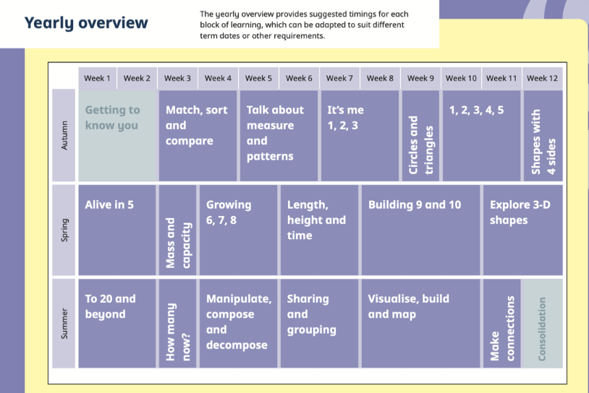
Maths
We have three Maths lessons every week and we use White Rose Maths to support the children with their Maths learning.
Children also have a Maths input in a small group once a week.
We have an inside and an outside Maths area.

Slide 18
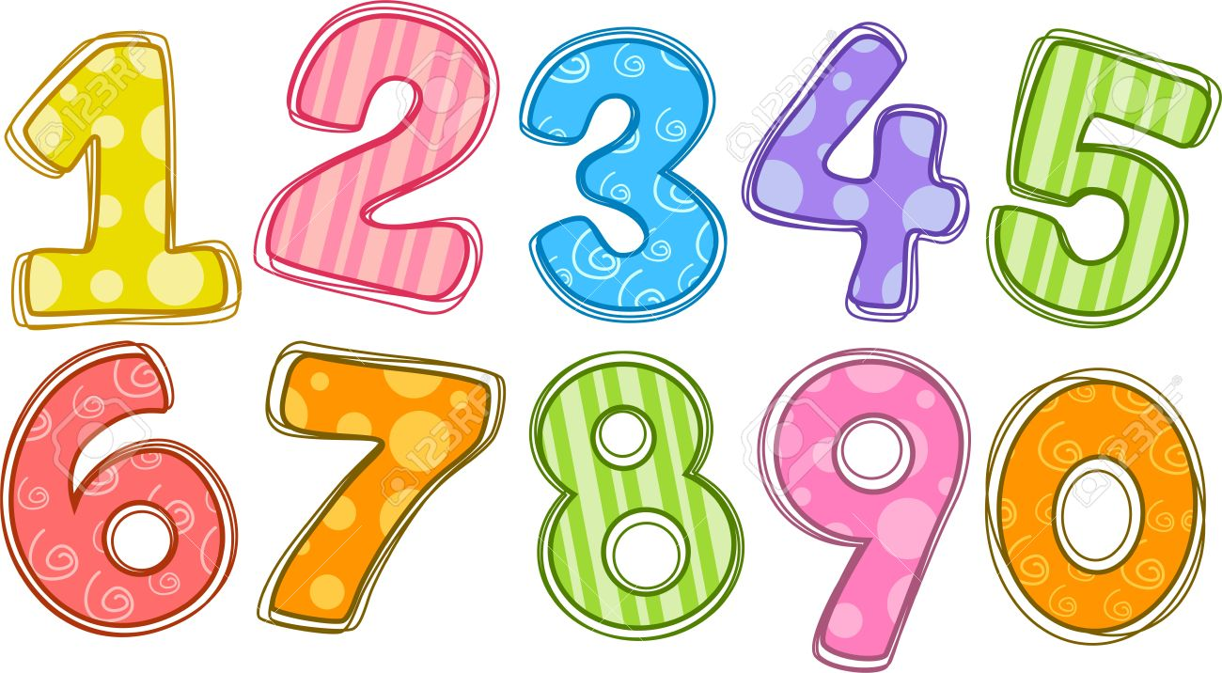
Maths
In the first term we do spend a considerable amount of time learning about the composition of numbers and what makes a 1, 2 or 3. We also explore numerical patterns through matching objects and shape, space and measure in the first term. This includes comparing size, mass and capacity as well as looking at simple patterns.
We also use lots of stories and rhymes to support the children with their Maths learning During the independent learning there are activities planned for the children to consolidate and extend their Maths knowledge and learning. One word you will be hearing a lot from us and the children is the word subsitise, this is identifying how many items there are without counting.

Slide 19
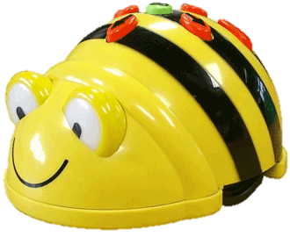
Understanding the World
UTW is split into three areas – Past and Present / People, Culture and Communities / The Natural World.
In the Autumn term we largely focus on; ourselves and families, changing seasons, the environment around us and using age-appropriate software. For example, in Autumn 2 we learn about Christmas in the past and Diwali
UTW is taught through focused lessons, circle times and questioning and investigations during child-initiated learning.
We have one UTW lesson a week with themed activities set up in the classroom for the children to explore.

Slide 20
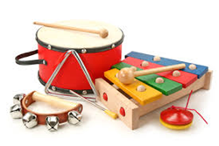
Expressive Arts and Design
EAD is split into two areas – Creating with Materials / Being Imaginative and Expressive.
In the Autumn term we largely focus on; acting out narratives during imaginative play, experimenting with instruments, using different tools and resources, exploring colours and materials. We have a ‘role-play’ shed and puppet theatre.
EAD is taught through focused lessons and experimentation during child-initiated learning. There are two focused activities a week for the children to complete in the art room, these will link to either our over-arching theme for the term, RE lesson or UTW lessons. Wednesdays are dedicated to junk modelling.
We also complete one-two pieces of work for the art exhibition each term. This term we are doing self portraits and looking at the artists Kandinsky, Mondain and Matisse – which also links to our learning in Maths.

Slide 21
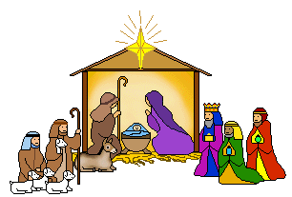
R.E
As a church school, R.E is one of the core subjects and a RE lesson is taught each week. In Reception this is predominately taught through art, stories and going out into our environment.
This term our topic is ‘Who Made the Wonderful World?’ and will become a Christmas topic after half term.
The children have one RE lesson a week and then activities based on the lesson available to them in enhanced provision.
We have a class RE book where we display the children’s work in RE.

Slide 22
Phonics
The Reception Phonics presentation for parents is on: Thursday 14th September: 3.30—4.15

Slide 23
What is Phonics ?
Phonics means the sounds that letters make in words
There are 26 letters
There are 44 sounds
There are over 140 ways to combine the 26 letters to make 44 sounds
We blend sounds together to help us read (build words up)
We segment words into sounds to help us spell (break words down)

Slide 24
What is ELS ?
From September 2022, Essential Letters and Sounds (ELS) is our chosen phonics programme and is validated by the DfE.
As a school, we have invested considerably in lots of new books which match precisely to the ELS phonics programme
The ELS programme teaches children to read by identify the phonemes (smallest unit of sound) and graphemes (written version of the sound) within words and using these to read words.
Children experience the joy of books and language whilst rapidly acquiring the skills they need to become fluent independent readers and writers.

Slide 25
How do we teach Phonics using ELS ?
We use a simple, consistent approach to teaching phonics. Your child will experience the same classroom routines within each lesson which reduces cognitive load and maximises the chances of success. The children will become very familiar with the structure of the lesson so the focus is upon the new phonic knowledge and skills being taught.
All children are supported within the lesson to use their new phonic knowledge independently.
In every single ELS lesson, your child will make the direct application to reading.

Slide 26
How do we teach Phonics using ELS ?
• Daily Phonics sessions –from the beginning of the school year
• Lots of opportunities for oral blending - c/oa/t and word
Recognition within the classroom and daily phonics session.
• Opportunities for writing-new grapheme, words and sentences within the classroom and through daily phonics sessions

Slide 27
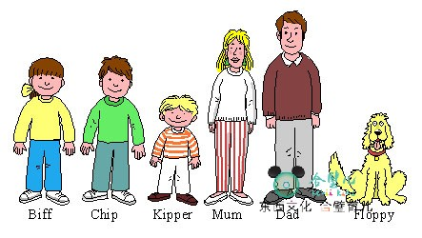
Reading Books and Records
We will be reading with your children on a 1: 1 basis during the morning. All children will be read with twice a week and they will have a set day when they are read with.
Please read with your child daily and write a message in their reading record books. These will be checked when your child is read with. The message does not need to be lengthy, just let us know what they did well or what they need more support with. I will provide you with a list of suggested comments for the reading record.
Children will receive two reading books a week as well as an online book which will be accessible through the Essential Letters and Sounds ebook library.

Slide 28
Reading
The first books that will have just come home are picture books with no words. This is to encourage the children to look at the pictures and use their imagination and inference skills to tell a story. This helps when they have a picture book with words as they then have the strategy of using the pictures to help them. We also do this so that the children get into a routine of sharing a school book with an adult, handling books, holding them the right way up and starting from left to right.
The next books will have one or two words per page, these aim to build up their understanding of linking the picture to the words which will become really important later on. The words will be linked to the phonics they will have learnt at school.
After that the children start the reading scale that will follow them into Years 1 and 2.
Spending 10 minutes a day reading with your child will hugely support them on their journey to becoming an independent reader.

Slide 29
Decodable readers
In addition to your child’s reading book we ask that you read the decodable text provided by the school four times across the week. These books will be accessible through the Essential Letters and Sounds ebook library. (You will find the log-in details in the inside of your child’s reading log.) We will set this book once a week on Fridays. This will allow your child to re-read each text several times, building their confidence and fluency. This is especially important as they begin to learn that the sounds within our language can be spelled in different ways.
For children, re-reading words and sentences that they can decode (sound out) until they are fluent (read with ease and precision) is a key part of learning to read. By reading texts several times, children have the greatest opportunity to achieve this fluency.
These texts are carefully matched to the teaching taking place in school. Your child will be practising what they have been taught in school with you at home.

Slide 30
Introducing sound wallets
At the start of each term we will give you a set of phoneme cards and HRS words.
Please could we kindly ask that these words are cut up and placed in your sound wallet.
On the weekly homework letter we will inform you which phonemes the children have learnt this week, along with which HRS words they have been introduced to.
Please could you practise these sounds and words each time you read with your child.

Slide 31
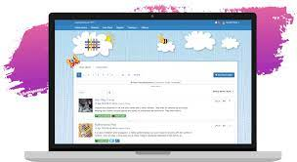
Tapestry
Online learning journal to record observations of your child during free flow play and group learning tasks
Parent log ins
Assessed against the Early Years Curriculum
The majority of learning will go on Tapestry but some written work will be put in a folder and Literacy books.
Please feel free to add comments to your child’s observations
You are welcome to add photos to Tapestry and tell us something amazing your child has done at home

Slide 32
Contact Books
We have sent home a small green book called a Contact Book. These books are checked daily.
These books are meant for non-urgent messages that you would like to get to us. For example if your child has lost a jumper, had a headache that morning or has a small worry.
If you have an important message for us, please tell an adult on the gate or phone the school office. Please remember that if someone different is collecting your child we will need to know via the school office.
If you have something important that you wish to discuss with us, please call the school office to arrange a telephone appointment.

Slide 33
Homework Newsletters
Homework is not compulsory in Reception. However, children are expected to read daily at home.
The weekly homework newsletter is to inform you of the what the children have been learning each week..
The homework letter will be sent home on a Friday.

Slide 34
No mandatory homework in Reception except we strongly encourage reading
Please read with your child daily and write a comment in their record book
Phonics workbook sent home mirrors learning from Essential Letters and Sounds
Phonics flashcards – please do these as often as you can

Slide 35
End of the day
Tidy up time
Gather belongings
Story and prayers

Slide 36
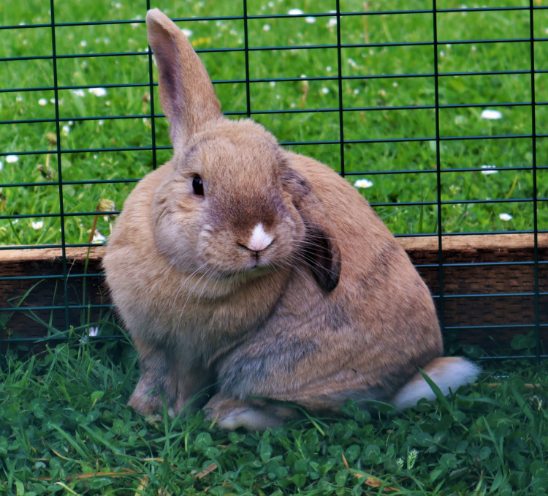
Peter Rabbit
The Reception children have responsibility for looking after our rabbit Peter. Children will take it in turns to visit the farm to feed and play with Peter. Please could you ensure that all children have a pair of wellies with them in school.
Our farm is very much dependent on the support of our families. We have a thriving volunteer rota for families who help look after the animals during weekends and holidays. If this is something you think you would like to be involved with please could you register your interest with the school office.
If you are unable to give your time, we also have ways of donating money through Sco-pay and also through sponsorship at our annual Hop-a-Thon. We have a termly Wellbeing Newsletter and this contains a wish list of items that are always needed such as food, straw and hay.

Slide 37
Saints Teams
On your child’s Saint’s day, they can come in with a t-shirt of their team colour. We will also use the teams on big sports events like Sports Relief and Sports Day.
St George 23rd April | St Patrick 17th March | St Andrew 30th November | St David 1st March

Slide 38
Reception Baseline Assessment
All children in Reception will be participating in the RBA in the first six weeks of term.
The purpose of the assessment is to provide a starting point for a new measure to show progress between Reception and Year 6.
The RBA is a short, interactive and practical assessment of your child’s early literacy, communication, language and mathematics skills when they begin school.
Your child can not ‘pass’ or ‘fail’ the assessment. Its main purpose is to create a starting point to measure the progress schools make with its pupils.

Slide 39
Things to note
Wellies
Junk modelling
Picking up your children at the end of the school day – please wave at us
Spare clothes
Fruit (we do provide fruit but your child may bring in fruit they prefer)
Only water in bottles please
Weekly homework letter – highlights what we have been up to and important dates

Slide 40
Diary Dates
Thursday 14th September: Year R Phonics Workshop, 3.30—4.15 (Classroom)
Thursday 5th October: Harvest Service at Christ Church, 9.30 am
Thursday 2nd November: Year R Buddy Collective Worship, 9.00 am (Hall)
Monday 27th November: Parent and Carer Evening (3.30—6.00pm)
Tuesday 28th November: Parent and Carer Evening (3.30—6.00pm)
Wednesday 29th November: Parent and Carer Evening (3.30 –6.00 pm)
Tuesday 5th December: Nativity Dress Rehearsal , 2.00—3.00pm
Wednesday 6th December: Nativity Performance, 2.00—3.00pm
Wednesday 13th December: Christmas Lunch
Thursday 14th December: Christmas Service at Christ Church, 9.00am

