Slide 1


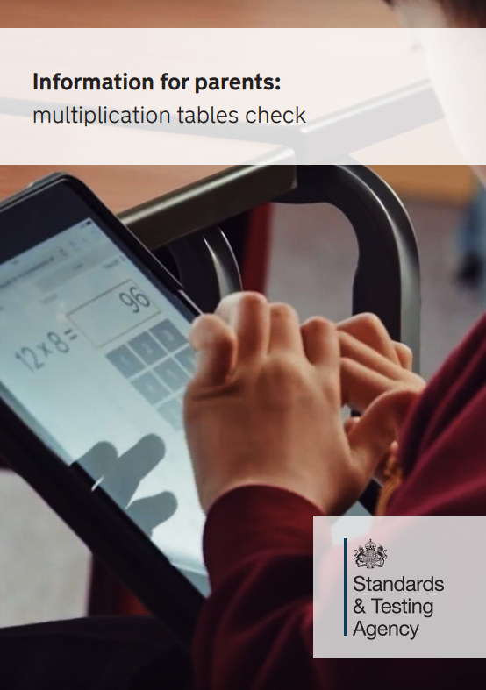
The Multiplication Tables Check (MTC)

Slide 2
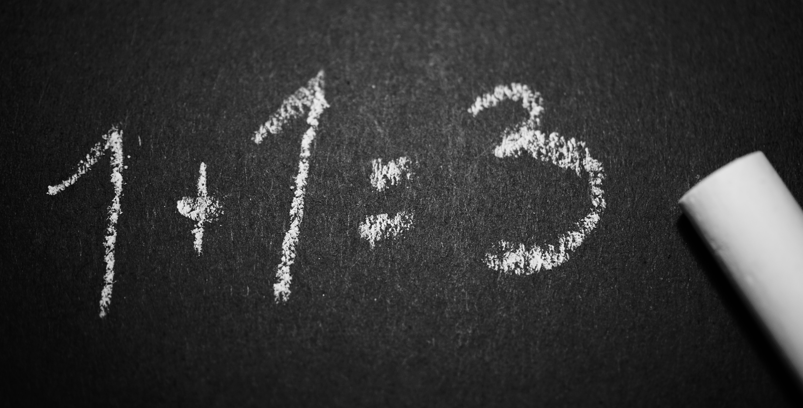


What is The MTC?
It’s a national test for Year 4 students
We’re not worried
Under the national curriculum primary school children are expected to know their 12 times tables by the end of Year 4
So we’ve been preparing students to know their times tables by the end of Year 4 for quite some time now and are not concerned about the check at all. We practice in class and with your help at home, we will be ready.

Slide 3

The practicalities
The Check Itself.
Takes place in June
Is done on a tablet or computer
Will take no longer than 5 minutes
There are 25 questions
Pupils have 6 seconds to answer each question
There’s no problem solving or division just simple “3 x 4 = ?” type questions
The results are for Teachers
There is no pass or fail mark
Results are not published

Slide 4
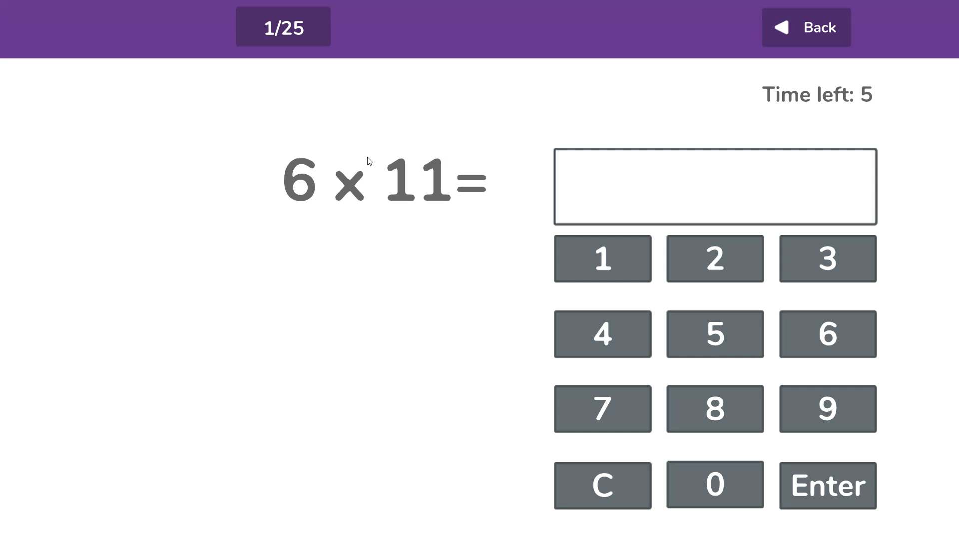

Slide 5

No Stress
Government has called it a “check” rather than a “test” or “exam” for a reason.
We will endeavour not to draw students’ attention to the check so will be not be referencing in class unduly.
Please be supportive of this approach and refrain from talking about the checks at home.

Slide 6
What if my child can’t access the test? – SEND Needs.
There are several access arrangements available for the check, which can be
used to support pupils with specific needs. Your child’s teacher will ensure that
the access arrangements are appropriate for your child before they take the
check in June.
The check has been designed so that it is inclusive and accessible to as many
children as possible, including those with special educational needs or disability
(SEND)
However, there may be some circumstances in which it will not be appropriate for a pupil to take the check, even when using suitable access arrangements.

Slide 7
Access Arrangements
Colour contrast pages.
Font size.
Pause - ‘next’ button between questions.
Additional time
Pupils cannot have additional time to complete the MTC questions. The purpose of the check is to determine whether pupils can recall their times tables fluently. Additional time would remove the fluent recall element of the check. The children will have a maximum time of 30 mins to complete. At this point the text will timeout.

Slide 8


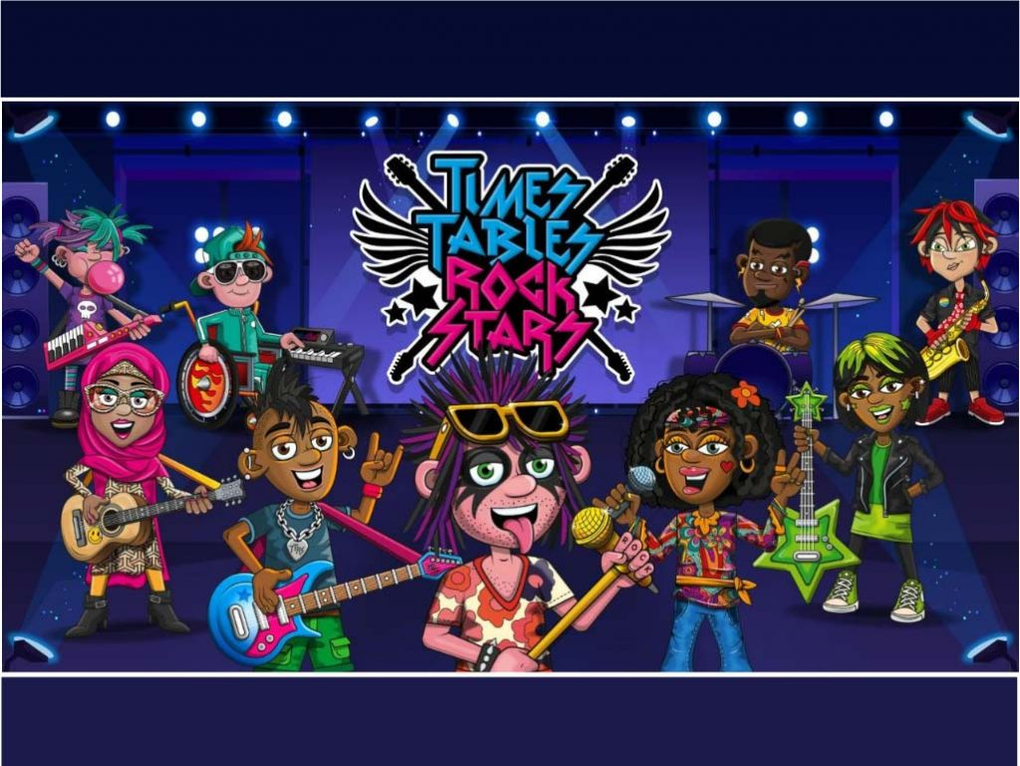
How You Can Help YouR Child?
Practise at Home
We will of course continue to teach the full curriculum, and would love your continued support to help practise the times tables with your children.
Some easy ways to do this include:
asking questions such as “What’s 7 x 8?”
reciting times tables by Rote (4 times 1 is 4, 4 times 2 is 8, etc)
singing times tables songs (there are loads online)
using apps and games (like TTRs and PurpleMash)

Slide 9


TTRS AND pURPLmASH
Your child’s username and password has already been sent to them.
This app features not only the check but a number of games and activities that will help your child learn and understand times tables
The app can be downloaded from the Apple Store, Google Play Store, Kindle/Amazon Store or Microsoft Store for FREE and is called Time Table Rockstars or Purplemash.

Slide 10
Will you receive results from your Child’s Test?
Yes. I will share your child’s score with you, as they would with all national curriculum assessments. There is no pass mark for the check.

Slide 11

Thank You
for your continued support

