Slide 1

Welcome to Reception

Slide 2
Friendly Faces in Reception
Here are the Reception Team
Class Teacher: Miss Gibbins
Class TA: Mrs Kendall

Slide 3
What to bring with you
Book bag
Water bottle
A piece of fruit (we do provide fruit)
A spare change of clothes. We will provide each child with a small coloured bag, which we will put their spare clothes into. If they need changing, this will be the bag that goes home with them. Please could it then be returned to us with fresh clothes as soon as possible. A packet of baby wipes is also really helpful to keep in their spare clothes bag too, as we do run out of these.
Please can children just bring their Nutfield Church book bags with a name keyring to identify it. They can start using rucksacks in KS2 (Year 3 onwards)
Children will not need to wear PE kits to school for the first half term (but can do on a Tuesday).

Slide 4
The first few days
Wednesday 2nd September: Group 1: Ottilie, Azalea, Molly, Riley, Reggie, Harrison, Laura, Freddie, Edith, Noah
Thursday 3rd September: Group 2: Olivia, Marley, Phoebe, Lily P, Harley-Lee, Mia, Amelia, Xavi, Sebastian, Eli
Friday 4th September: Group 3: Amiya-Jade, Ollie, Evie, Katie, Lily B, Freya, Florence, Emma, Alfie, William
Monday 7th September: All children in school
During your child’s first week at school we will be welcoming parents into the classroom to help them settle them in. When you hear the tambourine this will be your signal to say goodbye.
From Monday 7th September please could you line your child up on the playground and we will greet them from there.

Slide 5
Grouping
To start off with, the children will be split into groups according to age.
Red | Yellow | Green | Blue | Purple
William | Katie | Amelia | Marley | Harrison
Alfred | Evie | Mia | Olivia | Reggie
Emma | Ollie | Harley-Lee | Noah | Riley
Florence | Eli | Lily P | Edith | Molly
Freya | Sebastian | Phoebe | Freddie | Azalea
Lily B | Xavi | Amiya-Jade | Laura | Ottilie

Slide 6
A Day in Reception Class
8.45 – 9.00: Settling in time / Funky Fingers / Registration
9.00: Phonics
9.20 – 10.30: Choosing Time
10.30: Snack Time
10.45:Collective Worship
11.00: Literacy
11.30: Hand washing/Nursey Rhymes
11.45: Lunch
1.00: Maths
1.15 – 2.45: Choosing Time
3.00: Story Time
3. 15: Home Time.

Slide 7
Settling in during the morning
When the children first arrive in the morning we encourage them to develop their fine motor skills by using the threading, pegs, pencil control, cutting and playdoh which is on offer to them.
As well as completing the above activities the children will be quickly encouraged to get into the routine of independently putting their water bottles and bags away.
The children will also be encouraged to find their names and self register.
Once we are sat down for the register, we talk about the days of the week and look at the calendar. This allows the children to practice their number recognition and their counting. We also look at our visual timetable so the children know what they are doing the day.

Slide 8
Choosing Time
We have long uninterrupted times in the morning and afternoon for the children to explore their learning and their interests. This is a time when the children decide whether they want to go outside or stay in their classroom.
Each area has carefully planned activities which are linked to the theme of the term.
Choosing Time is a chance for children to explore their own interests but also practice and consolidate learning from their previous inputs. During this time children are observed and assessed against the area of learning or development statements. Then using the children’s interests and their level of development we plan ways to support them further in order to strengthen and deepen their learning. We also observe how children learn and this is through the characteristics of effective learning: playing and exploring, active learning and creating and thinking critically.
During this time we work 1:1 or in small groups to read and complete guided activities.

Slide 9
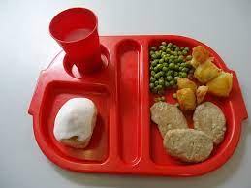
Lunchtime
Children go to the hall for their lunch. The class teacher stays with the class until 12.00. After 12.00 the children are looked after by Mrs Kendall, the class TA who will feedback to the class teacher any incidents or successes with eating at lunchtime. The children are encouraged to use their knives and forks and try new foods.
After their lunch the children are brought outside to play in the playground and depending on the weather they can go on the climbing wall, trim trail or field. This is a really lovely time for the children as they get to see all the school together and spend time.
Menus can be found on the school website.

Slide 10
Phonics
We are following the Essential Letters and Sounds phonics programme through Oxford Owl
At the start of each session the children will be encouraged to gather their white boards pens and rubbers. We start each lesson by learning the phoneme, that is all about how we pronounce the sound. Then we identify or talk about items that have that sound either at the start, in the middle or at the end. As part of our lesson the children also learn the grapheme. A grapheme is a letter or groups of letters which represents a sound (phoneme) in writing. We all have a really good go at writing the grapheme. Children also learn how to segment sounds to help them to sound out words when spelling and blend sounds to support when reading.

Slide 11
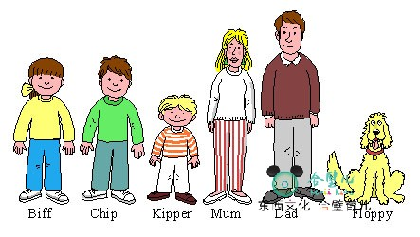

Reading Books and Records
We will be reading with your children on a 1: 1 basis during the morning. All children will be read with twice a week and they will have a set day when they are read with.
Please read with your child daily and write a message in their reading record books. These will be checked when your child is read with. The message does not need to be lengthy, just let us know what they did well or what they need more support with.
Children will receive two reading books a week as well as an online book which will be accessible through the Essential Letters and Sounds ebook library
Monday | Tuesday | Wednesday | Thursday | Friday

Slide 12
Reading
The first books that will have just come home are picture books with no words. This is to encourage the children to look at the pictures and use their imagination and inference skills to tell a story. This helps when they have a picture book with words as they then have the strategy of using the pictures to help them. We also do this so that the children get into a routine of sharing a school book with an adult, handling books, holding them the right way up and starting from left to right.
The next books will have one or two words per page, these aim to build up their understanding of linking the picture to the words which will become really important later on. The words will be linked to the phonemes they will have learnt at school.
After that the children start the reading scale that will follow them into Years 1 and 2.
We like the children to have read at least half the books in each book band before moving them onto the next stage.
Spending 10 minutes a day reading with your child will hugely support them on their journey to becoming an independent reader.

Slide 13
Decodable readers
In addition to your child’s reading book we ask that you read the decodable text provided by the school four times across the week. These books will be accessible through the Essential Letters and Sounds ebook library, which we will be providing the log-in details for in due course. We will set this book once a week on Fridays. This will allow your child to re-read each text several times, building their confidence and fluency. This is especially important as they begin to learn that the sounds within our language can be spelled in different ways.
For children, re-reading words and sentences that they can decode (sound out) until they are fluent (read with ease and precision) is a key part of learning to read. By reading texts several times, children have the greatest opportunity to achieve this fluency.
These texts are carefully matched to the teaching taking place in school. Your child will be practising what they have been taught in school with you at home.

Slide 14

Literacy
Literacy is split into three areas – Comprehension / Word Reading / Writing
We have four literacy lessons a week and one teacher-led literacy lesson in a small group of three children. These lessons will be linked to a story, a non-fiction text or a poem. We will also show the children how to use story mapping and innovation to change the story.
Our Literacy lessons are based on a text or our topic that term. Whilst looking at a book, the children will get to explore the characters, plot and setting.
In the first term our writing will be based on our topic ‘Outside Inside’. This topic allows the children to talk about Change in the world around them as well as the changes happening to them.
We will be focusing on the text ‘Where the Wild Things are’ by Maurice Sendak. This text is great for rhyming, exploring language and learning a text.
The children will be taught to form their letters correctly.

Slide 15
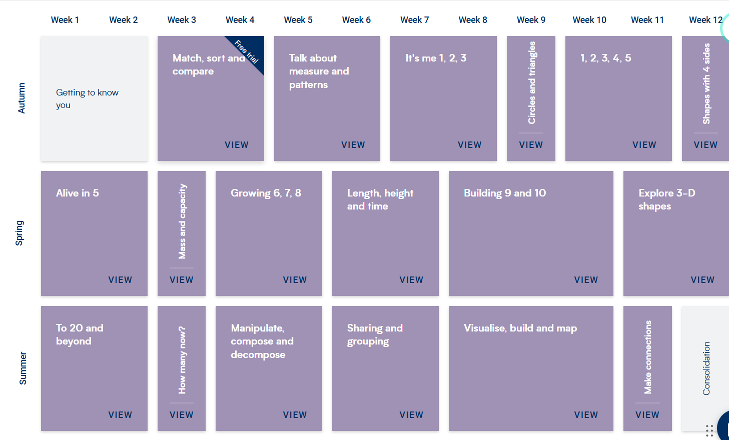
Maths
The children have three Maths lessons every week and one teacher-led lesson in a small group of three children. We use White Rose Maths to support the children with their Maths learning.

Slide 16

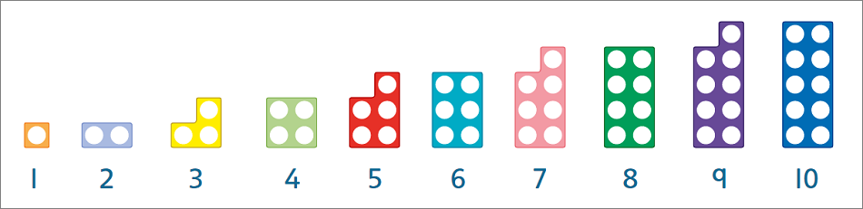
Maths
We do spend a considerable amount of time learning about the composition of numbers and what makes a 1, 2 or 3.
We also use lots of stories and rhymes to support the children with their Maths learning During the independent learning there are activities planned for the children to consolidate and extend their Maths knowledge and learning. One word you will be hearing a lot from us and the children is the word subsitise, this is identifying how many items there are without counting.

Slide 17

Topic Based Learning
In EYFS our learning is based around topics and we have a different topic each half term.
In the learning environment we have continuous provision – which means resources that are always there to play and learn with such as the reading snug, construction toys, literacy and maths games, role play, small world play, and open access to our arts and crafts room.
We also have enhanced provision which means resources or activities linked to the topic or interest. For example if the topic was ‘Outside Inside’, the children may investigate bugs as part of their enhanced provision.
Autumn 1 | Autumn 2 | Spring 1 | Spring 2 | Summer 1 | Summer 2
Outside Inside | Who am I? | Talents and Powers | Sewing a Seed | Amazing Me | The People Around Me
Under the Sea
Fairytales
Superheroes
A Bugs Life
5,4,3,2,1 Blast off!

Slide 18



Personal, Social and Emotional Development
PSED is split into three areas – Self-regulation / Managing Self / Building Relationships
In the Autumn term we largely focus on; how to treat others, helping each other, sharing, making friends, behavioural expectations, recognising and regulating emotions and self-esteem.
PSED is taught through focused lessons, circle times and modelling during child-initiated learning.
Communication and Language
C&L is split into two areas – Listening, Attention and Understanding / Speaking
In the Autumn term we largely focus on; maintaining attention and listening during adult focused learning, understanding instructions and stories, speaking in full sentences and exploring new sounds.
C&L is usually taught discreetly through carpet times, circle times and modelling during chil- initiated learning.

Slide 19

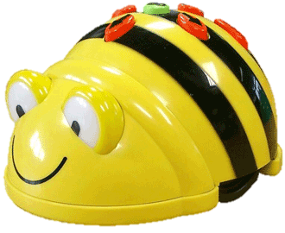
Understanding the World
UTW is split into three areas – Past and Present / People, Culture and Communities / The Natural World.
Examples of topics studied: Christmas in the past; Transport – old and new; The Moon Landings; Grace Darling; The Great Fire of London; Florence Nightingale; Diwali; Chinese New Year; Australia; Seasons; Sinking and Floating Experiments, investigating Magnetism.
UTW is taught through focused lessons, circle times and questioning and investigations during Choosing Time.

Slide 20

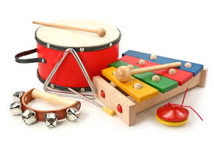
Expressive Arts and Design
EAD is split into two areas – Creating with Materials / Being Imaginative and Expressive.
Children are given an art task every week which they are encouraged to complete independently. These tasks are designed to encourage the development of skills in collage, painting, cutting and drawing. These tasks are always linked to the current topic. We also have two pieces of teacher-led artwork each term.
Children have free access to the art room and are encouraged to experiment with the craft materials available.
We encourage imaginative play and performance through our puppets and puppet theatre. We also have a large dressing-up shed with a wide range of outfits for the children to dress up in.

Slide 21
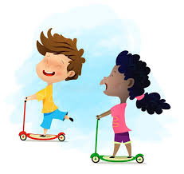
Physical Development (P.E)
PD is split into two areas – Gross Motor Skills / Fine Motor Skills .
In the Autumn term we largely focus on; different ways of moving and travelling, negotiating space, showing an understanding of good hygiene and health, holding a pencil and beginning to form recognisable letters.
PD is taught explicitly through PE lessons each week. In the first term this is conducted inside, we wear our school uniform and no shoes or socks. We then use PE kits during the second half of the Autumn term.
PD is also taught discreetly through provision in the classroom using resources such as scooters, balancing toys, threading and playdough.
PE Uniform:
Hair tied back for PE
Navy blue shorts (cotton or nylon)
Yellow t-shirts with logo on
White, black or blue socks
Black or blue trainers

Slide 22
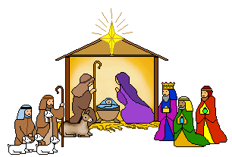

RE and daily worship
As a church school, RE is one of the core subjects and a RE lesson is taught each week. In Reception this is predominately taught through art, stories and going out into our environment.
This term our topic is ‘Who Am I and Where Do I Belong?’ and will become a Christmas topic after half term.
Collective Worship – we have class Collective Worship every morning which involves a Bible story and a prayer. Later on in the year, we will join the rest of the school for Collective Worship in the hall.
We always say a lunchtime and home time prayer.

Slide 23
Pedogogy – the way we teach
In the Early Years classroom at Nutfield Church Primary school we use two pedagogical approaches: play-based learning and inquiry-based learning.
Play is emphasised as a vehicle for learning and development which is split into two parts:
-Child-led learning, which involves following the child’s interests and supporting their learning in a way that is child-centered.
-Adult-led learning, which involves providing more structured learning experiences guided by an adult educator.
In our enhanced provision there is also a leaning towards Inquiry-Based Pedagogy. Inquiry-based pedagogy involves teachers posing questions and problems to children and allowing them to explore and discover the answers through hands-on experiences. This approach encourages children to ask questions, make predictions, and test their hypotheses.

Slide 24

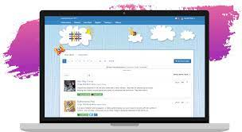
Tapestry
Tapestry is our way of recording the children’s learning. We will observe the children during independent learning. We will be putting on Tapestry all the ‘wow’ moments.
As well as us using tapestry, we are also really keen for you to use tapestry too. If there is a particular achievement or a special family occasion that your child is excited about, please do take a photograph of it and add it to tapestry. We can then see it at school and talk about it together.

Slide 25

Contact Books
We have sent home a small green book called a Contact Book. These books are checked daily.
These books are meant for non-urgent messages that you would like to get to us. For example if your child has lost a jumper, had a headache that morning or has a small worry.
If you have an important message for us, please tell an adult on the gate or phone the school office. Please remember that if someone different is collecting your child we will need to know via the school office.
If you have something important that you wish to discuss with us, please call the school office to arrange a telephone appointment.

Slide 26
Uniform
The school colours are blue and yellow. Children should come to school in combinations of these colours, and be smartly dressed. Hair ties and bands are expected to be in school colours only. Haircuts are recommended to reflect a smart outlook on life. Long or short hair is fine. Excessive use of hair gel is discouraged.
Please name your child’s uniform, including shoes.
Grey skirt/grey pinafore or grey school trousers/shorts (girls can wear blue gingham dresses in summer – please do not mix gingham tops with grey skirt/trousers)
Blue Sweatshirt or cardigan with logo on
Yellow polo shirt with logo on
White, black or blue socks or grey tights
Dark coloured low-heeled shoes
Uniform can be purchased online from Price & Buckland: www.price-buckland.co.uk

Slide 27
Saints Teams
On your child’s Saint’s day, they can come in with a t-shirt of their team colour. We will also use the teams on big sports events like Sports Day.
These will be confirmed in September. Siblings will be in the same teams.
St George | St Patrick | St Andrew | St David
Friday 23rd April | Wednesday 17th March | Monday 30th November | Tuesday 2nd March

Slide 28
Buddy Collective Worship
Each child in Reception will have a Year 6 “Buddy”. This is someone who will look out for them on the playground.
After October half term you will be invited to a Buddy Collective Worship.

Slide 29
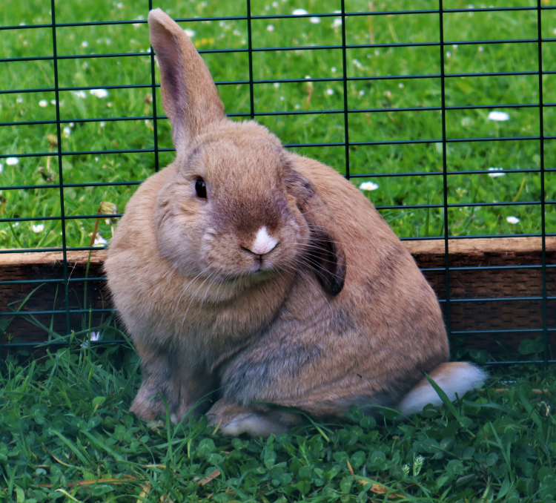
Peter Rabbit (and his new friends Flopsy and Mopsy)
The Reception children have responsibility for looking after our rabbit Peter. Children will take it in turns to visit the farm to feed and play with Peter. Please could you ensure that all children have a pair of wellies with them in school.
Our farm is very much dependent on the support of our families. We have a thriving volunteer rota for families who help look after the animals during weekends and holidays. If this is something you think you would like to be involved with please could you register your interest with the school office.
If you are unable to give your time, we also have ways of donating money through Sco-pay and also through sponsorship at our annual Hop-a-Thon. We have a termly Wellbeing Newsletter and this contains a wish list of items that are always needed such as food, straw and hay.

Slide 30
What you can do now in preparation for Reception.
Please can you encourage your children to
Identify the initial sounds in words.
Practise recognising and writing their name.
Spot words that rhyme.
Tidy up their toys.
Pick up items they have dropped.
Put lids on pens and glues.
Be respectful of equipment and furniture. For example, we wouldn’t draw on items at home so we wouldn’t do this at school either.
Flushing the toilet and washing their hands independently.
Putting their own coat.

Slide 31
Meet the Teacher
In September you will be invited to a ‘Meet the Teacher’ meeting where you will be given more information about the year ahead.

