Slide 1


Year 1
Welcome to
Meet the Teacher 2026

Slide 2
Miss Pyle
This is my second year at Nutfield.
I completed my teacher training in December last year.
Subjects that I love to teach are Phonics and Science.
I am Forest School trained so whenever appropriate we will go outside to enhance our learning e.g when learning about the seasons.
PPA time: Wednesday a.m – Miss Summers PPA teacher & Mrs Tunstill
ECT time: Wednesdsay p.m – Miss Summers PPA teacher & Mrs Tunstill

Slide 3
Meet our Teaching Assistants
Mrs Tunstill
(Mon – Thursday – all day )

Slide 4
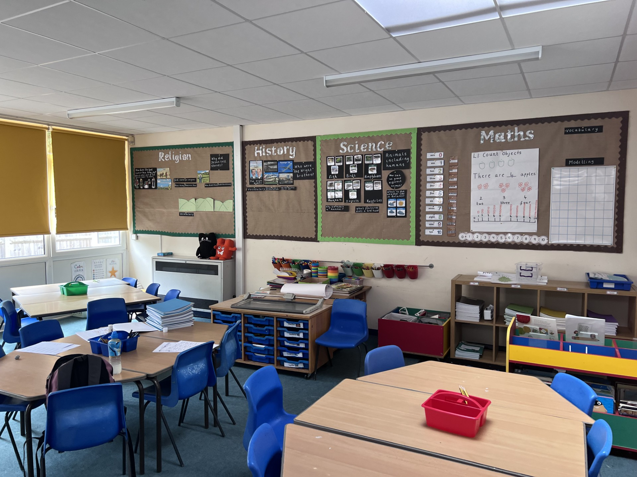
Transition From Reception
We will slowly phase out continuous provision and free flow activities.
There will be plenty of time for children to learn routines.
We will have 3 break times a day – morning, lunch-time and afternoon.
This term, there will be short, focused tasks at the pupils’ desks as well as group work.
We will have lots of learning through song and practical activities.
We will have lots of creativity and active learning stations as well as using toys such as lego to bring learning to life.
At home time we will have nursery rhymes, story times and reflection time.
The most important is children feel happy and safe in their new environment.

Slide 5
Curriculum - Maths
Place Value, addition and subtraction.
Building up throughout the year up to 0-100.
Further exploring 2D and 3D shapes.
Further exploring measurement – length, mass, money and time.
Introducing multiplication and division by exploring groups and sharing (Summer).

Slide 6












Curriculum – English
We look at 12 Books across the year
Using art and drama to support learning and creativity.
We have focus lessons/activities on spelling and handwriting.
In November, we also introduce comprehension activities.
Notes:
Cheeky photos for writing task

Slide 7

Curriculum – Phonics
In Year One, the children will take part in a Statutory Phonics Check.
It will happen in mid-June.
There will be a phonics meeting later in the year to help provide guidance and tips you can use at home to help your child learn to read.
The reading books we send home are essential to support, maintain and improve your child's reading level.
There will be a phonics evening about the test nearer the time.
Notes:
Reading levels from last year are currently being reviewed to ensure your child is receiving the correct books to support their reading journey.
From there we will be constantly considering their progress and ensuring children are moving levels when they are ready and only when they are ready.

Slide 8
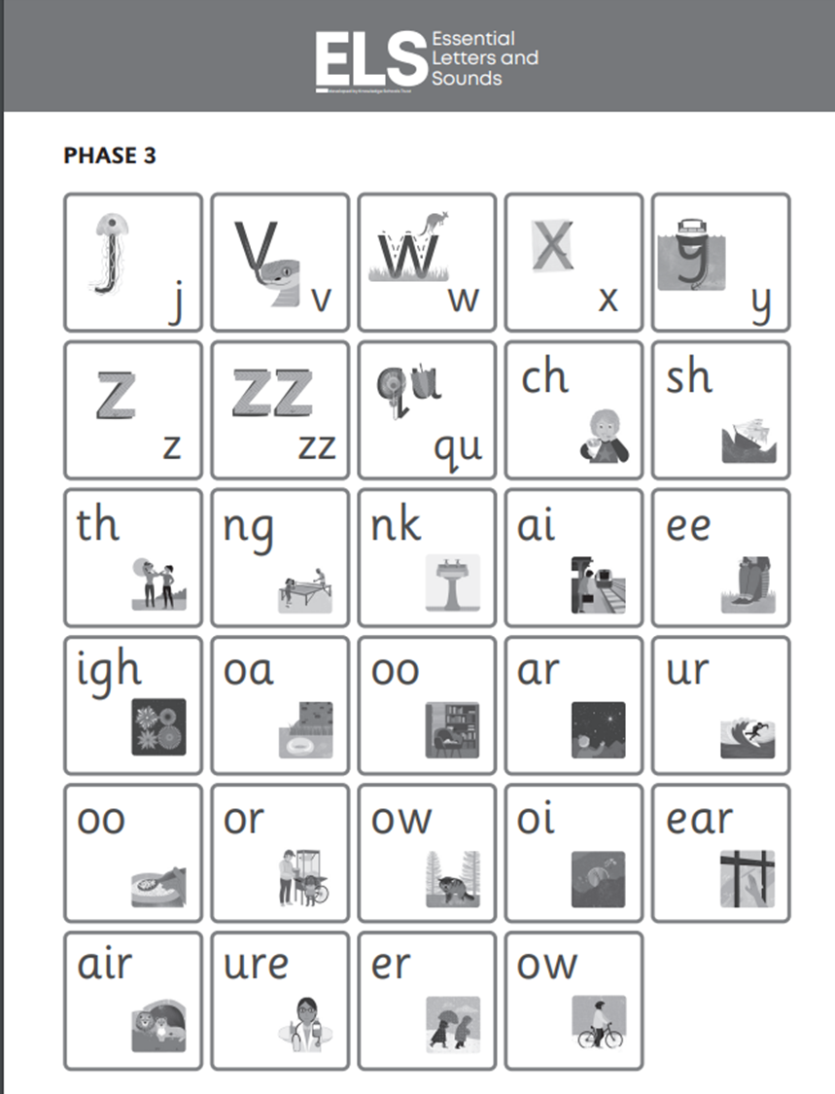
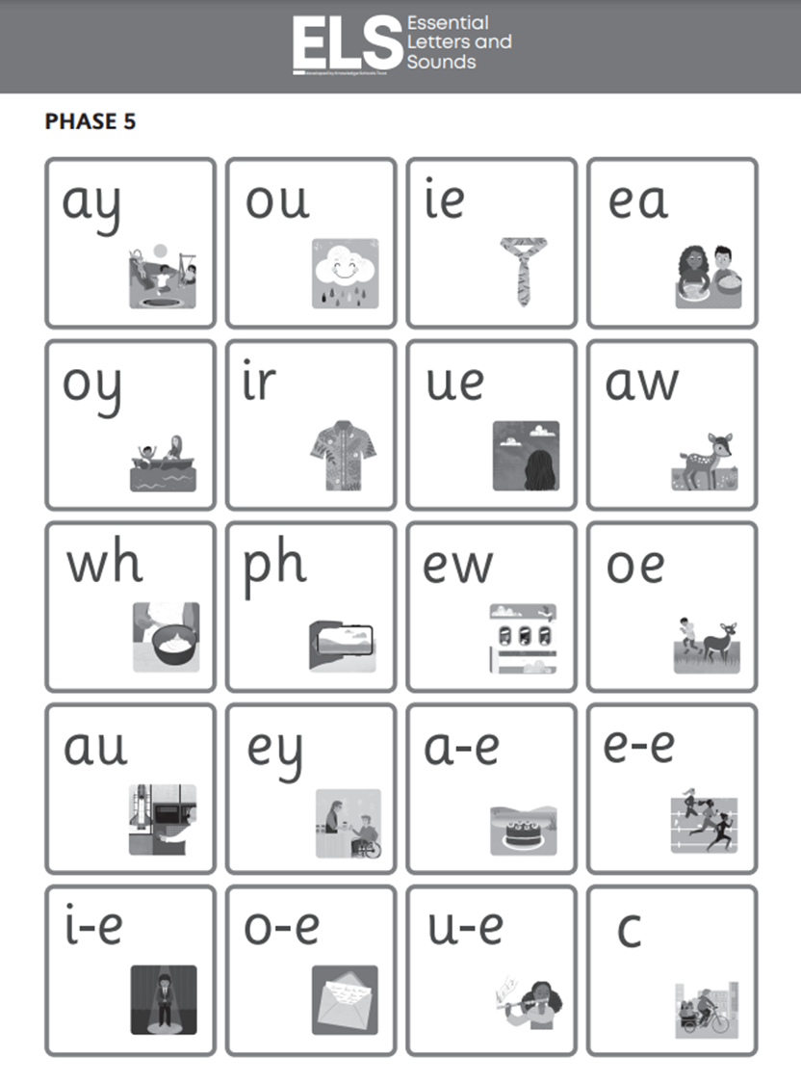

Slide 9
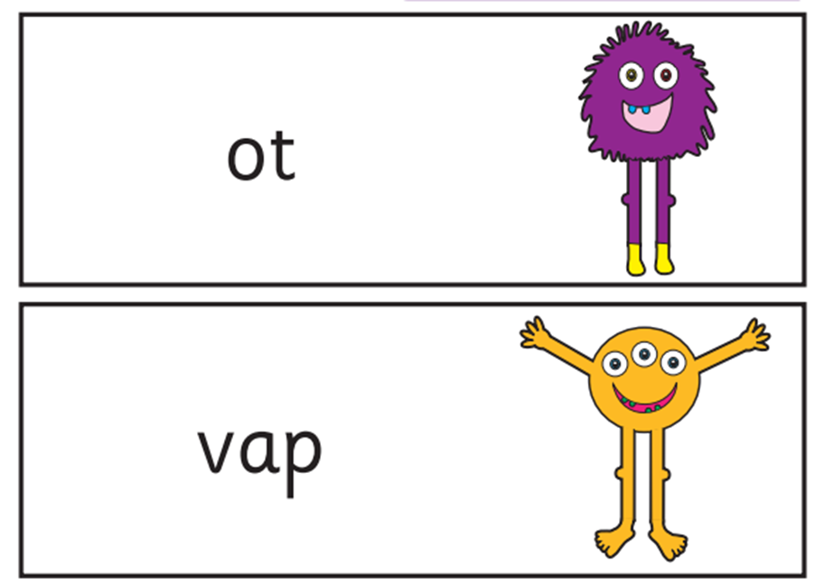

Slide 10

Reading Books will be changed 2 times a week on Monday and Thursday if they have completed the book. If your child needs a new book in between please write in your child’s reading record.
We suggest that (other than when reading), the reading book and record ‘lives’ in the children’s bags.

Slide 11
Curriculum – Humanities
Religion:
Why did Jesus tell stories?; What’s in our school’s name?; Why do Jewish people celebrate?; Who are our Christian neighbours?
History: The first aeroplane flight; Great Fire of London, Victorian children at play.
Geography: Polar bears or Penguins?; Sunhats or Umbrellas?; What if I lived in...?
Notes:
In year 1 we have a more structured foundation curriculum covering the humanities, stem, creative arts and wellbeing. The subjects being taught in these groups allows children to form important links.
A quick overview of our foundation subjects.

Slide 12

Curriculum – Science, Computing & DT
Science: seasons, animals, plants and materials.
Computing: how to use technology safely, responsibly & purposefully and simple algorithms
DT: structures, and healthy snacks

Slide 13
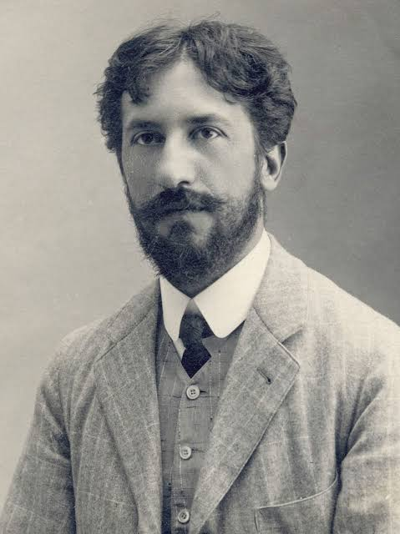

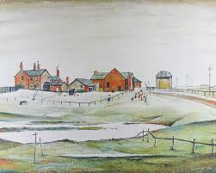
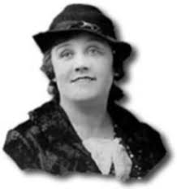
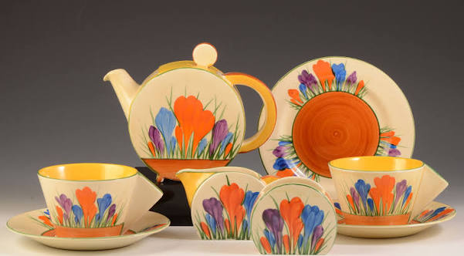
Curriculum – Creative Arts
Art: Piet Mondrian LS Lowry Clarice Cliff
Painting, sculpture, collage, printing, textiles, drawing.
Music: Hip hop, Reggae, Blues/Jazz, Latin, Pop and Classical
French: greetings, colours, numbers, days of the week, animals, family, countries.

Slide 14
Curriculum – Well-being
PE: fundamentals, gymnastics, dance, team games and athletics, well being Wednesday
Farm: this year we are looking after the chickens.
PSHE: friendships, families and healthy bodies, healthy minds

Slide 15


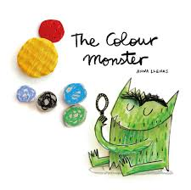
Emotional Literacy
Mindfulness: various mindful activities helping us to focus on our well being each morning and afternoon.
Feelings: we will be using a feelings thermometer to check in with how we are feeling and start discussing the meaning of different feelings each week. We will use stories to first help us learn about each emotion before we use this thermometer.
Calm Corner: our calm corner is for anytime we are feeling worried or need to reset. It is a chance to help us transition any big feelings in a calm space.

Slide 16
Dress up days
In order to support children’s understanding and enhance learning we have a range of dress up days as well as school trips that happen through the year.
These include Victorian day.
World book day ( whole school dress up day)
Carnival day to support our book Julian is a mermaid.
Underwater animal day to support our book Leo and the Octopus.
We will let you know about the final dates of these in the next homework letter so please look out for them.

Slide 17
Trips
We will have about 3 trips this year to support our learning.
This is as well as some visits to school and local trips e.g to Christchurch.
We will likely have trips to support Science, the arts e.g going to the theatre and then an RE trip e.g going to the Synagogue.
When these trips are confirmed we will put this in a homework letter with plenty of notice for you.

Slide 18
Our PE is on a THURSDAY afternoon.
This year we are asking for all children to come into school in their PE kit on PE days.

Slide 19
School Uniform
Uniform
Grey pinafore dress, skirt, shorts or trousers
Yellow polo shirt, with the school logo
Royal blue cardigan or royal blue sweatshirt, with the school logo
White/grey socks or tights
Black, brown or blue school shoes
In the summer, blue/white checked dress
Long hair should be tied back with small black, blue, brown, navy or white hair fastenings.
Pierced ears are allowed but we ask that this is done in school holidays so children do not miss their P.E. lesson. Children should only wear studs please.
PE Kit
Yellow T-shirt, with Nutfield Church Primary School logo
Royal blue shorts
Plimsolls or trainers (football boots for clubs)
During the winter, children are encouraged to wear navy jogging bottoms and a P.E jumper. Please try to keep to school colours.
Drawstring P.E. bag with Nutfield Church Primary School logo
Notes:
A few friendly reminders

Slide 20
Other Reminders
Snacks
Children are allowed to bring in fruit/veg snacks with them for break time.
No Nuts please!
Water Bottles
All children are required to have a named water bottle in the classroom.
Absences
Please telephone the Office to let us know if your child is unwell and will not be attending school.

Slide 21
Homework
Homework letters will be sent home every Friday with tasks for children to complete before Wednesday.
The majority of the tasks will be set on Purple Mash and will support their learning.
Purple Mash logins will be sent home today and stuck inside the children’s reading records.
We would like all children to read at home daily.
This only has to be for around 10 minutes and is a great addition to the bedtime routine. Please remember to log it in their reading record.
Talk to your child about what they are learning at school; the best way of remembering something is to
tell someone about it!

Slide 22

9th December Nativity performance
Year One Phonics training – 3.30pm – 4.15pm – Classroom
Monday 23rd November – 25th November
Notes:
A few key dates this term

Slide 23
Collect the handouts from your child’s table.
Feel free to have a look around your child’s new learning space.
Come and introduce yourself to me!
Notes:
Before you leave:

Slide 24
Any Questions?

