Slide 1
Staff
Welcome to Year 2!
Mrs Brooks – Monday, Tuesday and Wednesday
Mrs Summers– Thursday and Friday
Mrs O’Hanlon

Slide 2
School Values
Community and Peace – Autumn
Wisdom and Hope - Spring
Dignity and Joy – Summer

Slide 3
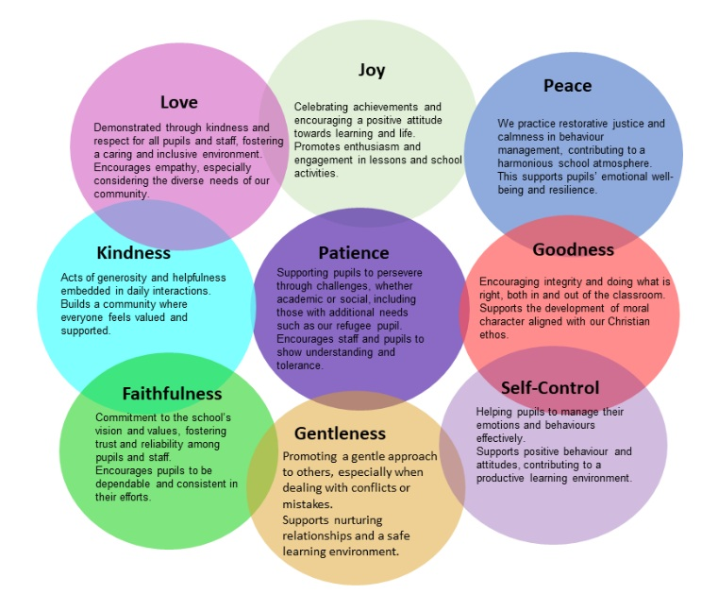
Spirituality
Fruits of the Spirits
By embedding the Fruit of the Spirit into our school culture, curriculum, collective worship, and Buddy system, we create an inclusive and supportive environment where every pupil can flourish. This spiritual framework encourages positive relationships, emotional well- being, and a strong moral compass, which are essential for pupils’ holistic development and for living well together as a community.
Through this biblical lens, the Fruit of the Spirit become a living expression of our Christian vision, enabling pupils to embody Christ-like qualities and flourish in all aspects of their lives academically, socially, and spiritually

Slide 4
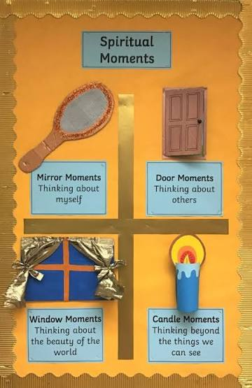
Spirituality at Nutfield Church School
A focus on spirituality enables our children to be happy, to flourish and to live life in all its fullness. As a school, we have chosen to use the Windows, Mirrors, Doors concept as a common reflective structure for spirituality:

Slide 5
Windows (Learning About Life)
Look outward at the wider world.
Notice life's "wows" (moments of awe, beauty, and deep gratitude).
Encounter life's "ows" (moments of pain, confusion, or injustice that challenge us).
Engage with new perspectives, cultures, and beliefs.
Mirrors (Learning From Life)
Look inward for personal and shared reflection.
Meditate on deep personal values, feelings, and big life questions.
See how experiences resonate with or challenge inner beliefs.
Build self-awareness and empathy for how others feel
Doors (Learning to Live Life)
Step out into action or creative expression.
Transform inner realizations into purposeful behavior.
Make deliberate choices to act as agents of positive change.
Put core values into practice within the community.

Slide 6
Spiritual development will happen in all aspects of school life and beyond. There will be opportunities in the classroom woven throughout our curriculum, there will be space and time given during our collective worship and SMSC learning. We are committed to modelling, leading and supporting all of our school community to enjoy and appreciate the strength and faith in oneself that spirituality can bring.

Slide 7
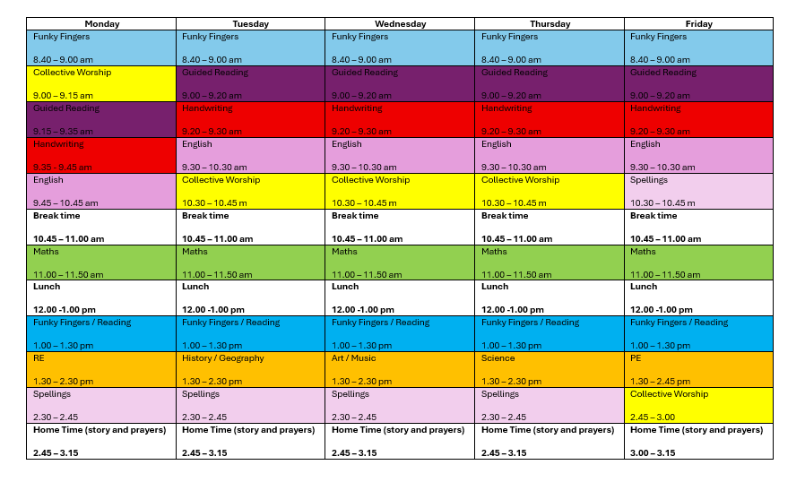
Our Timetable

Slide 8

English
Every term we study a different book and this half term our book is “The Journey Home”
This year we are studying a variety of different books that explore different concepts and genre.
There will be a grammar and punctuation focus in both reading and writing.
Lots of drama, role play and art.
Notes:
Our English lessons will centre around a variety of high quality texts, which will enable the children to explore a vast range of genres and concepts. We study a different book every half term.
I must stress that you don’t go and buy or read the books once it is revealed what they are – the scheme of work revolves around mystery and as a class we work through the book to enable the children to be creative as possible. For example, until Monday, we had only read 1 paragraph of The Pied Piper.
In addition to reading and writing, English will be taught through a range of different medias (drama, art and role play). There will be many an opportunity for the children to perform! The picture is of the children being told their was a rat running under their feet.
In addition, there will also be a focus on grammar and punctuation and applying this to reading and writing, this will be done during English lessons and through Guided Reading sessions.

Slide 9

Reading
At Nutfield Church School, we want our pupils to love reading!
We encourage our pupils to read every school day, for 10-15 minutes, or more if they would like, and it should be recorded in their reading record (which should be kept in their bags in KS1 and handed in every day)
Children will have the opportunity to be heard read 2-3 times a week, through 1: 1 reading with an adult and in small groups in Guided Reading sessions.
Children will change their books on a designated day. This will be the day they read with an adult. They will then be given two decodable reading books for the week. Children are also welcome to read their own books alongside the decodable reading books.
Please sign their reading record when they read
Children will work through the book bands and we will move children up when they are ready
Children are then encouraged to read Lime+ books in school but please feel free to read as many other books as you like at home!
Notes:
Our English lessons will centre around a variety of high quality texts, which will enable the children to explore a vast range of genres and concepts. We study a different book every half term.
I must stress that you don’t go and buy or read the books once it is revealed what they are – the scheme of work revolves around mystery and as a class we work through the book to enable the children to be creative as possible. For example, until Monday, we had only read 1 paragraph of The Pied Piper.
In addition to reading and writing, English will be taught through a range of different medias (drama, art and role play). There will be many an opportunity for the children to perform! The picture is of the children being told their was a rat running under their feet.
In addition, there will also be a focus on grammar and punctuation and applying this to reading and writing, this will be done during English lessons and through Guided Reading sessions.

Slide 10
Helping with Reading
Literal Questions:
  These are simple questions where children are asked a fact from within the story (i.e., the information is literally within the text). For example:
    “What was the pirate’s name?”
    “Can you remember who was on the boat?”
    “What happened after they got off the boat?”
Inference Questions
Inference questions need children to look beyond the text and give information that was not specifically provided, but which was implied (i.e., children need to ‘read between the lines’). For example:
  “What do you think happened next?”
  “Why do you think he did that?”
  “How do you think the pirate felt when he was left behind?”
Notes:
Our English lessons will centre around a variety of high quality texts, which will enable the children to explore a vast range of genres and concepts. We study a different book every half term.
I must stress that you don’t go and buy or read the books once it is revealed what they are – the scheme of work revolves around mystery and as a class we work through the book to enable the children to be creative as possible. For example, until Monday, we had only read 1 paragraph of The Pied Piper.
In addition to reading and writing, English will be taught through a range of different medias (drama, art and role play). There will be many an opportunity for the children to perform! The picture is of the children being told their was a rat running under their feet.
In addition, there will also be a focus on grammar and punctuation and applying this to reading and writing, this will be done during English lessons and through Guided Reading sessions.

Slide 11
Helping with Reading
Evaluative Questions:
Evaluative questions require children to read behind and beyond the lines. For example:
  “Do you think he should have done that?”
  “Do you think the Pirates were very different from each other?”
Take time to think about the questions and discussions that you have with your child as you read with them, but most importantly, enjoy sharing these stories together.
Notes:
Our English lessons will centre around a variety of high quality texts, which will enable the children to explore a vast range of genres and concepts. We study a different book every half term.
I must stress that you don’t go and buy or read the books once it is revealed what they are – the scheme of work revolves around mystery and as a class we work through the book to enable the children to be creative as possible. For example, until Monday, we had only read 1 paragraph of The Pied Piper.
In addition to reading and writing, English will be taught through a range of different medias (drama, art and role play). There will be many an opportunity for the children to perform! The picture is of the children being told their was a rat running under their feet.
In addition, there will also be a focus on grammar and punctuation and applying this to reading and writing, this will be done during English lessons and through Guided Reading sessions.

Slide 12
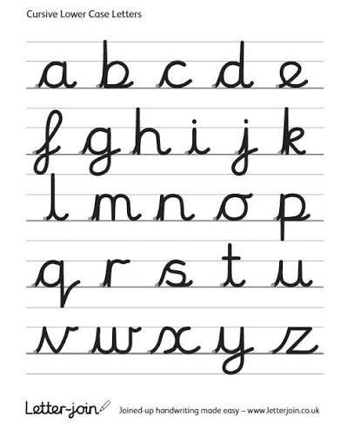
Spelling and Handwriting
Weekly spelling homework and spelling tests. Spelling will be set on purple mash.
It is important for the children to be able to spell fluently for writing activities during lessons.
We will be introducing pre-cursive letter formation followed by cursive writing towards the end of the year in our daily handwriting sessions.
Notes:
This term, our focus will be improving our confidence with spelling and using a wider range of vocabulary to ensure that our writing is the best it can be!
Every week, a set of spellings will be sent home and tested on a Friday
These spellings with either be from the 200 high frequency words, words from the Year3/4 curriculum or words that we are using during our topics.
The Year3/4 curriculum list all contain words the children need to be able to spell by the end of Y4, so do not worry too much if the children are struggling with these, there are 2 years for them to learn – but its nice to get a head start.
More importantly though is the childrens ability to spell these words during writing activities and especially when it comes to being fluent in writing.
We are also having a big push on handwriting this year. By the end of the year the children need to be using horizontal and diagonal strokes to join letters, we are having handwriting practise in our guided reading sesions and 2/3 times during the week.

Slide 13
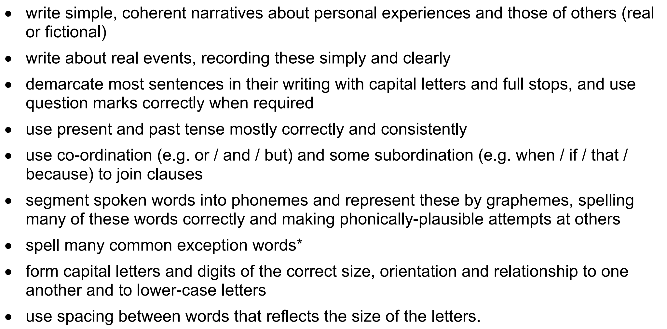
Writing

Slide 14
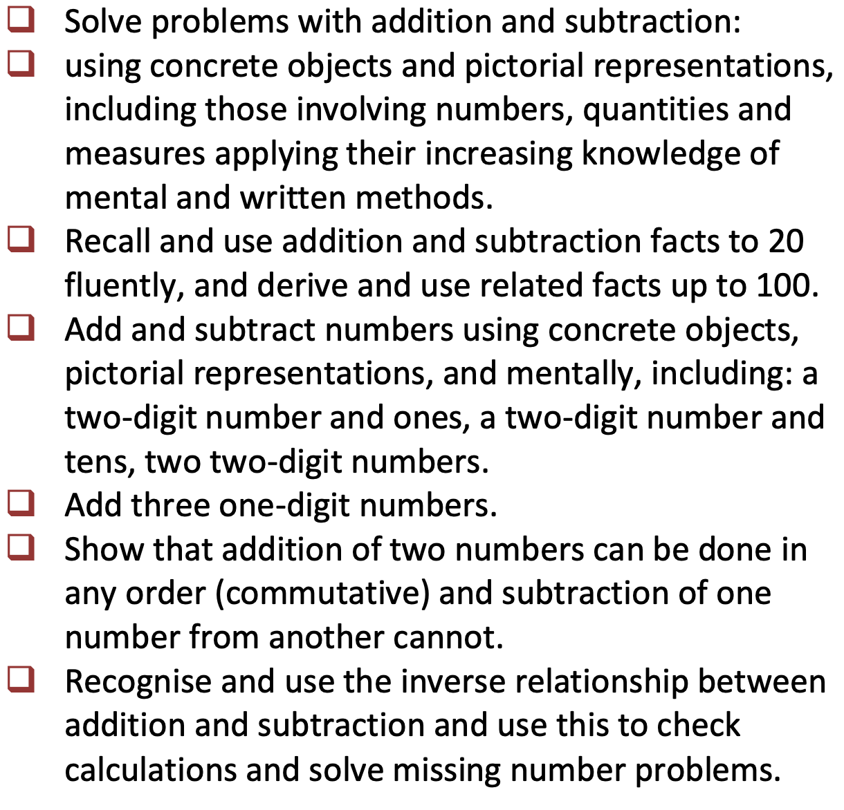
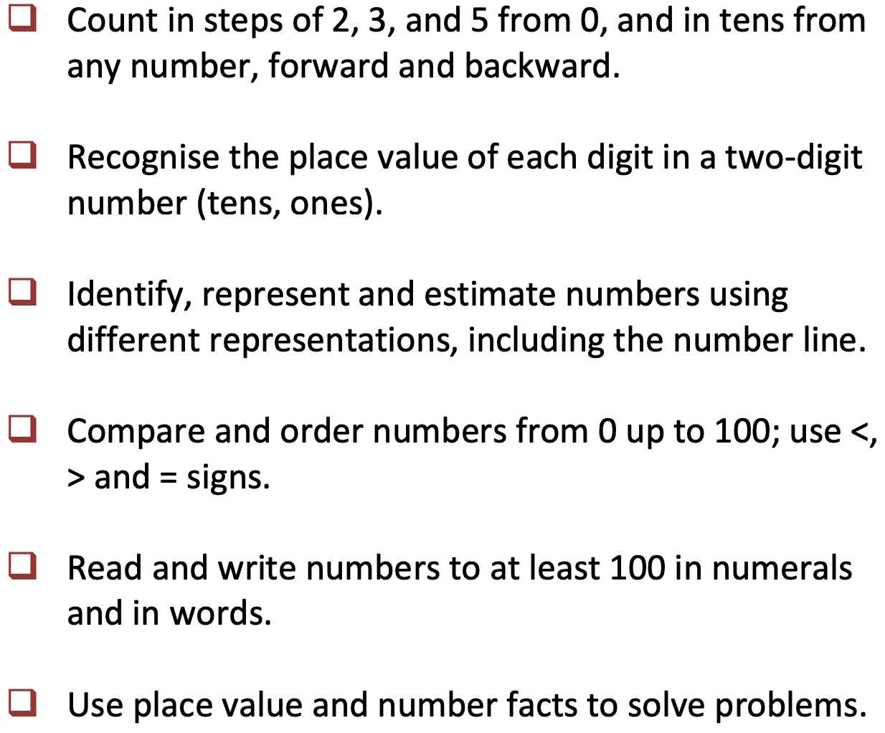
Maths
Notes:
We will start the term by extending our knowledge and recapping place value and our number bonds. Understanding place value – the value of each digit in a number.
These are a key mathematical skill and plays an extremely important role in helping the children to understand and progress in other areas of number.
We will also be focusing on adding and subtracting numbers up to 200 mentally and using the inverse to check our answers.
Through the year, the children will continue to recap their 2, 5 and 10 times tables and will begin to learn their 3, 4 and 8 times tables. Please practise these at home. A multiplication grid will be stuck into the children’s homework books for their use.
New curriculum means there is a focus on applying the knowledge and methods taught during maths lessons, using word problems, challenges and setting up role plays; the children will be able to apply their learning to real life examples and explain how they know an answer is correct.
Fractions – looking at fractions are part of a number, adding and subtracting fractions and ordering fractions.

Slide 15
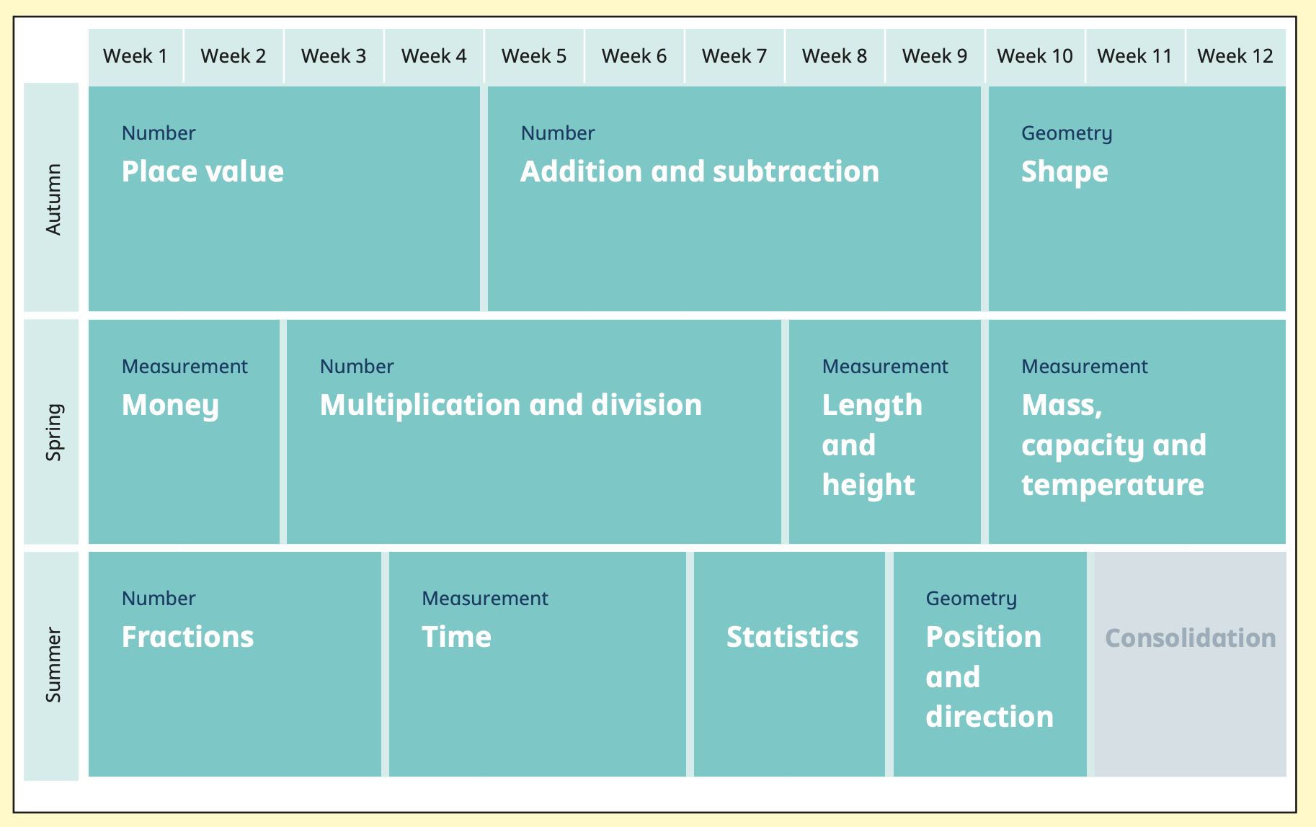
Notes:
We will start the term by extending our knowledge and recapping place value and our number bonds. Understanding place value – the value of each digit in a number.
These are a key mathematical skill and plays an extremely important role in helping the children to understand and progress in other areas of number.
We will also be focusing on adding and subtracting numbers up to 200 mentally and using the inverse to check our answers.
Through the year, the children will continue to recap their 2, 5 and 10 times tables and will begin to learn their 3, 4 and 8 times tables. Please practise these at home. A multiplication grid will be stuck into the children’s homework books for their use.
New curriculum means there is a focus on applying the knowledge and methods taught during maths lessons, using word problems, challenges and setting up role plays; the children will be able to apply their learning to real life examples and explain how they know an answer is correct.
Fractions – looking at fractions are part of a number, adding and subtracting fractions and ordering fractions.

Slide 16
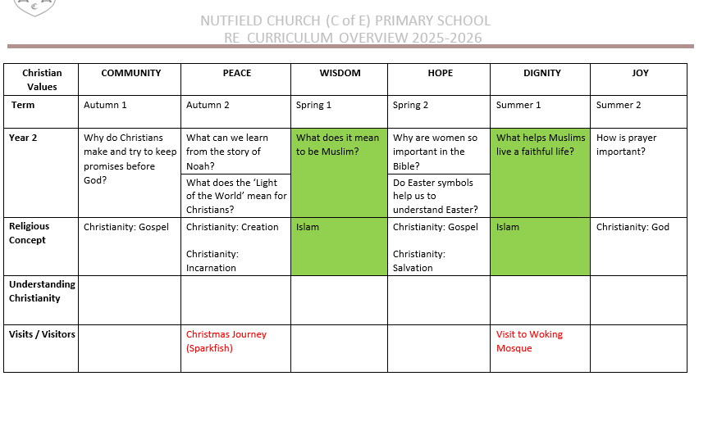
RE

Slide 17

Wellbeing
We will be following the Jigsaw PSHE programme. There are six sequential units we will be following over the course of the year.
The classroom has a calm corner and an emotions check in station, which children can access when required.
The outdoor area now has equipment such as bouncy balls, skipping ropes and trampolines when children require a brain break.
When the children arrive at school and after lunch there will be a carousel of mindfulness activities for them to engage with. These include playdoh, bead threading, jigsaws, peg boards and geo boards. These activities also help with fine motor skills, which we will continue to develop with the children as it supports writing and pencil control.
Notes:
Through RE lessons, we will continue to teach Philosophy for Children to facilitate critical and deeper thinking and provide opportunities for children to practise these skills across the curriculum.

Slide 18

PE
P.E is on Thursday afternoon.
Children will come into school in their P.E Kit on their allocated P.E day (Thursday)
P.E Uniform:
Yellow T-shirt, with Nutfield Church Primary School logo.
Blue/black sports shorts.
Plimsolls or trainers
A school jumper/fleece/cardigan can be worn during the colder months.
Blue/black jogging
On wetter / colder days a coat can be worn for P.E.
Notes:
Mr smith - I will hand over and collect the children at the end of the day on Wednesday.
All chidlren will get the oppourtunity to participate in district sport events if they want to – so don’t worry if your child isnt picked for something right away. Mr Smith is in charge of picking the children for this.

Slide 19
Science
Animals including Humans
Living Things and Their Habitats
Plants
Use of Everyday Materials
Famous Scientists
Notes:
Animals inc - children have designed a character who doesn’t eat – but gets their energy and food from other sources.

Slide 20
Science, Computing and D&T
Computing this year will be taught primarily through Science. However, there will be opportunities to use Computing throughout the curriculum.
Children will be able to use Purple Mash throughout the year for homework and in lessons.
Passwords for Purple Mash have not changed. Passwords for Purple Mash and Times Tables Rockstars were sent home with the children on Wednesday.
We will focus on:
  Basic Skills - Learn how to save and retrieve own work.
  Learn how to change font style, size and colour.
  Use technology safely and respectfully
  Recognise common uses of information technology beyopassword – compass 86nd school

Slide 21
Science, Computing and D&T
  Autumn – Bird Houses/Animal Habitats
    Design purposeful, functional, appealing products for themselves and other users based on design criteria.
    Build structures, exploring how they can be made stronger, stiffer and more stable.
  Spring
    use the basic principles of a healthy and varied diet to prepare dishes.
    Understand where food comes from.
    Plan and create a healthy savoury meal so that they are able to feed themselves and others a healthy and varied diet.
  Summer - Make own instruments out of different materials
    Design purposeful, functional, appealing products for themselves and other users based on design criteria.
    Build structures, exploring how they can be made stronger, stiffer and more stable.

Slide 22
Online Safety – KS1
At Nutfield Church School, we teach children in all classes how to stay safe in the online world, through regular Internet Safety lessons, using a mixture of videos and activities, aimed at their different ages and experiences.
As staying safe online straddles school and home, we encourage parent, family and wider school community involvement in our efforts to inform children about the digital world.
Please see our website for more information. https://nutfieldchurchprimary.co.uk/online-safety/
Online Safety is taught throughout the Science, Computing and Design and Technology curriculum in all year groups through the Jigsaw PSHE programme.
If a child searches something they shouldn’t an email will be sent to the School Business Manager, it is then investigated by Miss Mitchell (our Online Safety Lead).

Slide 23
Geography and History
We will be teaching Geography at the start of each term. After half term, we will be teaching History.
 | Autumn 1 | Autumn 2 | Spring 1 | Spring 2 | Summer 1 | Summer 2
Geography | Is it really round? |  | A visit to China |  | Where shall we go?
History |  | Gunpowder Plot |  | Women who made a difference |  | What it was like to be a child during WWII
Notes:
If you have any special knowledge or expertise in any of these topics, please feel free to let me know!
They will also be learning about the discovery of Tutankhamun, creating their own version of his Death Mask and will learn to write sentences in Hieroglyphics.
In the next few weeks the children will be bringing home their own mummified apple, which we have started to mummify using similar techniques to the Egyptians. We will also be making bread using an Ancient Egyptian recipe.

Slide 24
Expressive Arts
Our Art will be linked to our curriculum but also to specific artists such as Ted Harrison
We will be looking at:
Mixing colours
Use of colour
Drawing and sketching techniques
Clay sculpturing
African animals
African landscapes
We use a programme called ‘Charanga.’ This allows children to explore music through voice, recorders and percussion instruments.
In Autumn 2 we will start to learn the songs for the KS1 Nativity.
Notes:
This year at Nutfield Church, our expressive arts program will be linked with our KUW topic. So this term we will be:
We will also be focusing on scultpure, collage, printing and textiles this year.

Slide 25
Last few notices

Slide 26
SATs (Special Challenges)
First thing you need to remember is…. Don’t worry!
We want the children to be happy, successfully and well-rounded.
SATS assessments will take place in the summer term. Children are assessed in Reading, Writing, EGPS, Maths (reasoning and arithmetic)

Slide 27
Homework
Times Table Rock Stars
10 Spellings set on Purple Mash
15 minutes of daily Reading
Notes:
Please write comment in reading record book
Responsibitly – children responsible for taking books home – we are reminding them as getting ready to go home

Slide 28

Notes:
Please write comment in reading record book
Responsibitly – children responsible for taking books home – we are reminding them as getting ready to go home

Slide 29

play.ttrockstars.com/

Slide 30
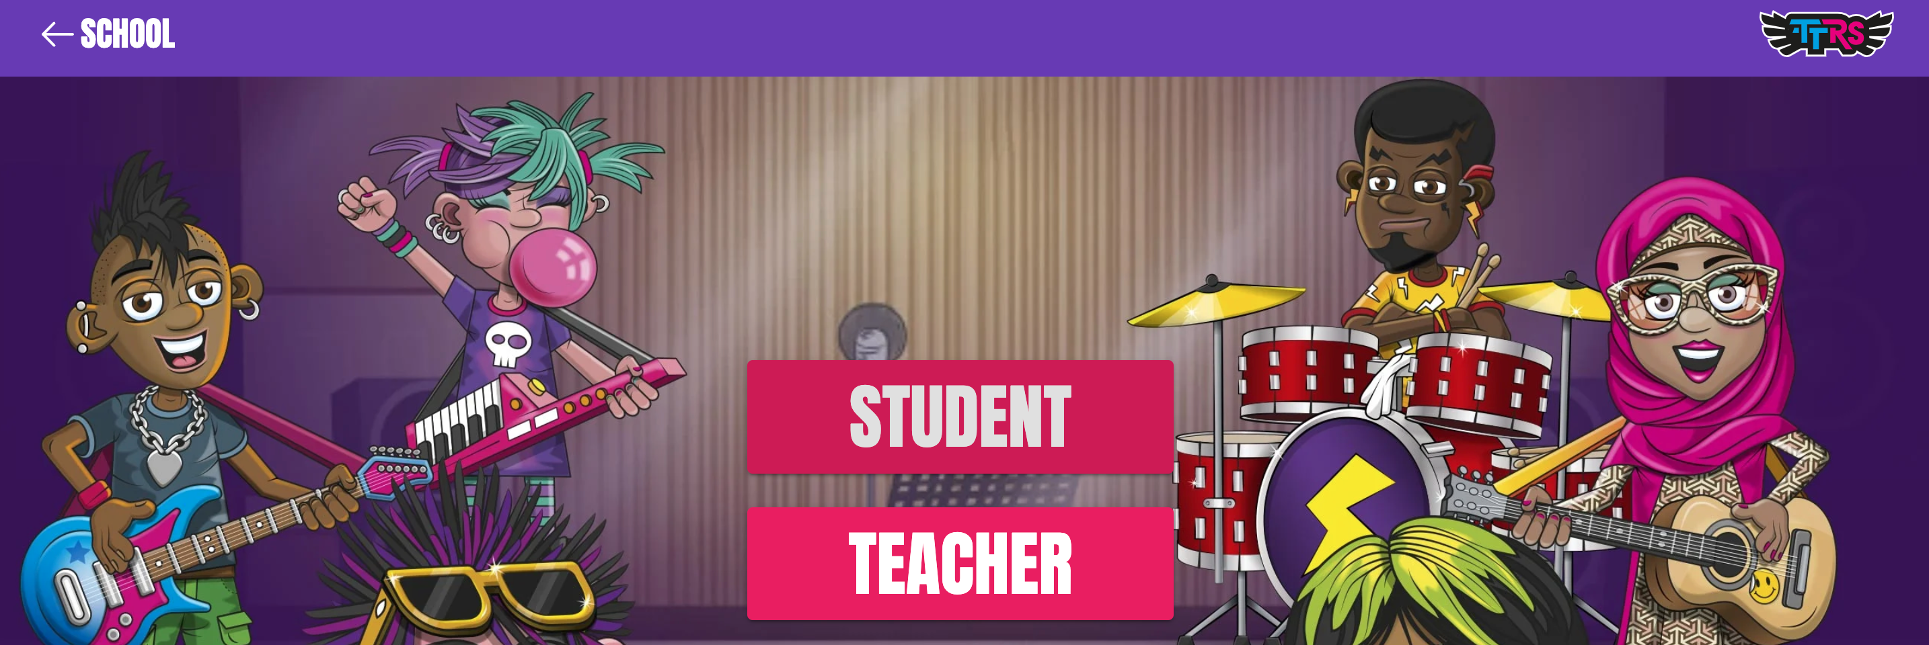
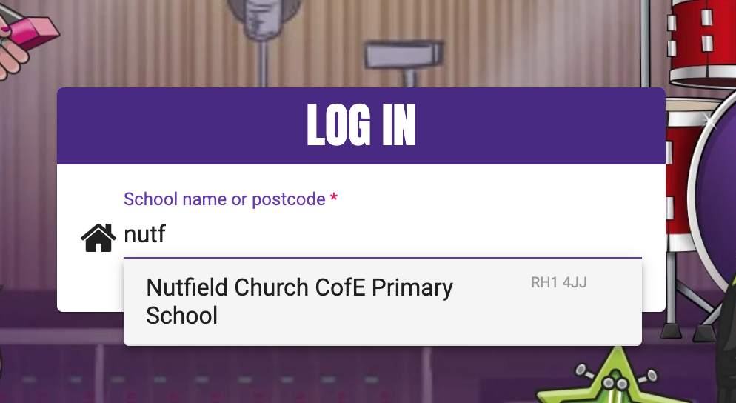

Slide 31
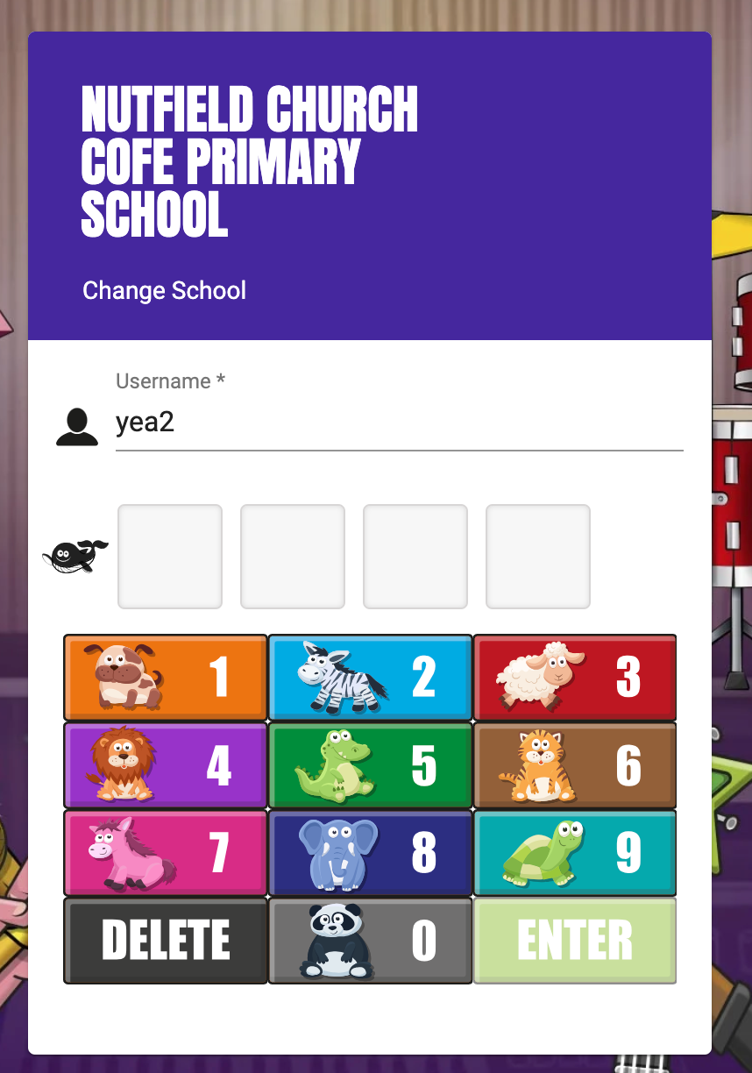
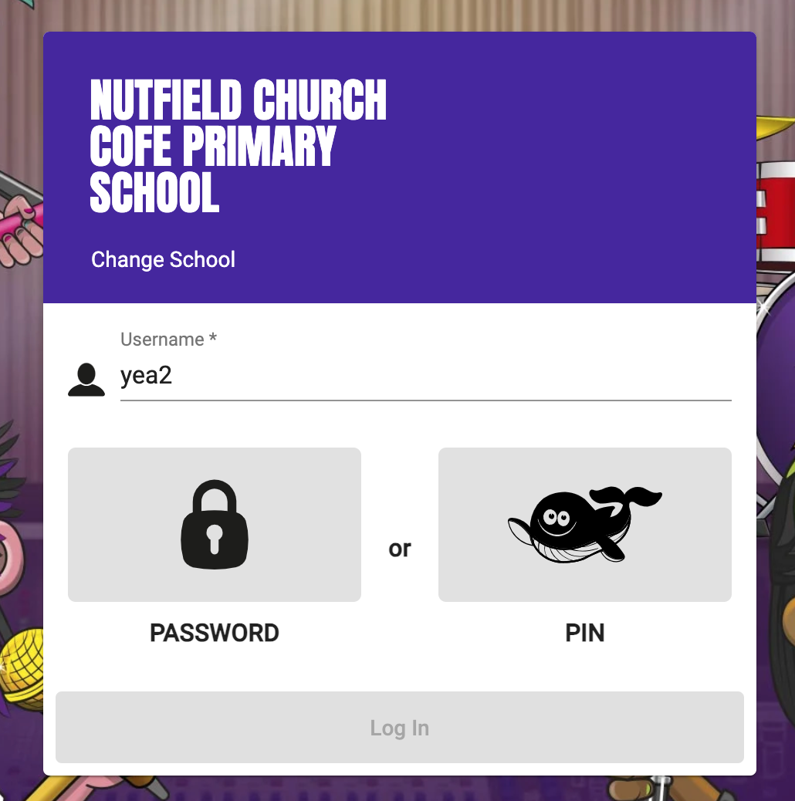

Slide 32
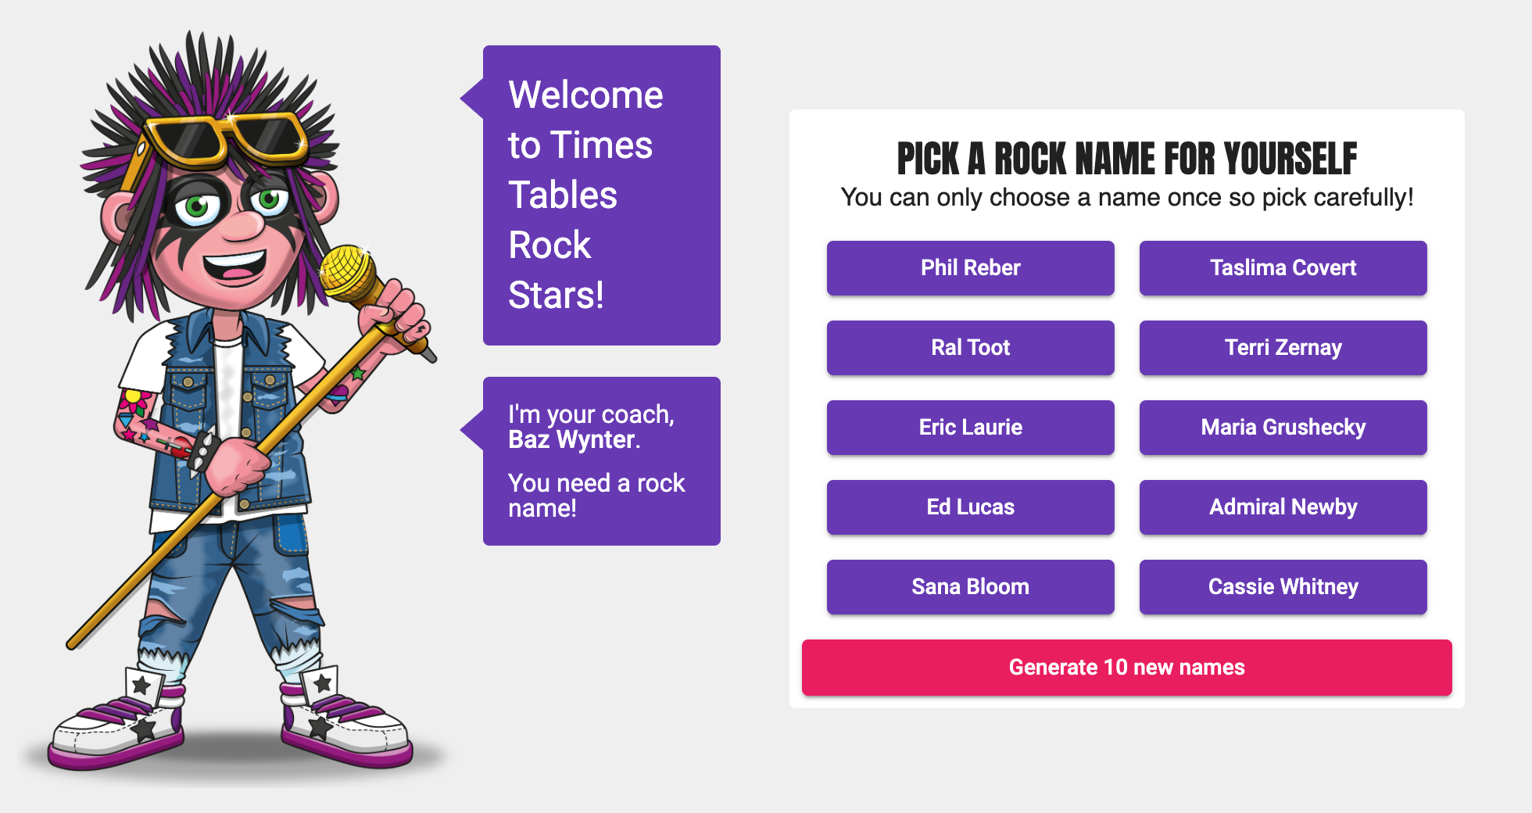

Slide 33

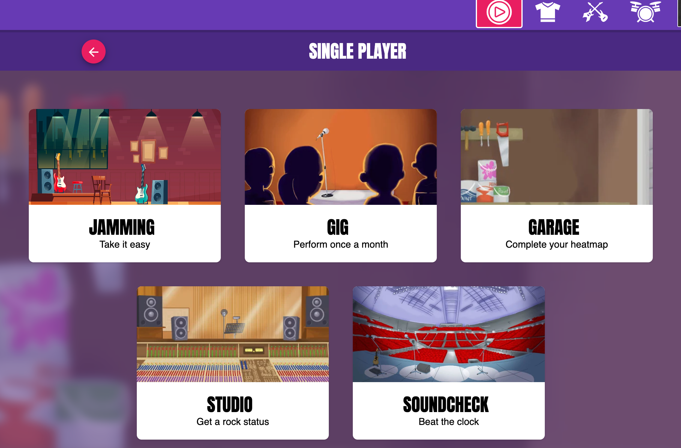

Slide 34
Homework
The initial Gig will give the children all the times tables.
It starts with the 10s, 2s and 5s. It will then generate questions for the 3s and works up to 12 x 12.
If your child gets to the 3s and does not know the answer, they can either leave the timer to run out or put in random answers.
From their results, the algorithm devises a program that suits the child's current ability and helps them progress through their other times tables.
Once the children have completed the Gig, they will not be able to complete another for a month.
Notes:
Please write comment in reading record book
Responsibitly – children responsible for taking books home – we are reminding them as getting ready to go home

Slide 35
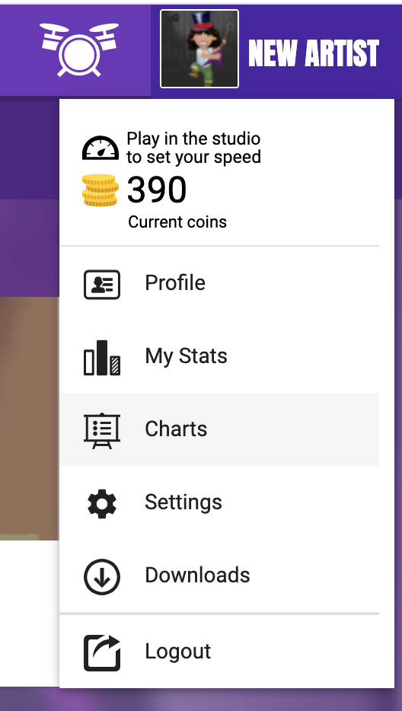
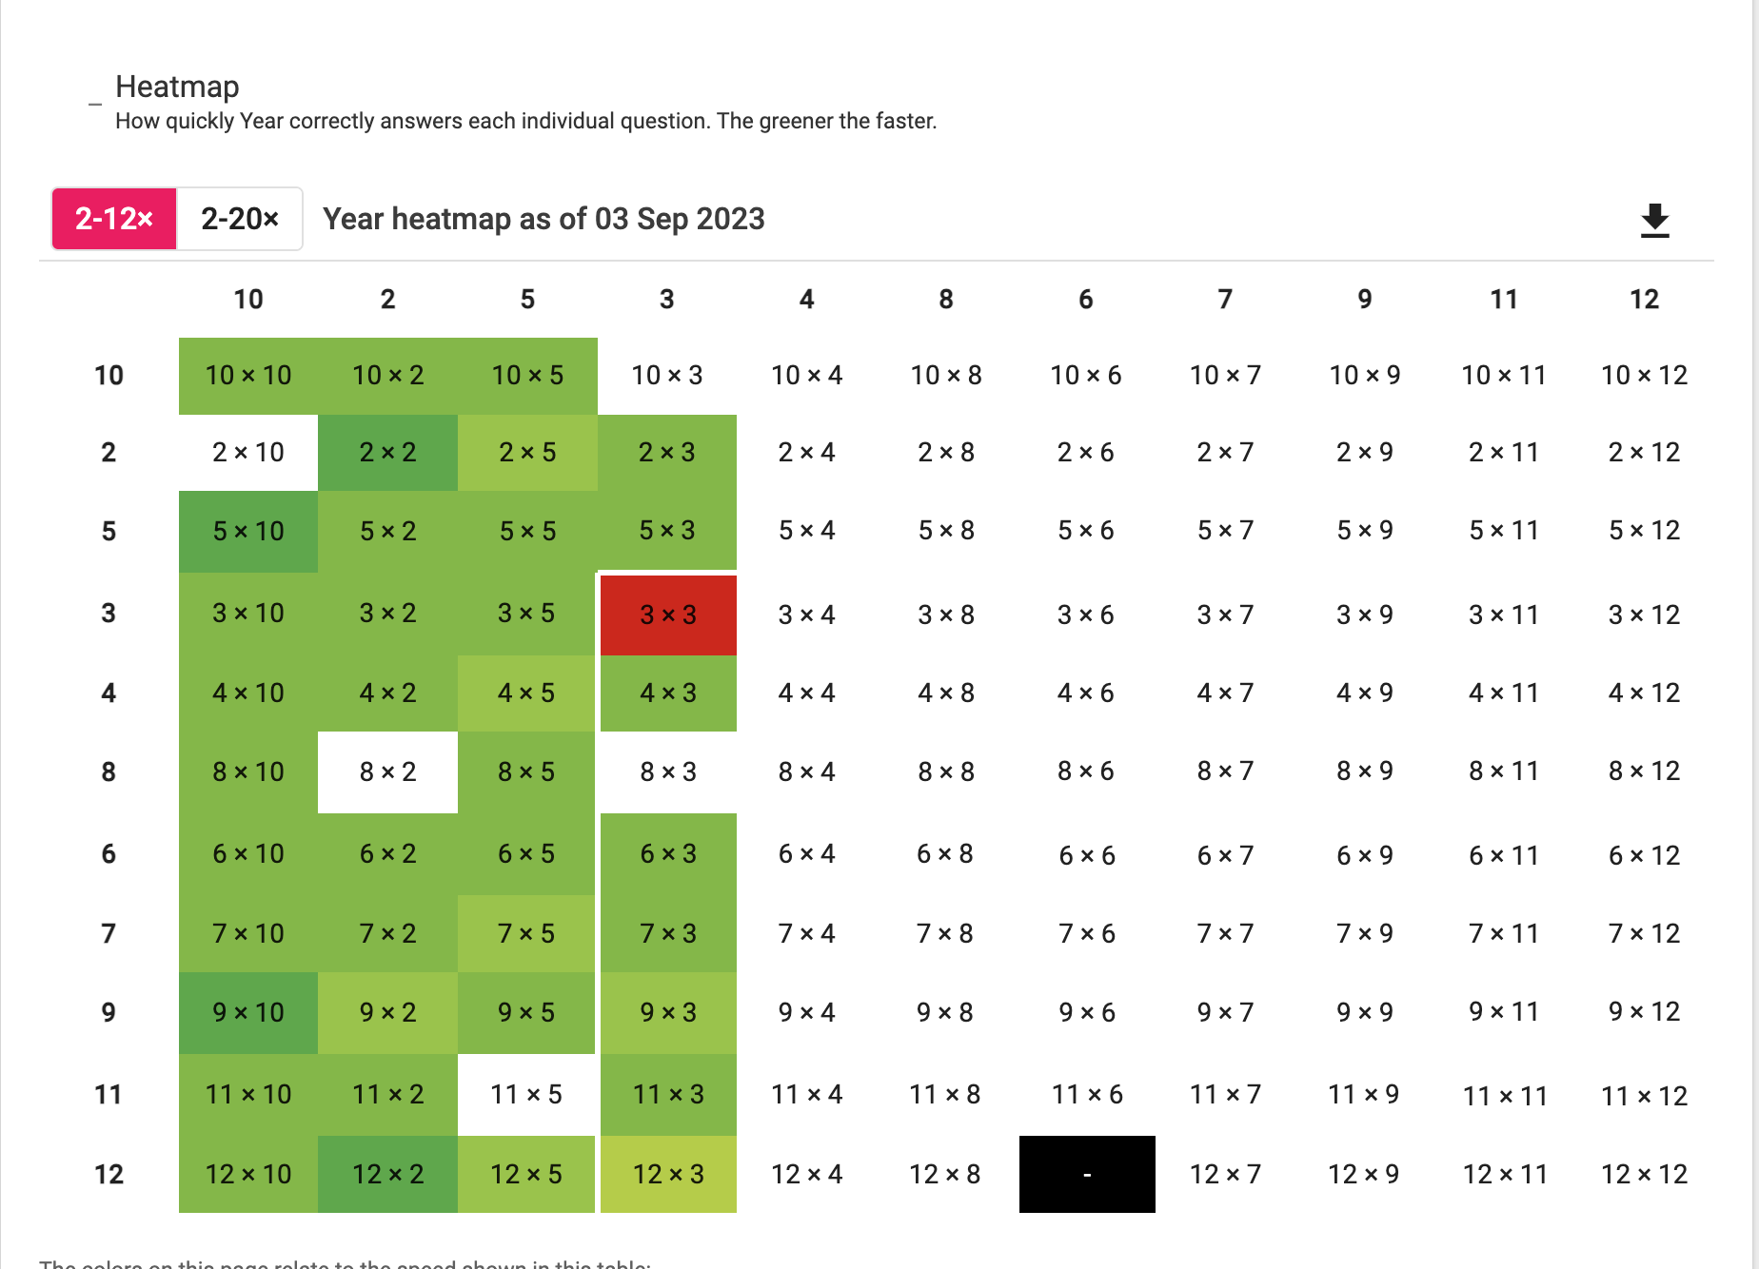
Homework
You can check their progress and attainment by checking their heat maps:
Notes:
Please write comment in reading record book
Responsibitly – children responsible for taking books home – we are reminding them as getting ready to go home

Slide 36
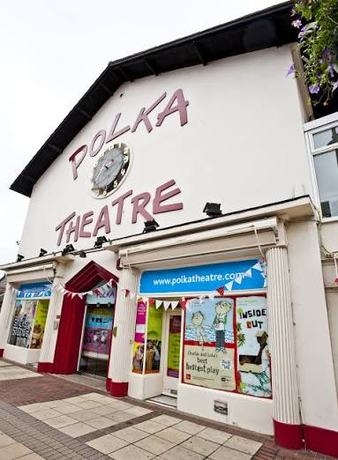
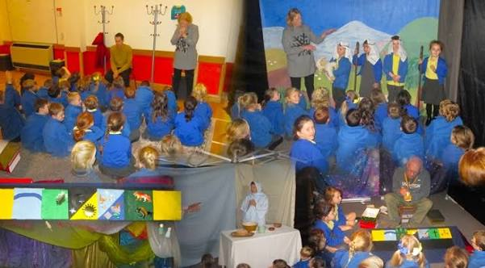

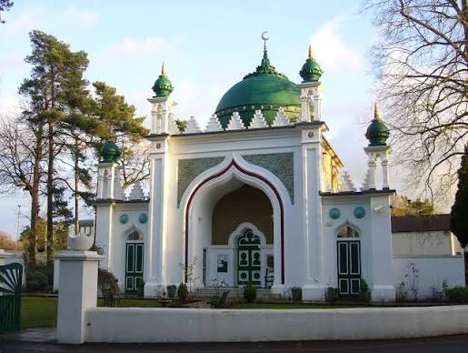
Planned trips
We have the following trips planned this year
British Wildlife Centre: Thursday 3rd September
The Christmas Journey (Sparkfish): Thursday 26th November
Peter Pan at the Polka Theatre: Thursday 21st January
Woking Mosque: Date TBC

Slide 37
Snacks and Water bottles
Fruit
Children in KS1 are given fruit at snack time. However, the fruit varies from day to day and is not always to everyone’s liking so you may wish to send in your own fruit for snack.
Water
Please ensure pupils have a named water bottle with them.
Notes:
In the Upper School, children are not provided with a snack for breaktime.
Please include a healthy snack for the children in their school bags.
We don’t have a water fountain in the Upper School, so all children will need a named water bottle.
There are a few cups if the children forget in the morning.

Slide 38
Uniform
Blue Nutfield Church jumper/cardigan
Nutfield Church Fleece
Yellow Nutfield Church polo shirt
Grey pinafore, skirt or trousers
Blue summer dress
White, Black or Grey socks
Black shoes
Hair bands and clips must be blue or navy
Spare trainers or wellies for all outdoor learning.

Slide 39
Attendance
It is incredibly important for the children to attend school everyday.
We love seeing the children and teaching them everyday!
If they are unwell, telephone the Office to let us know if your child is unwell and will not be attending school.
Pick up and Drop off
Any information can be send either through a note with your child OR email the office.
Please let us know who is picking up your child if it is not you.
If there is a long-standing arrangement, please let the office know through email and us know.
Children need to be dropped off 8.40am– 8.50am and picked up at 3.15pm.
We start our learning at 8.50am.

Slide 40
Contact
Please do contact us if you have any questions either through the office or catch me on the playground at the end of the day.
Do keep up to date with Mrs Farrah-Green’s newsletters,

