Slide 1
WELCOME to Year 3
MRS Fran Newman – Class Teacher
Mrs Constantin - Teaching Assistant
Mrs hope and MRs Constantin (Wednesday PM)

Slide 2

School Values
Community and Peace – Autumn
Wisdom and Dignity - Spring
Hope and Joy - Summer

Slide 3
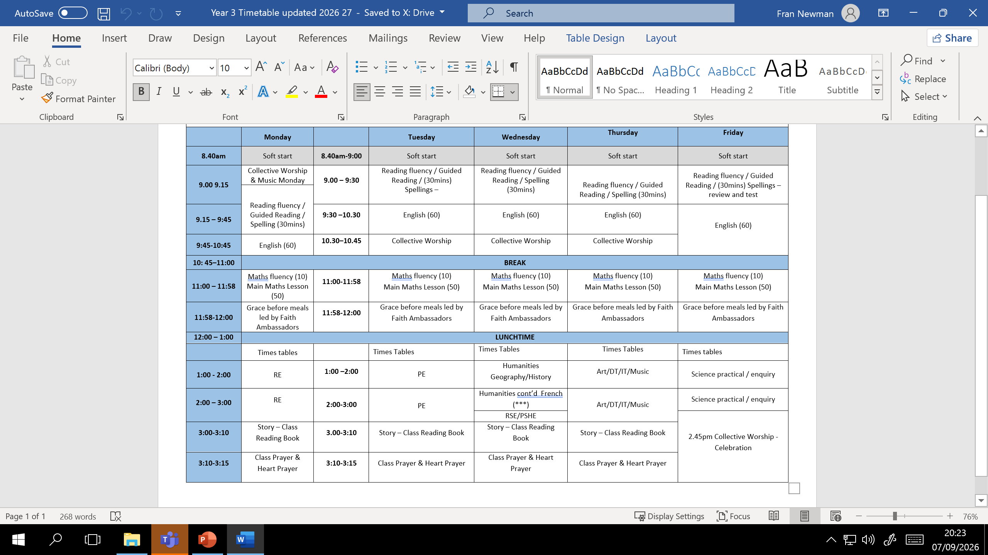

Slide 4
Expectations and communication
Belongings –Named
No Trainers
Shoe Laces!
WEllies
going home with someone different?
Email office
Want to talk?
info@ nutfield.surrey.sch.uk
What’s happening?
pack own bags
reading logs
reading book
Wear PE KIT on Tuesday
Notes:
Take greater responsibility for belongings
Please encourage the children to pack their own bags, remembering their reading logs, reading book and remember that from this year children will come to school in their P.E. kits.
Please let us know if your child is going home with someone different by either emailing the office or sending a note in with your child in the morning.
If you would like to talk to me then please call the office or send an email and I will give you a call – this prevents any long emails and a face-to-face conversation or telephone call is always more time efficient for all.
Do keep up-to-date with Mrs Newman’s newsletters and the my homework letters for information regarding changes in the school day.

Slide 5
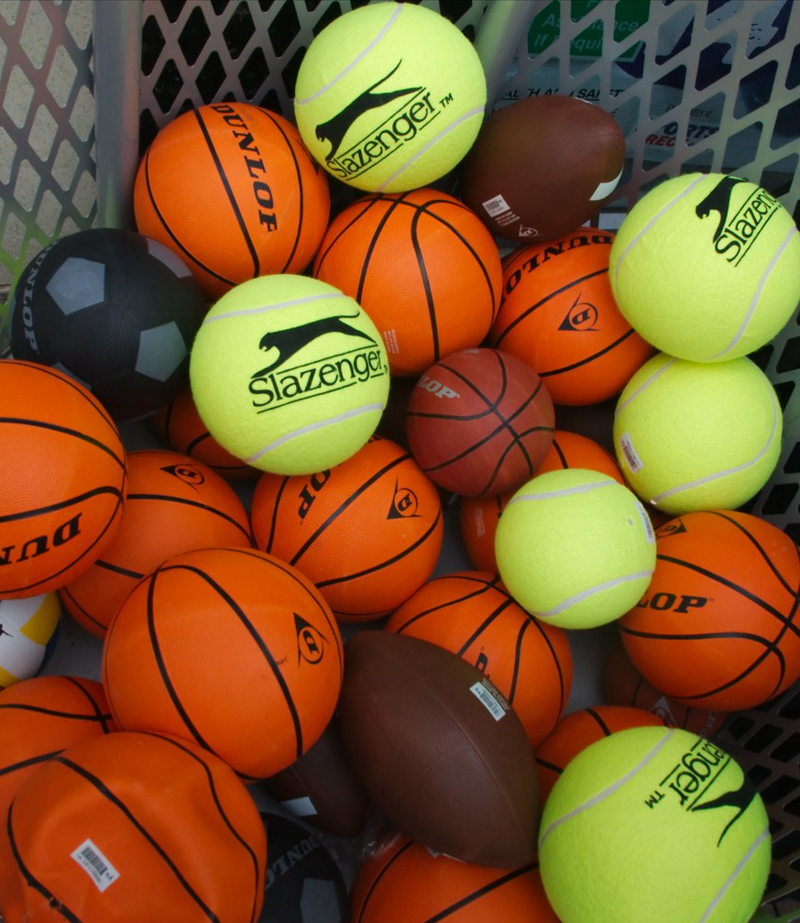
Physical Education
Tuesday is PE day
Children arrive at school wearing PE kit
KIT
Yellow t-shirt with school logo
Blue/black sports shorts
Plimsols or trainers
A school jumper/fleece/cardigan can be worn during the colder months
Blue/black jogging bottoms
On wet days a coat may be worn
This Photo by Unknown Author is licensed under CC BY-SA

Slide 6

Reading
We want our pupils to love reading
15-20 minutes daily
Reading Records
Sign when they read with you
Bring every day in Book Bags
Children learning to complete these themselves)
Children on Oxford Reading Level will work through the book bands
Once children reach the Lime Level, they become an Independent Reader and receive a ‘Golden Sticker of Greatness’ from Mrs Farray-Green
Children are then encouraged to read Lime+ books in school
*Some children will still read frequently with an adult
Read wider at home

Slide 7

English and Grammar
Building upon Year 2…
FOCUS
Identifying different word classes: adjectives, nouns, verbs
Using adverbs effectively
Expanded noun phrases
Subordinating conjunctions
Co-ordinating conjunctions
Different types of sentences: statements, commands, questions and exclamations

Slide 8

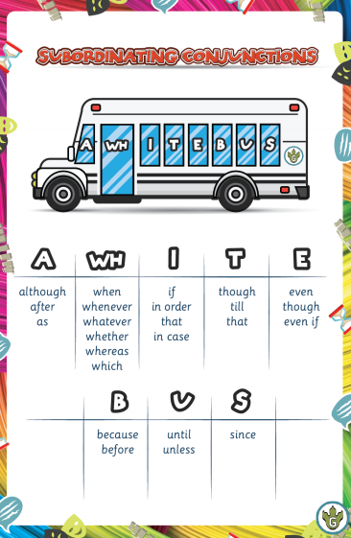
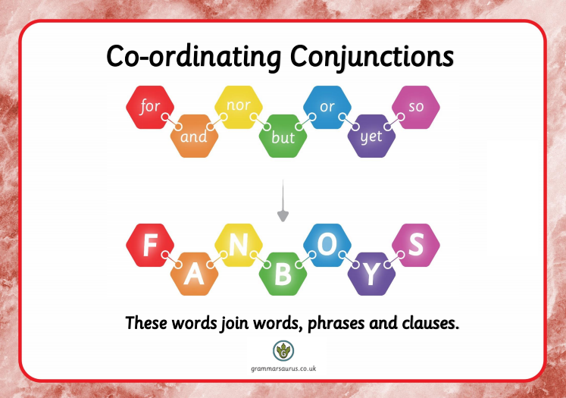
Coordinating and Subordinating conjunctions

Slide 9

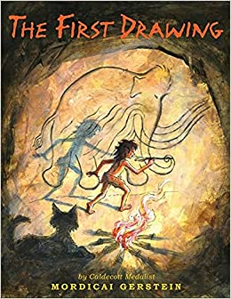
English – Book-led learning
English learning is all book-led
Each half-term a different book will inspire their writing and model language, punctuation, and grammar

Slide 10
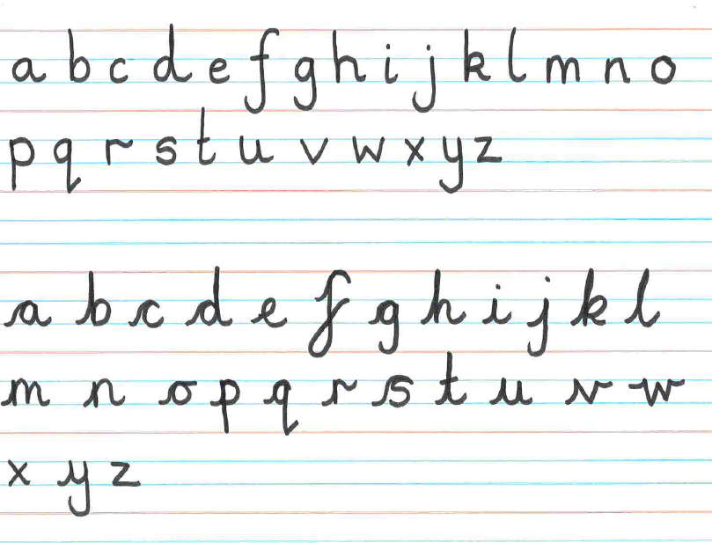
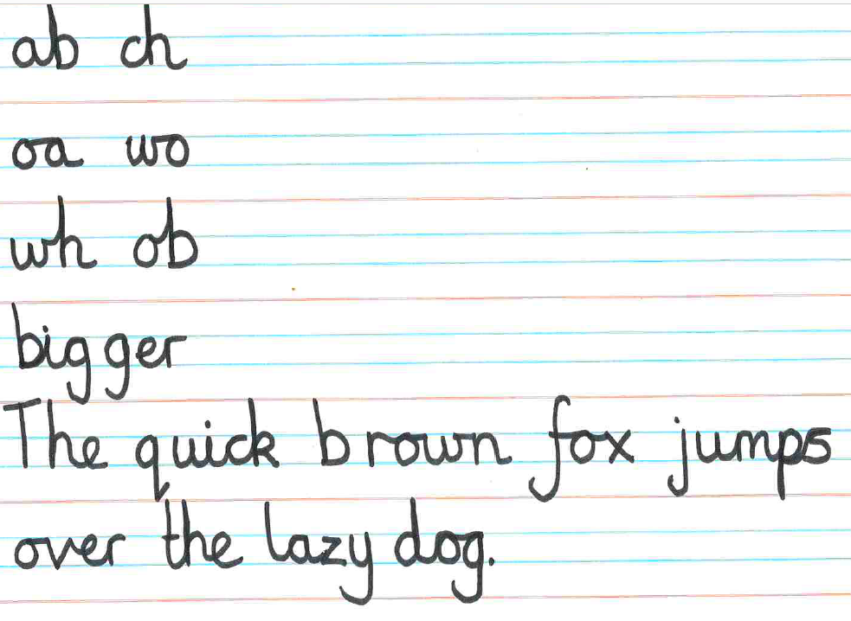
Handwriting
Focus on letter formation, letter lead-ins and lead-outs to ensure that their cursive handwriting is neat and legible
Notes:
Handwriting is a big part of the curriculum and there are daily sessions

Slide 11
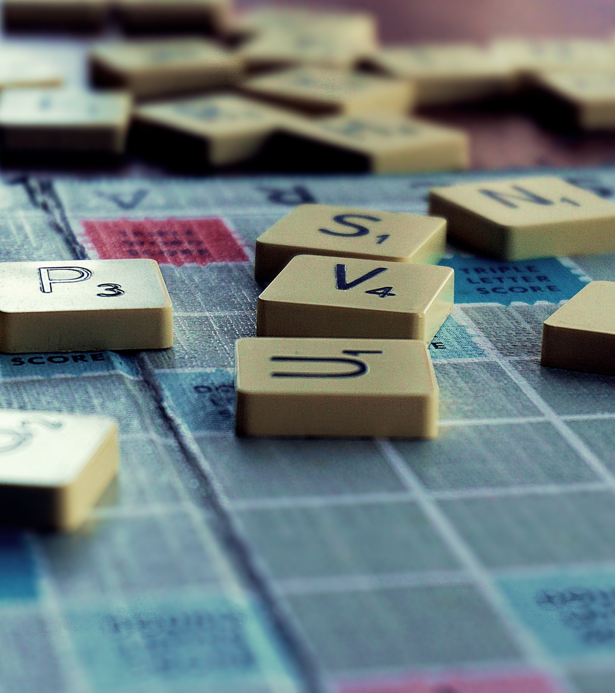
Spelling
We use Purple Mash from Year 1-6
Spellings will be set on PM each week
PM is a fun and interactive way of learning spellings
Test each Friday

Slide 12

Maths
Building on Year 2
This term we focus on place value, addition, subtraction, multiplication and division
*All the methods used are found in the White Rose Calculation Policy which is on the school website

Slide 13


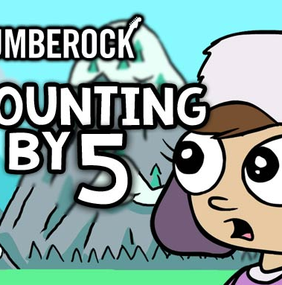

Times tables
Developing Year 2 work with new techniques and methods
By the end of Year 4 → Know all of their times tables to 12 x 12
By the end of Year 3 → Know 2, 3, 4, 5, 8, and 10 times tables
They should be able to use the inverse, E.g. 45 ÷ 5 = ?
Learning through games, songs and raps

Slide 14

Speaking of multiplication
Multiplication is very important for KS2
Goal: memorise tables up to 12 x 12 by the end of Year 4
Rockstars is a fun, interactive, online learning tool
This will all build towards the Year 4 times table check

Slide 15
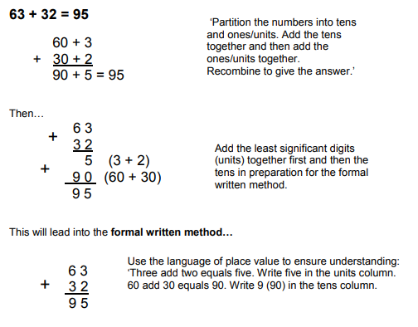
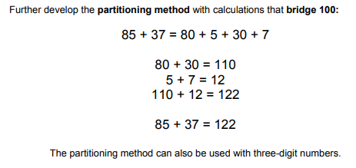
Addition
Starting with a method resembling the one taught in Year 2...
…we then move onto a more formal method

Slide 16
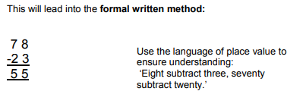
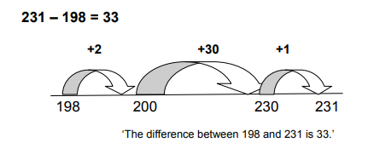
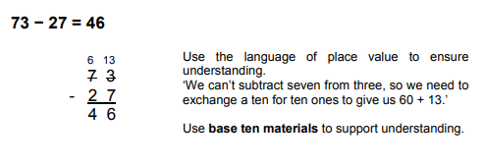
Subtraction
They will then move onto a formal method of subtraction which they will lay out in a column
The children will start by using a number line and jumping in given amount backwards to find the answer
Nearer the end of the year, the children will move onto the column method of subtraction where they will need to carry numbers over
*They should be familiar with this method from Year 2

Slide 17
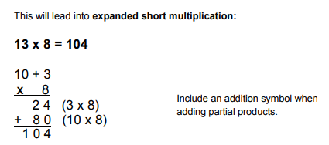
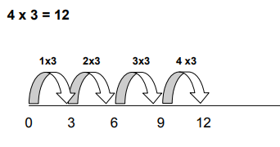
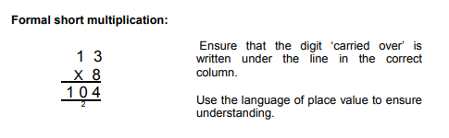
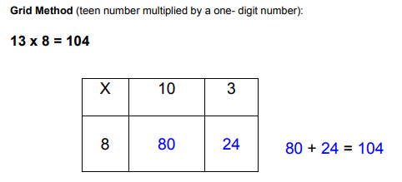
Multiplication
The expanded short method shows each step of the solution to ensure they spot any mistakes
They will start by making simple jumps on a number line. They should be familiar with this from Year 2
The grid method helps children understand the place value involved in multiplying a 2-digit number by a 1-digit number
By the end of the year, the children will be able to confidently use the formal short method of multiplication

Slide 18
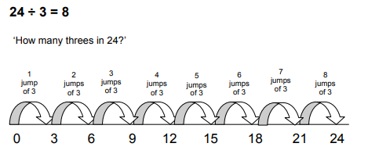
Division
Other methods include:
Sharing/grouping
Using place-value counters
Exchanging a ten for ten ones
The children will start by using a number line and jumping back in groups

Slide 19


Science
Friday afternoons
Largely practical
Term topic: Forces and Magnets
Focus skill: to conduct a fair test
Notes:
Many different experiments
Develop the ability to write a well-thought-through conclusion

Slide 20
Online Safety
We teach children how to stay safe in the online world, through regular Internet Safety lessons, using a mixture of age-appropriate videos and activities
Staying safe online straddles school and home, so we encourage parent, family and wider school community involvement in our efforts to inform children about the digital world
More information: https://nutfieldchurchprimary.co.uk/online-safety

Slide 21
Online SafetY
We have a filtering and monitoring system which blocks inappropriate key words and searches
An inappropriate search will trigger an email to Miss Paulino who will investigate
Online Safety is taught in all year groups through the Science, Computing and Design and Technology curriculum
KS1 use Purple Mash’s Online Safety scheme
KS2 use Google’s ‘Interland and Be Internet Kind’ schemes

Slide 22

Art, DT, IT, Music
6 skills
painting, collage, sculpture, textiles, drawing and printing
Art
Artist of the term= Kandinsky
French
Say name
Ask/answer: How old are you?
Greetings
Numbers 1-12
Music
Listen, appraise, recognise instruments, styles, ﬁnd the pulse
IT
Use Google – research and interpret results.
Purple Mash to publish writing

Slide 23

Wellbeing
PE (Tuesday afternoons)
PSHE: British Values, friendships, emotions and anti-bullying
Wellbeing+: Local animals focus on birds & hedgehogs

Slide 24

Emotional Literacy Programme - NCPS
1. EXPRESSING EMOTIONS
Students can share how they are feeling using the visual the ‘feelings thermometer’.
2. Emotion Vocabulary Building
Introduced to new emotion words each week and discuss their meanings and expressions.
3. Mindfulness Activities
Each day there will be short mindfulness exercises like deep breathing or guided imagery to help children manage stress and anxiety.
4. Calming Down Strategies
Children will be taught specific techniques for calming down when they are feeling overwhelmed, such as counting to ten or taking a break. The class has a calm corner. Visual timetable-daily routines are embedded.

Slide 25

Religious education
Monday afternoons
Our topic this half term is Christianity
What is the Bible?
Where do the stories we know fit?
Why is the bible important?
How does the bible change the way Christians live?

Slide 26

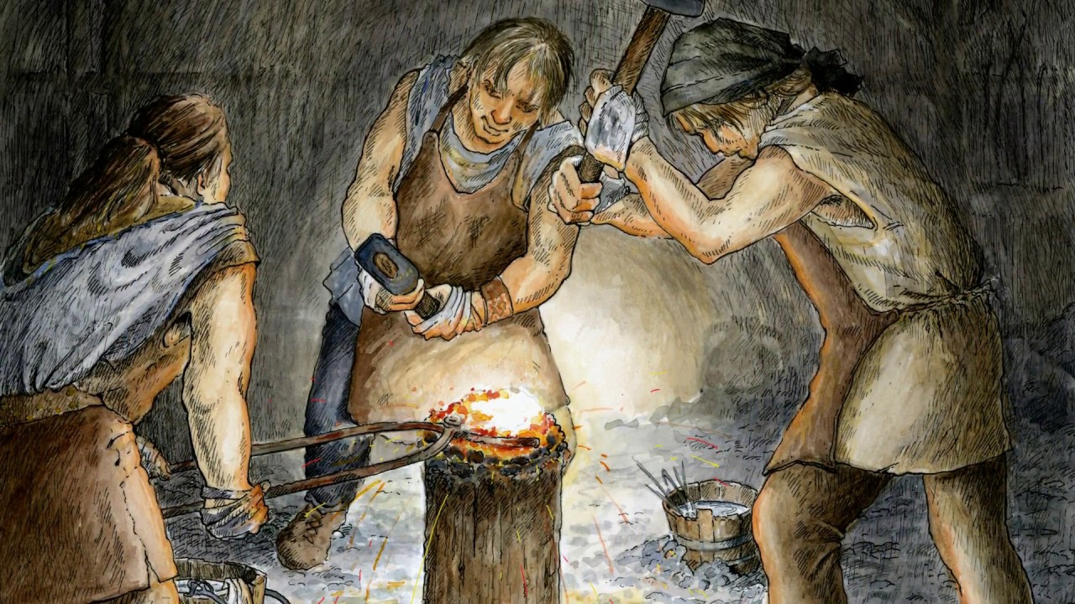
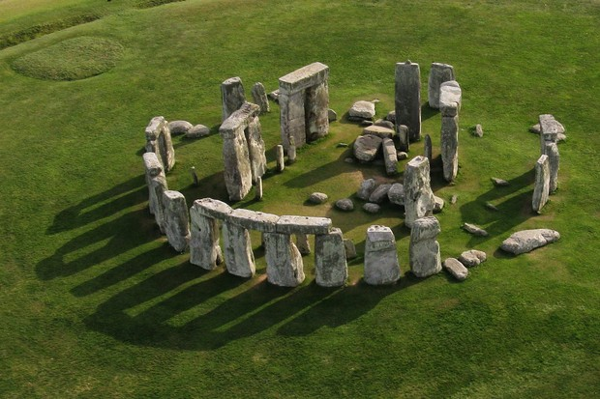
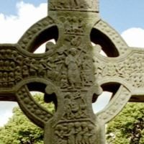
History

Slide 27


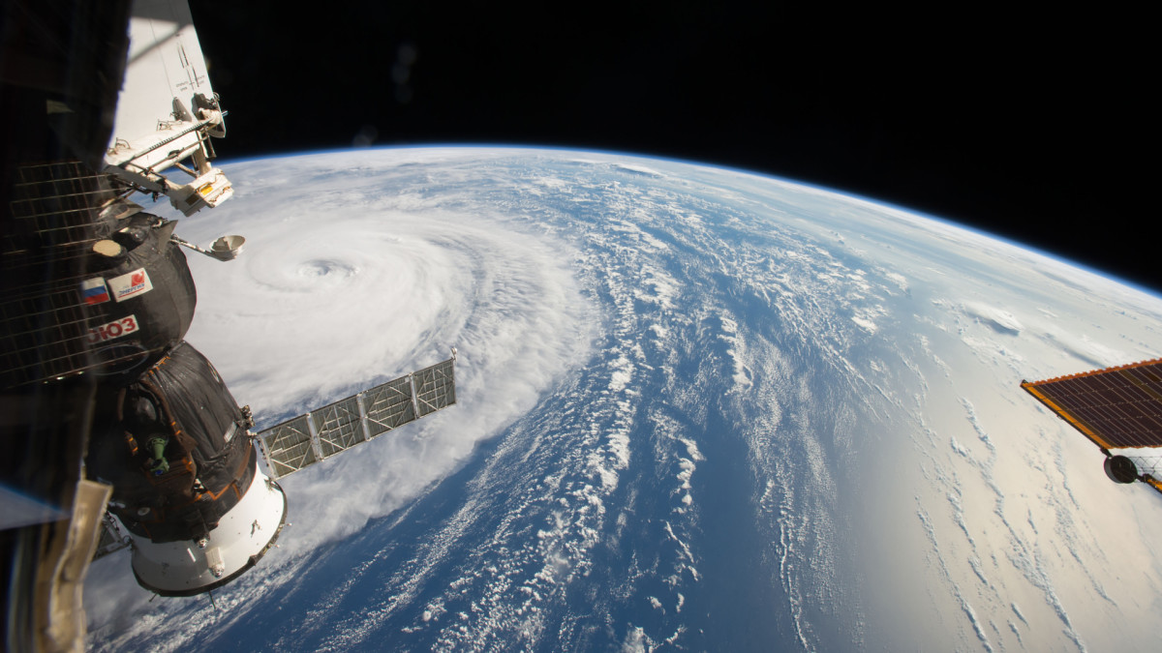
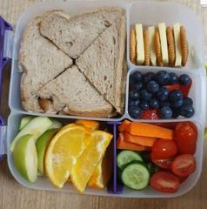
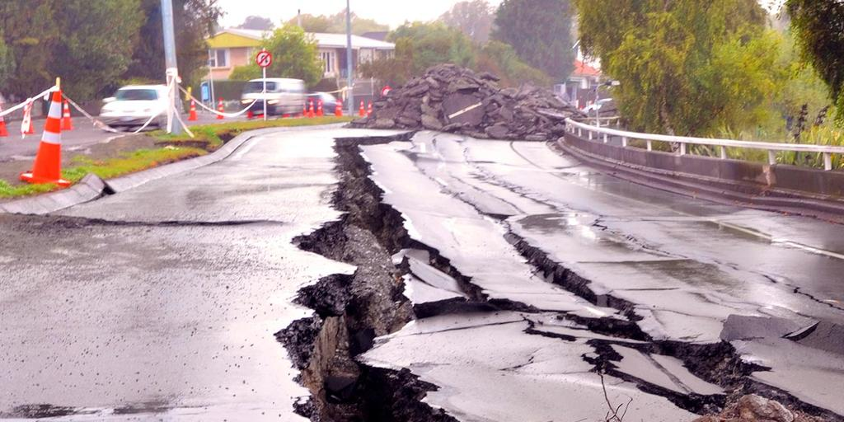
Geography

Slide 28
Snacks and water bottles
Snacks no longer provided in KS2
Please provide a snack for morning break. (Fruit and vegetables preferably)
We are a ‘Nut Free’ School. (If you have a packed lunch, please check the labels)
All children will need a named water bottle. (These are kept in the classroom during lesson times)

Slide 29
Fidget TOYS
Please- no fidget toys, games or blue tac unless pre-arranged with the school.

Slide 30
Attendance
It is incredibly important for the children to attend school every day
01
We love seeing the children and teaching them every day
02
If they are unwell and unable to attend school, please telephone the office
03

Slide 31
Homework
Friday Homework Letter
this will now be online along with other important information
Homework includes
Reading, TTRS practice, spellings practice (Purple Mash) and My Maths
Weekly spelling test
Noted in the Reading Record

Slide 32

ANY questions?

