Slide 1
Staff
Welcome to Year 4!
Monday & Tuesday – Miss Mitchell
Wednesday – Friday – Mrs Boyle
Miss Oastler: Teaching/Special Needs Assistant

Slide 2
School Values
Community and Peace – Autumn
Wisdom and Hope - Spring
Dignity and Joy - Summer

Slide 3
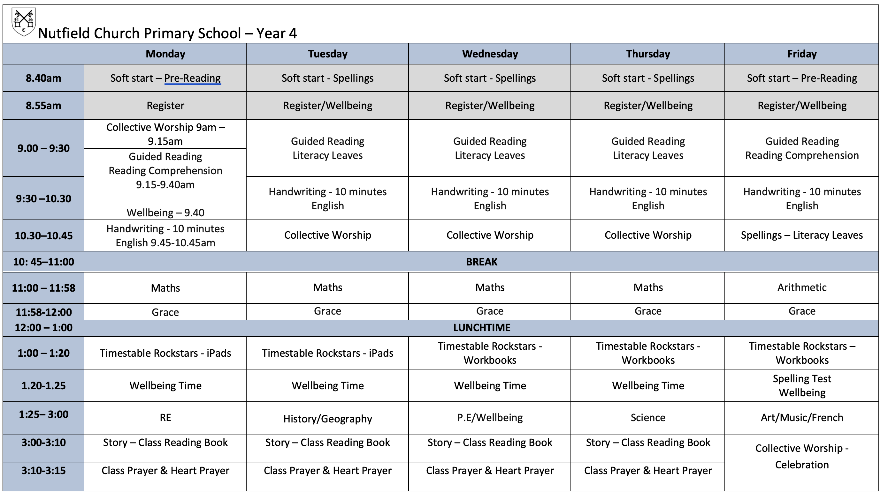
Our Timetable

Slide 4
Whole school changes for the children this year:
We will no longer be using labels in the children's books. They will need to write out the date and the Learning Objective at the start of each lesson. This is to ensure they can correctly identify what they are learning about and also spell each day and month correctly.
We will be starting every week with a Collective Worship at 9am. This is so the children and staff can start the week together. Our Celebration Worship is now on a Friday at 3pm.
Handwriting is now built into our English lesson.
Notes:
Our English lessons will centre around a variety of high quality texts, which will enable the children to explore a vast range of genres and concepts. We study a different book every half term.
I must stress that you don’t go and buy or read the books once it is revealed what they are – the scheme of work revolves around mystery and as a class we work through the book to enable the children to be creative as possible. For example, until Monday, we had only read 1 paragraph of The Pied Piper.
In addition to reading and writing, English will be taught through a range of different medias (drama, art and role play). There will be many an opportunity for the children to perform! The picture is of the children being told their was a rat running under their feet.
In addition, there will also be a focus on grammar and punctuation and applying this to reading and writing, this will be done during English lessons and through Guided Reading sessions.

Slide 5

English
Every half term we read a different book and base our writing on this text. This term we are starting with Varmints – a fantastic book and film.
This year we are studying a variety of different books that explore different concepts and genre.
Grammar and punctuation focus in both reading and writing.
Lots of drama, role play and art.
Notes:
Our English lessons will centre around a variety of high quality texts, which will enable the children to explore a vast range of genres and concepts. We study a different book every half term.
I must stress that you don’t go and buy or read the books once it is revealed what they are – the scheme of work revolves around mystery and as a class we work through the book to enable the children to be creative as possible. For example, until Monday, we had only read 1 paragraph of The Pied Piper.
In addition to reading and writing, English will be taught through a range of different medias (drama, art and role play). There will be many an opportunity for the children to perform! The picture is of the children being told their was a rat running under their feet.
In addition, there will also be a focus on grammar and punctuation and applying this to reading and writing, this will be done during English lessons and through Guided Reading sessions.

Slide 6

Reading
It is important to read with your child or have your child read every night. It is not important what the children are reading, as long as they are reading!
Ensure the children are using their Reading Records. We do have a reward system in place for it – a team point per day and if they read Monday-Friday they get 10!
We will be doing a combination of whole class reading a set book or text – these will be on a Tuesday, Wednesday and Thursday.
On a Monday and Friday we will be focusing on building the children's independent reading comprehension skills and answering different types of questions.
This term, we will be reading ‘Zombierella’. If you have a copy, it would be useful to have it in school.
Notes:
Our English lessons will centre around a variety of high quality texts, which will enable the children to explore a vast range of genres and concepts. We study a different book every half term.
I must stress that you don’t go and buy or read the books once it is revealed what they are – the scheme of work revolves around mystery and as a class we work through the book to enable the children to be creative as possible. For example, until Monday, we had only read 1 paragraph of The Pied Piper.
In addition to reading and writing, English will be taught through a range of different medias (drama, art and role play). There will be many an opportunity for the children to perform! The picture is of the children being told their was a rat running under their feet.
In addition, there will also be a focus on grammar and punctuation and applying this to reading and writing, this will be done during English lessons and through Guided Reading sessions.

Slide 7



Spelling and Handwriting
Spelling and Handwriting are a huge whole school focus this year.
We will be having weekly spelling homework and spelling tests as usual.
It is important for the children to be able to spell fluently for writing activities during all lessons.
We will be focussing on the Year 3 and 4 spellings as our ‘Soft start’ first thing in the morning and will be having one weekly spelling session.
Handwriting is now for the first 8-10 minutes of every English lesson and is done in the same books on the same page as our English writing work.
Use the diagonal and horizontal strokes that are needed to join letters and increase the legibility, consistency and quality of their handwriting. Handwriting practice every day this term.
We will be having a ‘Best Presenter’ and ‘Most Improved Presenter’ every week.
Notes:
This term, our focus will be improving our confidence with spelling and using a wider range of vocabulary to ensure that our writing is the best it can be!
Every week, a set of spellings will be sent home and tested on a Friday
These spellings with either be from the 200 high frequency words, words from the Year3/4 curriculum or words that we are using during our topics.
The Year3/4 curriculum list all contain words the children need to be able to spell by the end of Y4, so do not worry too much if the children are struggling with these, there are 2 years for them to learn – but its nice to get a head start.
More importantly though is the childrens ability to spell these words during writing activities and especially when it comes to being fluent in writing.
We are also having a big push on handwriting this year. By the end of the year the children need to be using horizontal and diagonal strokes to join letters, we are having handwriting practise in our guided reading sesions and 2/3 times during the week.

Slide 8
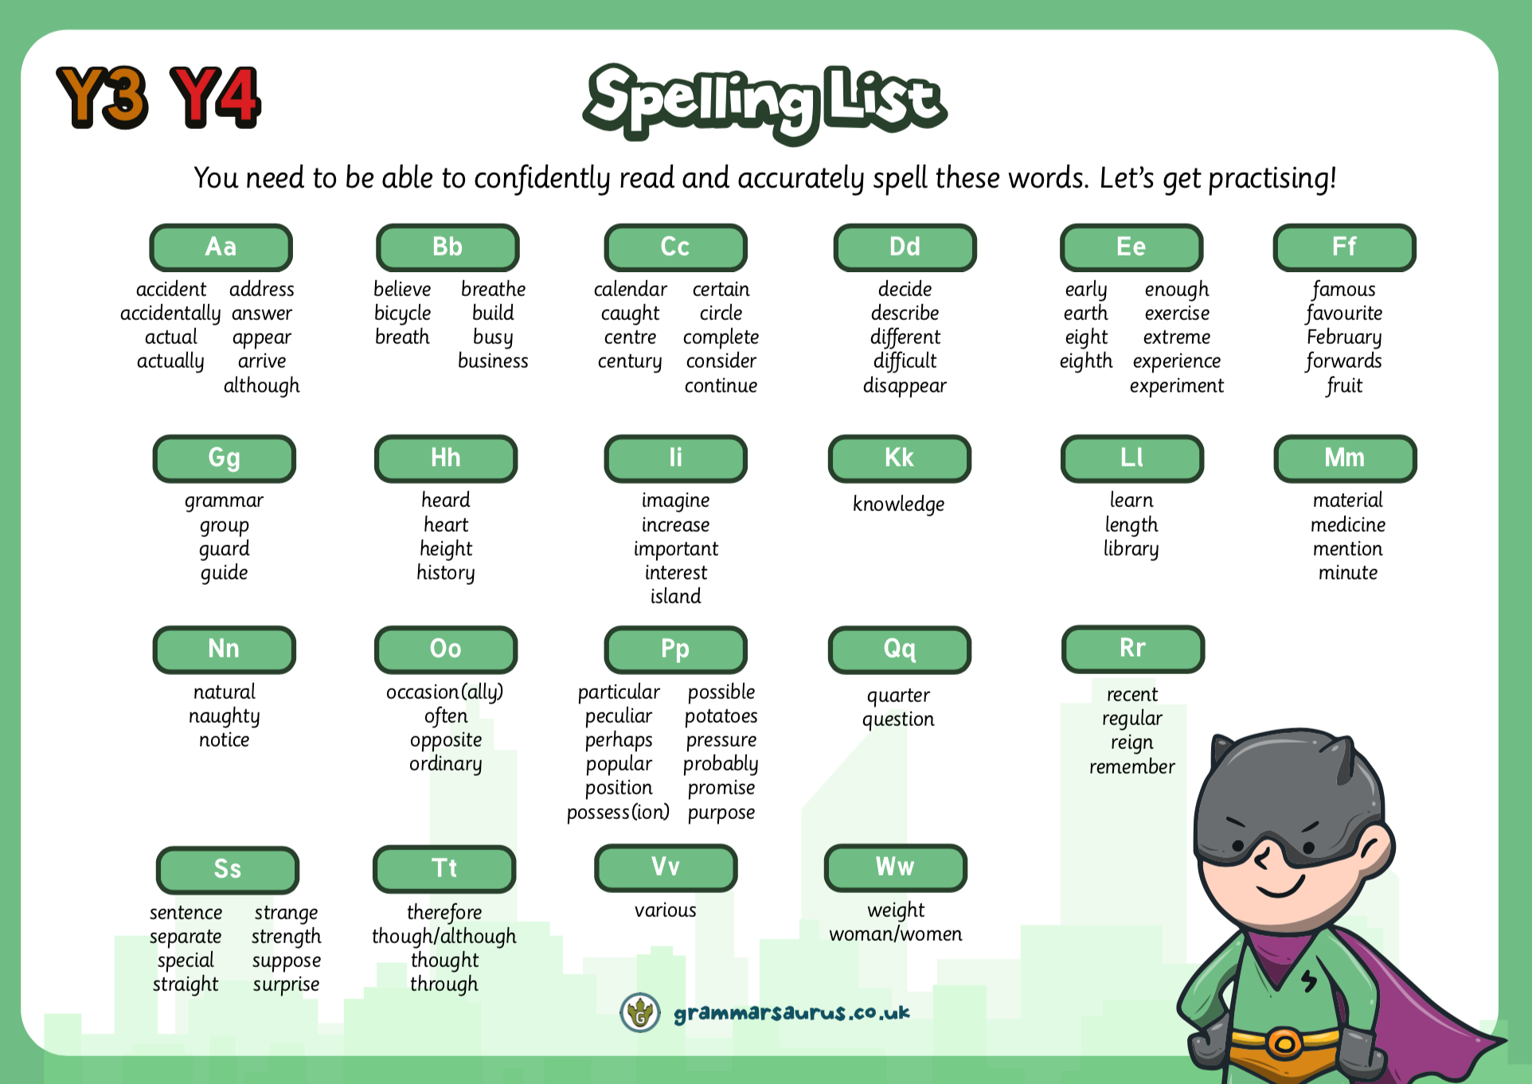
Reading
Daily Guided Reading sessions.
Children will all read with Mr Cook once a week
It is important for the children to read for 20 minutes daily at home.
It is not important what the children are reading, as long as they are reading!
Notes:
In the Upper school, we have daily guided reading sessions.
Carousel. Children to work with me on GR. LW on independent reading. Handwriting and a follow up – using the info from sessions with me and creating their own version or response. Children MUST have their reading log in school everyday.
All children are expected to read regularly at home and we ask that yellow reading diaries live in book bags so they can be accessed at school and at home.
In Year 3, it is expected that the children write their own comments on what they have read, and please do ensure these are signed regularly by you. These will be checked weekly.
It might be they are reading a magazine, comic, fiction, non-ficiton, the news. ANYTHING.

Slide 9
Maths
This term we are covering:
  Place Value of numbers up to 10,000.
  Adding and subtracting numbers up to 10,000.
  Times tables – ALL Times Tables
    Practise at home.
  Multiplying and dividing
  Fractions
  We will also be focusing on applying the knowledge and methods taught during maths lessons, using word problems, challenges and setting up role plays.
Throughout the year we will be looking at
  Fractions
  Shape
  Statistics
  Measure
Our calculation policy ensure the children are taught different methods, leading to a secure understanding of the formal written method.
Please refer to the White Rose policy for extra help during homework.
If you have any questions please don’t hesitate to speak to us.
Notes:
We will start the term by extending our knowledge and recapping place value and our number bonds. Understanding place value – the value of each digit in a number.
These are a key mathematical skill and plays an extremely important role in helping the children to understand and progress in other areas of number.
We will also be focusing on adding and subtracting numbers up to 200 mentally and using the inverse to check our answers.
Through the year, the children will continue to recap their 2, 5 and 10 times tables and will begin to learn their 3, 4 and 8 times tables. Please practise these at home. A multiplication grid will be stuck into the children’s homework books for their use.
New curriculum means there is a focus on applying the knowledge and methods taught during maths lessons, using word problems, challenges and setting up role plays; the children will be able to apply their learning to real life examples and explain how they know an answer is correct.
Fractions – looking at fractions are part of a number, adding and subtracting fractions and ordering fractions.

Slide 10
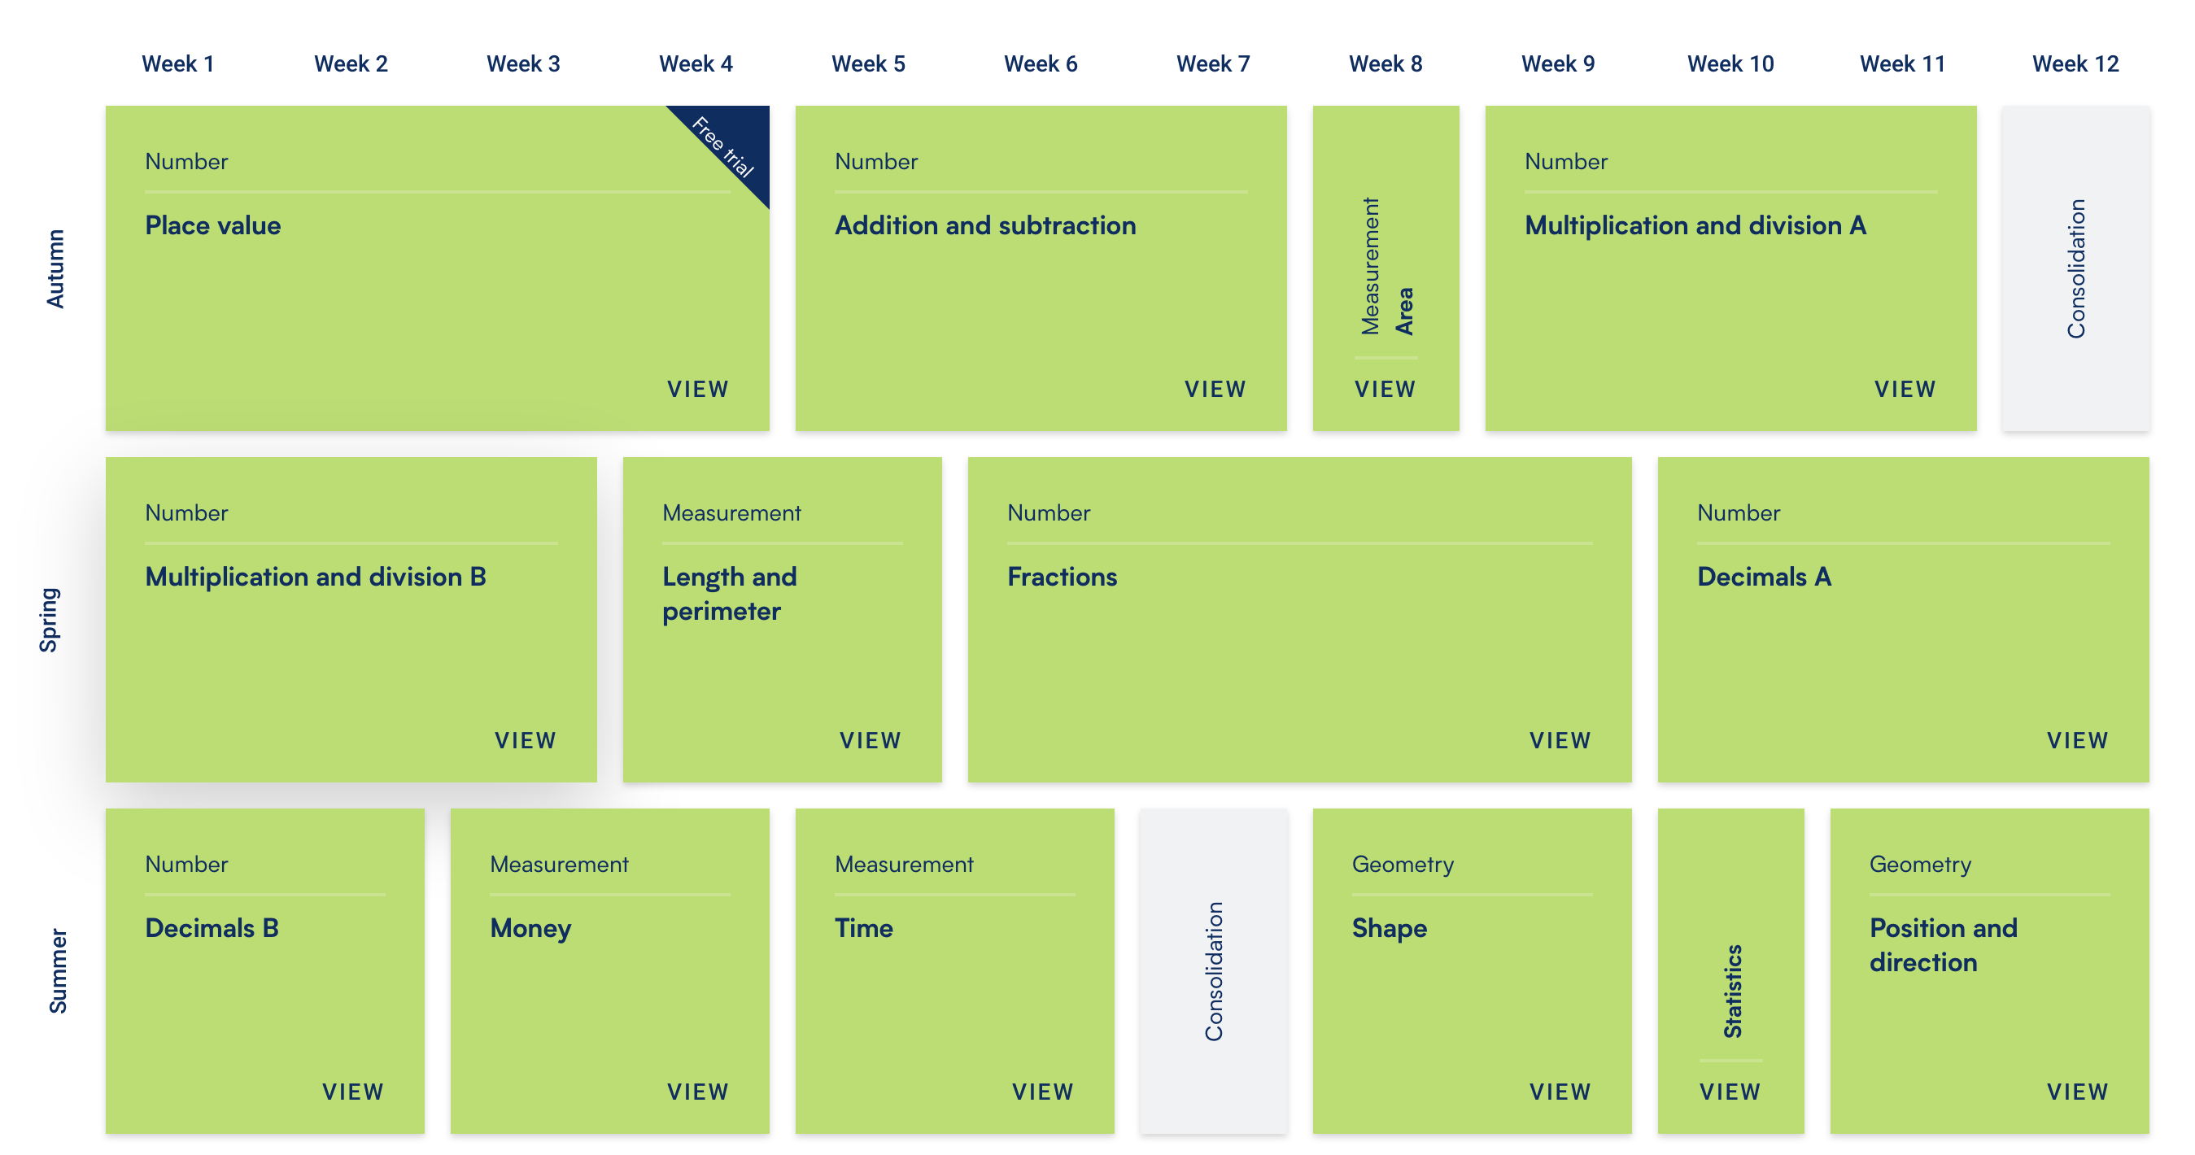
Notes:
We will start the term by extending our knowledge and recapping place value and our number bonds. Understanding place value – the value of each digit in a number.
These are a key mathematical skill and plays an extremely important role in helping the children to understand and progress in other areas of number.
We will also be focusing on adding and subtracting numbers up to 200 mentally and using the inverse to check our answers.
Through the year, the children will continue to recap their 2, 5 and 10 times tables and will begin to learn their 3, 4 and 8 times tables. Please practise these at home. A multiplication grid will be stuck into the children’s homework books for their use.
New curriculum means there is a focus on applying the knowledge and methods taught during maths lessons, using word problems, challenges and setting up role plays; the children will be able to apply their learning to real life examples and explain how they know an answer is correct.
Fractions – looking at fractions are part of a number, adding and subtracting fractions and ordering fractions.

Slide 11
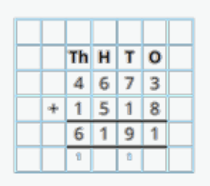
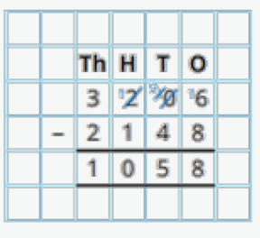
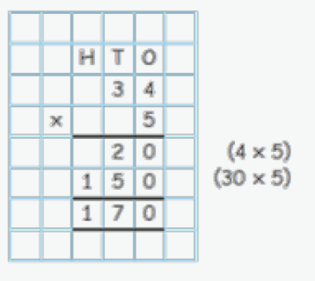
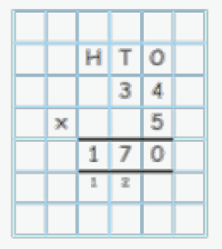
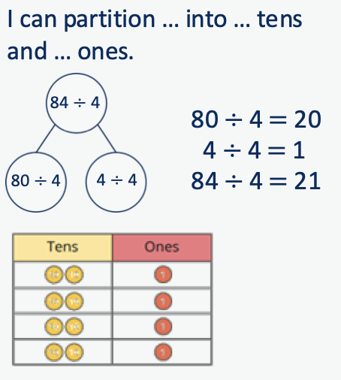
The calculation policy shows you all the ways we learn to add, subtract multiply and divide.
These are the formal ways that the children will learn ready for Year 5.
Notes:
We will start the term by extending our knowledge and recapping place value and our number bonds. Understanding place value – the value of each digit in a number.
These are a key mathematical skill and plays an extremely important role in helping the children to understand and progress in other areas of number.
We will also be focusing on adding and subtracting numbers up to 200 mentally and using the inverse to check our answers.
Through the year, the children will continue to recap their 2, 5 and 10 times tables and will begin to learn their 3, 4 and 8 times tables. Please practise these at home. A multiplication grid will be stuck into the children’s homework books for their use.
New curriculum means there is a focus on applying the knowledge and methods taught during maths lessons, using word problems, challenges and setting up role plays; the children will be able to apply their learning to real life examples and explain how they know an answer is correct.
Fractions – looking at fractions are part of a number, adding and subtracting fractions and ordering fractions.

Slide 12
Year 4 Multiplication Check
As you might be aware, there is the mandatory Year 4 Multiplication check this school year (June). This check helps the children be ready for Year 5 and 6 by ensuring they learn their Times Tables.
To prepare the children for this, we are going to be:
  Having twice weekly practice (as much as possible) on the iPads to practice the skills needed.
    Beat the Teacher on TTRS (historic firm favourite)
    Class competitions in our sessions.
  3 times a week daily practice in TTRS booklets.
    Completing the checks and uploading their data to track progress.
  Using Times Table Rock Stars for homework – do ensure you are practicing at home. TTRS says a daily 3 minute game is all that is needed to ensure the children become confident and fluent.
  TTRS certificates for leveling up and and going up Rock Status’
  TTRS champion – the champion is based on the time the children put into TTRS at home.
  A future meeting has been scheduled to ensure you have the full information closer to the time.
Notes:
We will start the term by extending our knowledge and recapping place value and our number bonds. Understanding place value – the value of each digit in a number.
These are a key mathematical skill and plays an extremely important role in helping the children to understand and progress in other areas of number.
We will also be focusing on adding and subtracting numbers up to 200 mentally and using the inverse to check our answers.
Through the year, the children will continue to recap their 2, 5 and 10 times tables and will begin to learn their 3, 4 and 8 times tables. Please practise these at home. A multiplication grid will be stuck into the children’s homework books for their use.
New curriculum means there is a focus on applying the knowledge and methods taught during maths lessons, using word problems, challenges and setting up role plays; the children will be able to apply their learning to real life examples and explain how they know an answer is correct.
Fractions – looking at fractions are part of a number, adding and subtracting fractions and ordering fractions.

Slide 13
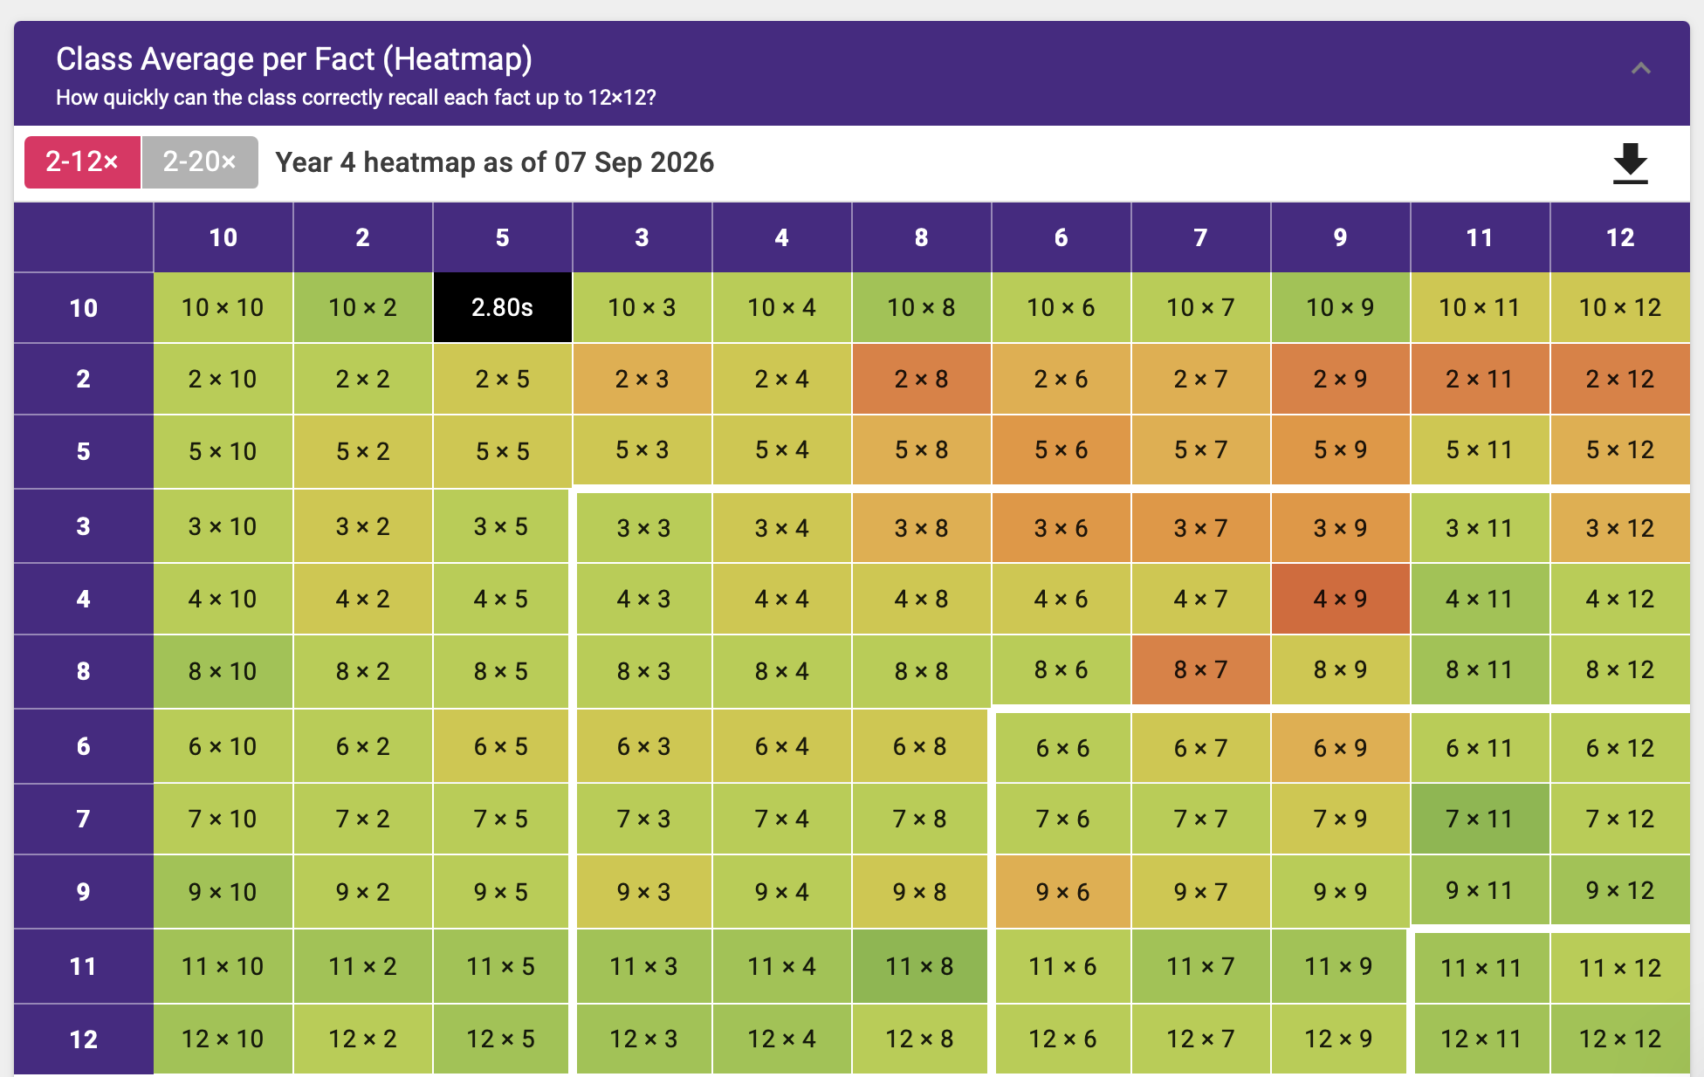
Year 4 Multiplication Check - TTRS
We will be completing the Gig in school during our TTRS sessions as close to the 1st of each month. We completed September yesterday.
The children will also be doing their Studio session during this time.
They will receive a Rock Status certificates when they move up a Rock Status – this links to their Studio session.
There are also certificates for ‘Going Green’ on their heat map.
Notes:
We will start the term by extending our knowledge and recapping place value and our number bonds. Understanding place value – the value of each digit in a number.
These are a key mathematical skill and plays an extremely important role in helping the children to understand and progress in other areas of number.
We will also be focusing on adding and subtracting numbers up to 200 mentally and using the inverse to check our answers.
Through the year, the children will continue to recap their 2, 5 and 10 times tables and will begin to learn their 3, 4 and 8 times tables. Please practise these at home. A multiplication grid will be stuck into the children’s homework books for their use.
New curriculum means there is a focus on applying the knowledge and methods taught during maths lessons, using word problems, challenges and setting up role plays; the children will be able to apply their learning to real life examples and explain how they know an answer is correct.
Fractions – looking at fractions are part of a number, adding and subtracting fractions and ordering fractions.

Slide 14
RE
On a Monday for the whole school. Each half a term is a different topic:
  What makes an old testament Hero?
  Non- religious world views. (Agnostic/ Atheism)
  What does the journey through advent mean?
  What do Sikhs believe?
  What would Jesus do?
  How does Holy Communion build a community?
  How does faith guide people to try and make the world a fairer place?

Slide 15
Wellbeing PE
We encourage our children to listen and respond with thoughtfulness and respect.
These wellbeing lessons will also include PSHE, Friendships, PE and The British Values. They are taught through Jigsaw.
Our PE day is Wednesday and is taught by Mrs Boyle.
The children must come to school in their full PE kit on Wednesday.
Sports included in our curriculum are: cross country, tag rugby, quick sticks, dodge ball, netball, basketball, tennis cricket, rounders, athletics.
We aim to get the children outside in all weathers as much as possible during PE. So do ensure they are dressed appropriately for the weather.
Notes:
Through RE lessons, we will continue to teach Philosophy for Children to facilitate critical and deeper thinking and provide opportunities for children to practise these skills across the curriculum.

Slide 16

PE Kit
If your child is selected to go on a tournament they will be asked to wear the Nutfield Sports Kit.
This must be washed and returned as soon as possible to ensure the next children have a chance of wearing it.
No visible logos – please do not wear any branded items for PE with visible logos.
Earrings (studs only)
Hair tied back for PE
Navy blue shorts (cotton or nylon) or joggers
Yellow t-shirts
White, black or blue socks
Black or blue trainers
Notes:
Navy/blue tracksuit bottoms - important for the winter months
Trainers – not plimpsoles for outdoor PE
Spare socks – girls will not be allowed to do PE in their tights
Earrings – please encourage the girls to learn to take their earrings out on their own as much as possible, we advise that children do not do PE in their earrings, although we know this isnt always possible.
If anyone has any spare or old PE that they don’t need anymore, could they please bring it in to have as a class spare.

Slide 17
Science
Science, Computing and D&T are continuing to be taught together.
Mrs Boyle will teach Science weekly.
Computing will still be used for different subjects.
Our Science topics are:
  Sound, State of Matter, Living Things, Animals Including Humans and Electricity
Notes:
Animals inc - children have designed a character who doesn’t eat – but gets their energy and food from other sources.

Slide 18
Computing
Computing this year will be taught primarily through Science. However, there will be opportunities to use Computing throughout the curriculum.
Children will be able to use Purple Mash throughout the year for homework and in lessons.
Passwords for Purple Mash and MyMaths have not changed – all this information will be sent home in the children's Reading Records. They also have this in class in their trays.
We will focus on:
  Internet and E-Saftey
  Typing
  Adding images to Word, Powerpoint and Publisher documents

Slide 19
Design and Technology
Topics include:
  Cooking
  Electrical systems – electicity unit of Science
  Innovative design – Art – Picasso

Slide 20
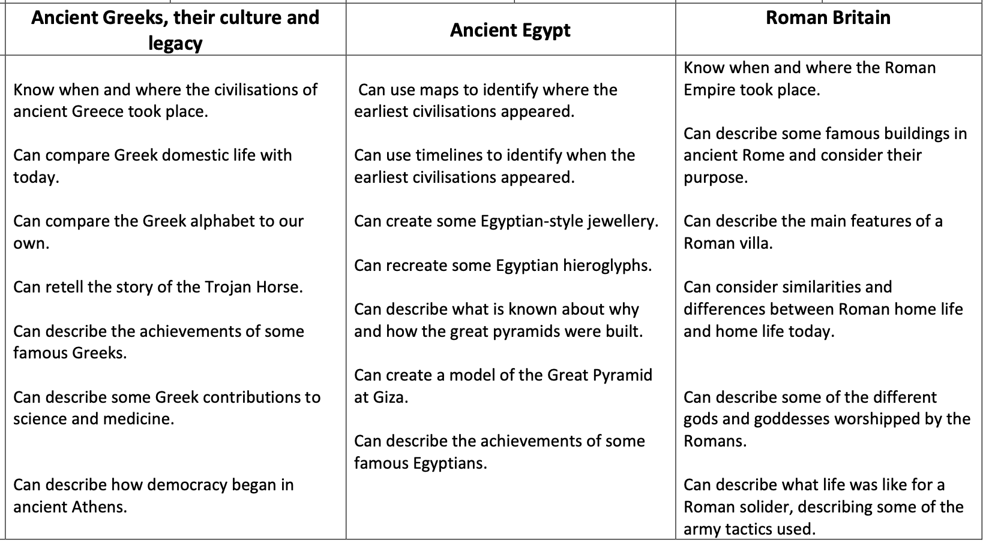
History
We will be teaching alternating between History and Geography each half term. We are starting with History and the Ancient Greeks.
Notes:
If you have any special knowledge or expertise in any of these topics, please feel free to let me know!
They will also be learning about the discovery of Tutankhamun, creating their own version of his Death Mask and will learn to write sentences in Hieroglyphics.
In the next few weeks the children will be bringing home their own mummified apple, which we have started to mummify using similar techniques to the Egyptians. We will also be making bread using an Ancient Egyptian recipe.

Slide 21
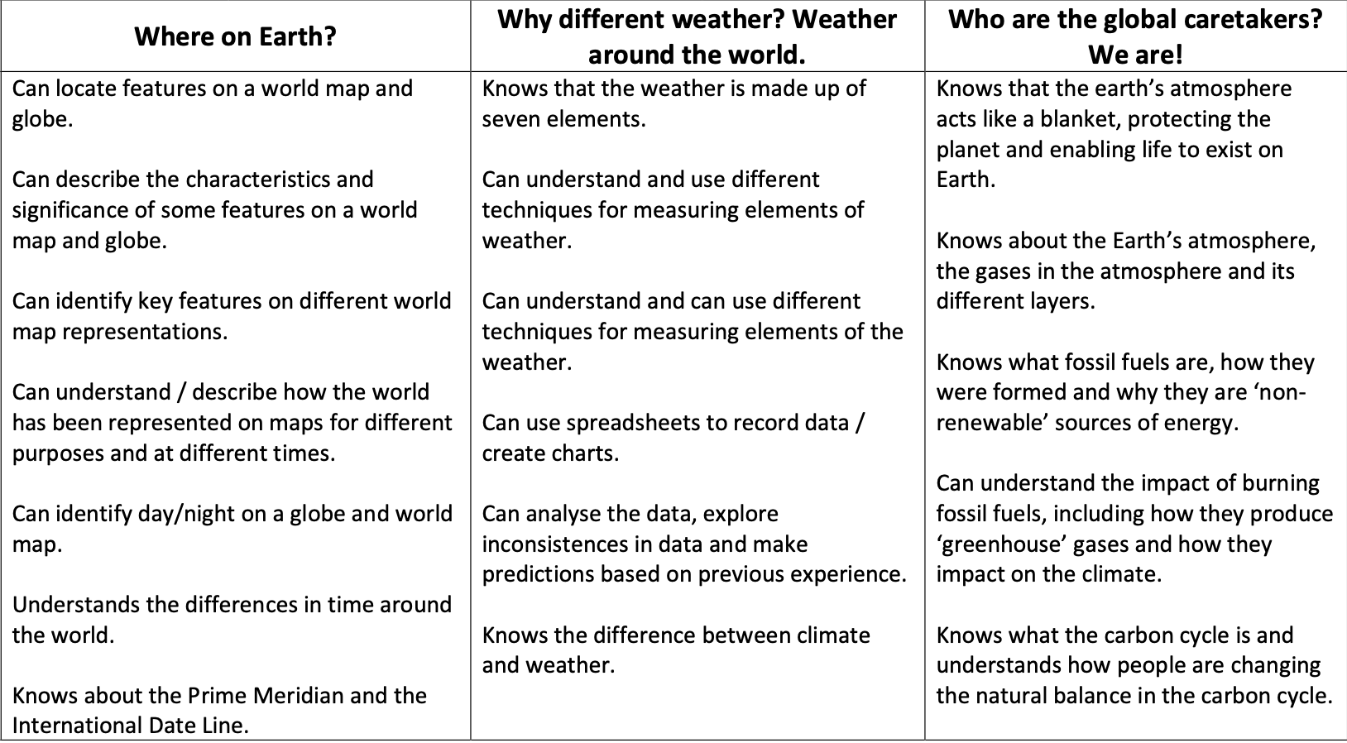
Geography
Notes:
If you have any special knowledge or expertise in any of these topics, please feel free to let me know!
They will also be learning about the discovery of Tutankhamun, creating their own version of his Death Mask and will learn to write sentences in Hieroglyphics.
In the next few weeks the children will be bringing home their own mummified apple, which we have started to mummify using similar techniques to the Egyptians. We will also be making bread using an Ancient Egyptian recipe.

Slide 22
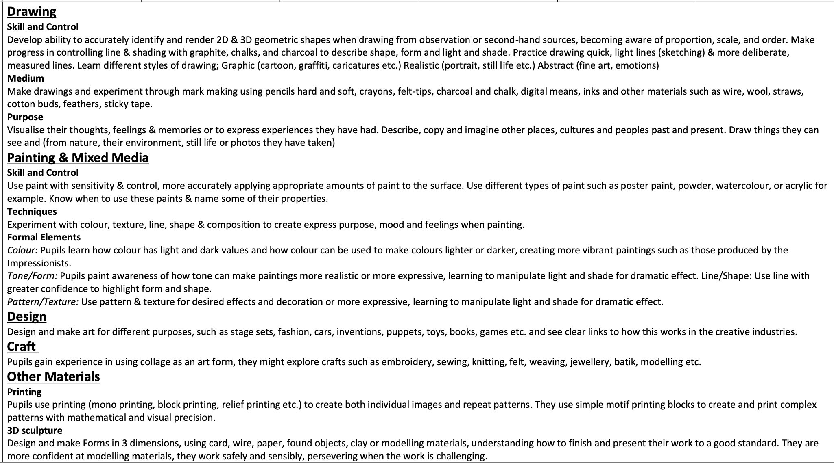
Art - Skills
Notes:
This year at Nutfield Church, our expressive arts program will be linked with our KUW topic. So this term we will be:
We will also be focusing on scultpure, collage, printing and textiles this year.

Slide 23
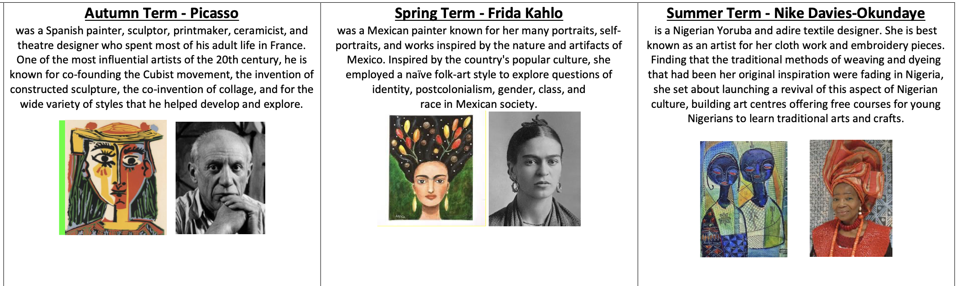
Artists
Notes:
This year at Nutfield Church, our expressive arts program will be linked with our KUW topic. So this term we will be:
We will also be focusing on scultpure, collage, printing and textiles this year.

Slide 24
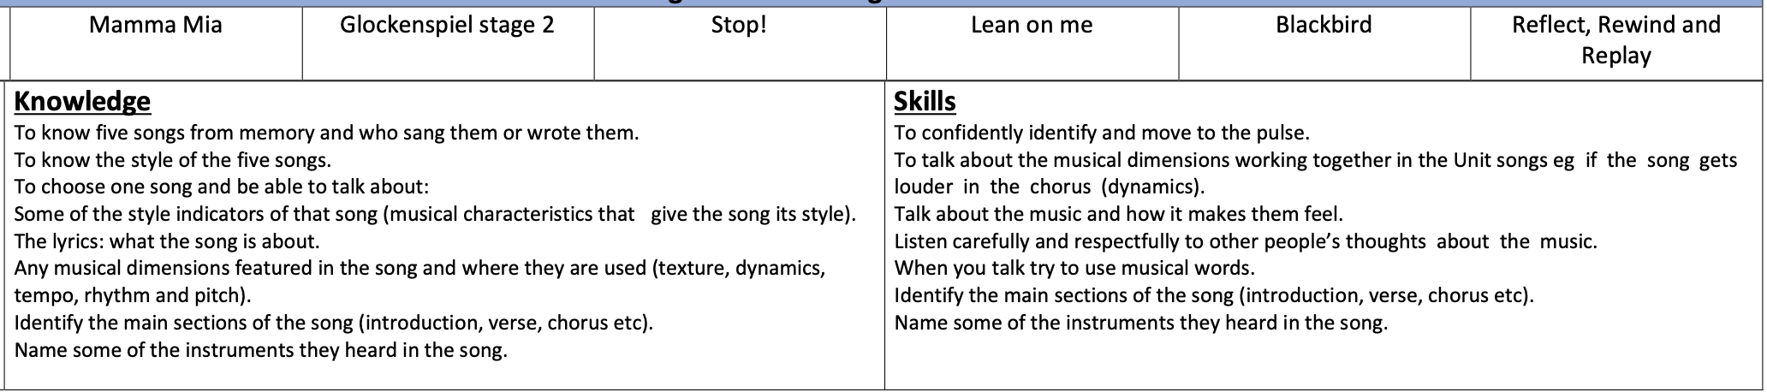
Music
Notes:
This year at Nutfield Church, our expressive arts program will be linked with our KUW topic. So this term we will be:
We will also be focusing on scultpure, collage, printing and textiles this year.

Slide 25
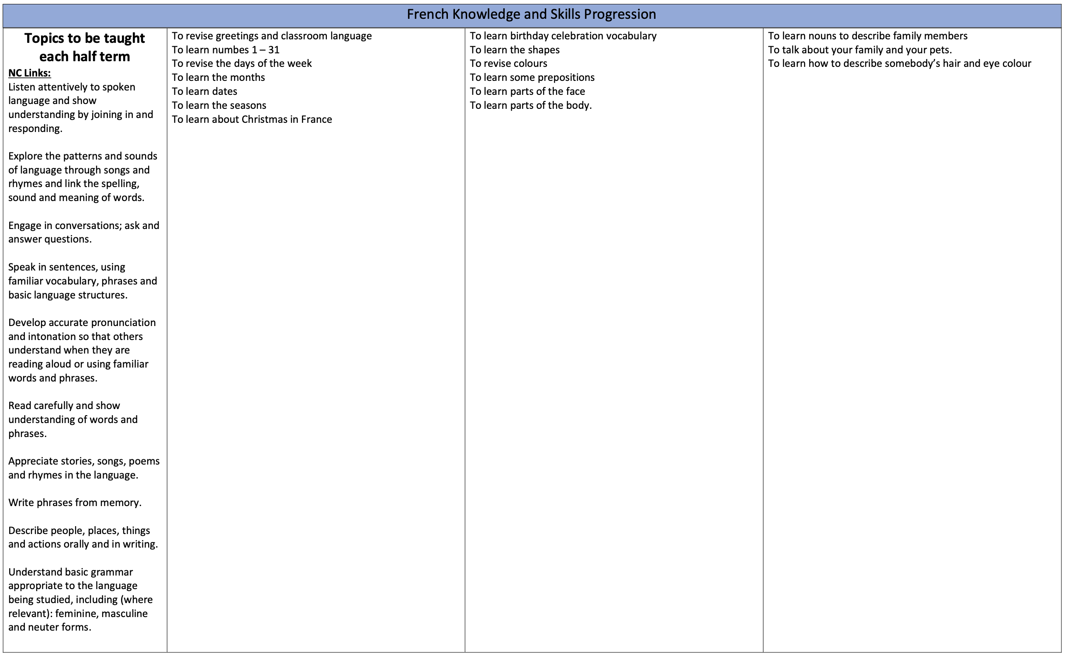
French
Notes:
This year at Nutfield Church, our expressive arts program will be linked with our KUW topic. So this term we will be:
We will also be focusing on scultpure, collage, printing and textiles this year.

Slide 26
Homework
Homework will be a mixture of:
One piece of Maths – TTRS
One piece of Spellings – in Homework books or Purple Mash.
Reading for 20 minutes every day.
Notes:
Please write comment in reading record book
Responsibitly – children responsible for taking books home – we are reminding them as getting ready to go home

Slide 27
Stationery
In every child's tray they have a named whiteboard, whiteboard pen and ruler.
The children do not need to bring in any stationary.
  Please NO toys, fidget toys, games or blue tac.
    Only with permission from Mrs Cordey.
Notes:
Please write comment in reading record book
Responsibitly – children responsible for taking books home – we are reminding them as getting ready to go home

Slide 28
Snacks and Water bottles
Please include a healthy snack for the children in their school bags for breaktime.
We are a nut free school – so absolutely no nuts please. There are members of the school community with Nut allergies.
All children will need a named water bottle. These are kept on the trolley at all times.
Children will have access to their water during the day.
Notes:
In the Upper School, children are not provided with a snack for breaktime.
Please include a healthy snack for the children in their school bags.
We don’t have a water fountain in the Upper School, so all children will need a named water bottle.
There are a few cups if the children forget in the morning.

Slide 29
Uniform
Blue Nutfield Church jumper/cardigan
Nutfield Church Fleece
Yellow polo shirt
Grey pinafore, skirt or trousers
Blue summer dress
White, Black or Grey socks
Black shoes
Hair bands and clips must be blue or navy
Spare trainers or wellies for all outdoor learning.

Slide 30
Attendance
It is incredibly important for the children to attend school everyday.
We love seeing the children and teaching them everyday!
If they are unwell, telephone the Office to let us know if your child is unwell and will not be attending school.
Pick up and Drop off
Any information can be sent by email to the office.
Please let us know who is picking up your child if it is not you in advance. We will not let them go unless we have confirmation from yourselves.
If there is a long-standing arrangement, please let the office know through email.
Children need to be dropped off 8.40am– 8.55am and picked up at 3.15pm.
We start our learning at 9am.

Slide 31
Mobile Phones
Mobile Phones and other Tech should not be bought into school.
This includes:
  Smart Watches with cameras
  Cameras
  iPads
  iPods
  etc

Slide 32
E-Safety KS2
DOs
• Talk to your child regularly about what they do online and on their phone. Who are they talking to and what about?
• Keep your computer/tablet in an area of the house that is easy to supervise i.e. where you will walk past every now and again.
• Reinforce the message of not talking to strangers, giving out any personal details and sending inappropriate words or images.
• Subscribe to your internet service provider’s filter system.
• Build this relationship/practice now while it is relatively easy in preparation for when your child is a teenager!
DON’Ts
• Take an “it will never happen to us” attitude
• Allow your child to join social media sites where they are under the age limit (age limits exist for a reason!)

Slide 33
High Ashurst - 23rd – 25th September
Early start/Late return
  Departure: Gates open at 8.00am / coach leaves at 8.15am
  Arrive back: 5:15pm approx.
Activities include:
  High ropes
  Archery
  Orienteering
  Fire making
  Low Ropes
  Abseiling

Slide 34
High Ashurst - 23rd – 25th September
Kit list:
Packed lunch/water bottle are required.
Jogging bottoms/leggings
Trainers/walking shoes.
No shorts or skirts please – they cannot complete activities in shorts/skirts and must be wearing long legged clothes.
Change of clothes just in case
Waterproofs if weather is rainy
If Sunny and hot, a hat is recommended and an application of sun cream before leaving school is also advised.

Slide 35
Contact
Please do contact us if you have any questions either through the office, by note with the children or at the gate in the morning.
Do keep up to date with newsletters for information regarding changes in the school day.

