Slide 1

Staff
Welcome to Year 5!
Mrs Rutter
Ms Baber
Mrs Green

Slide 2
School Values
Community and Peace – Autumn
Wisdom and Hope – Spring
Dignity and Joy - Summer

Slide 3
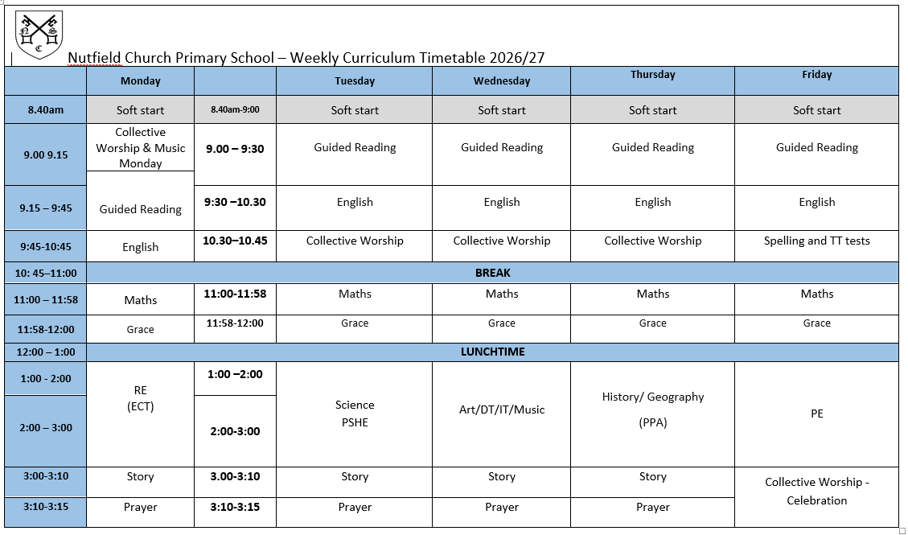
Our Timetable

Slide 4

English
Every term we study a different book and this half term our book is “The Man Who Walked Between the Towers”
This year we are studying a variety of different books that explore different concepts and genre.
Grammar and punctuation focus in both reading and writing.
Lots of drama, role play and art.
Notes:
Our English lessons will centre around a variety of high quality texts, which will enable the children to explore a vast range of genres and concepts. We study a different book every half term.
I must stress that you don’t go and buy or read the books once it is revealed what they are – the scheme of work revolves around mystery and as a class we work through the book to enable the children to be creative as possible. For example, until Monday, we had only read 1 paragraph of The Pied Piper.
In addition to reading and writing, English will be taught through a range of different medias (drama, art and role play). There will be many an opportunity for the children to perform! The picture is of the children being told their was a rat running under their feet.
In addition, there will also be a focus on grammar and punctuation and applying this to reading and writing, this will be done during English lessons and through Guided Reading sessions.

Slide 5

Guided Reading
We will be doing a combination of whole class reading a text and independent reading comprehensions.
This term, we will be reading ‘Cogheart’ by Peter Bunzl. If you have a copy, it would be useful to have it in school as it is beneficial for the children have their own copy.
Notes:
Our English lessons will centre around a variety of high quality texts, which will enable the children to explore a vast range of genres and concepts. We study a different book every half term.
I must stress that you don’t go and buy or read the books once it is revealed what they are – the scheme of work revolves around mystery and as a class we work through the book to enable the children to be creative as possible. For example, until Monday, we had only read 1 paragraph of The Pied Piper.
In addition to reading and writing, English will be taught through a range of different medias (drama, art and role play). There will be many an opportunity for the children to perform! The picture is of the children being told their was a rat running under their feet.
In addition, there will also be a focus on grammar and punctuation and applying this to reading and writing, this will be done during English lessons and through Guided Reading sessions.

Slide 6
Reading at Home
At Nutfield Church School, we want our children to love reading!
It is important to read with your child or have your child read every night. It is not important what the children are reading, as long as they are reading!
We encourage our pupils to read every school day, for 20 minutes, or more, and it should be recorded in their reading record (please ensure they are in bags every day for reading in class).
Now children are in Years 5 and 6 we will start to encourage children to write neatly in their own.

Slide 7
Year 5 Grammar Terms
Ambiguity – If a phrase, clause or sentence is ambiguous, the meaning is not clear.
Cohesion – A text which has cohesion fits together logically. A reader can see how one part moves onto another. We use cohesive devices such as connective phrases and conjunctions.
Modal Verbs - Modal verbs add meaning to the main verb. You cannot make a modal verb plural. Some common modal verbs are
  Will
  Shall
  Should
  Could
  Can
  Must
Parenthesis – is used to add extra detail to a sentence which is already grammatically correct without it. We can use brackets (), dashes – or commas, to separate the parenthetical information from the rest.
  Mrs Jones (my teacher) works in Year 5.
  The product of four and nine - 36 - is a square number.
  Michael, who sits next to me, is brilliant at Art.
Notes:
Our English lessons will centre around a variety of high quality texts, which will enable the children to explore a vast range of genres and concepts. We study a different book every half term.
I must stress that you don’t go and buy or read the books once it is revealed what they are – the scheme of work revolves around mystery and as a class we work through the book to enable the children to be creative as possible. For example, until Monday, we had only read 1 paragraph of The Pied Piper.
In addition to reading and writing, English will be taught through a range of different medias (drama, art and role play). There will be many an opportunity for the children to perform! The picture is of the children being told their was a rat running under their feet.
In addition, there will also be a focus on grammar and punctuation and applying this to reading and writing, this will be done during English lessons and through Guided Reading sessions.

Slide 8
Year 5 Grammar Terms
Relative Clause – a special type of subordinate clause which adds extra information to another noun or clause.
  James, who never does his homework, is very lazy.
    The extra clause tells us more about James.
  All the chocolate pudding was gone by the time I got to lunch, which really annoyed me.
    This refers to the whole previous clause about chocolate pudding.
Relative pronoun – introduces a relative clause. They refer back to a noun or clause that we already know. The start with
  Who
  Which
  Where
  That
  When
Notes:
Our English lessons will centre around a variety of high quality texts, which will enable the children to explore a vast range of genres and concepts. We study a different book every half term.
I must stress that you don’t go and buy or read the books once it is revealed what they are – the scheme of work revolves around mystery and as a class we work through the book to enable the children to be creative as possible. For example, until Monday, we had only read 1 paragraph of The Pied Piper.
In addition to reading and writing, English will be taught through a range of different medias (drama, art and role play). There will be many an opportunity for the children to perform! The picture is of the children being told their was a rat running under their feet.
In addition, there will also be a focus on grammar and punctuation and applying this to reading and writing, this will be done during English lessons and through Guided Reading sessions.

Slide 9
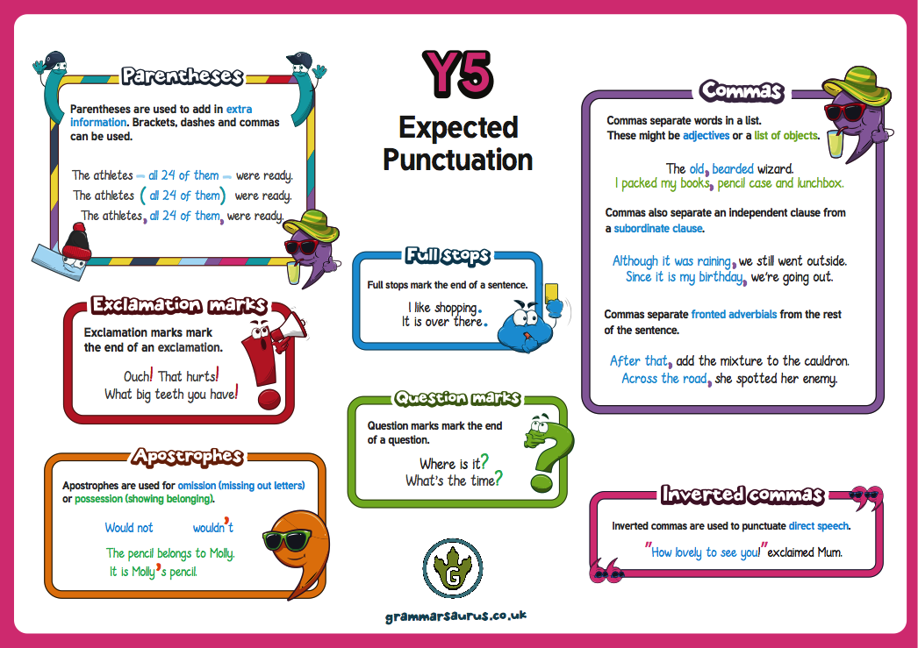

Slide 10
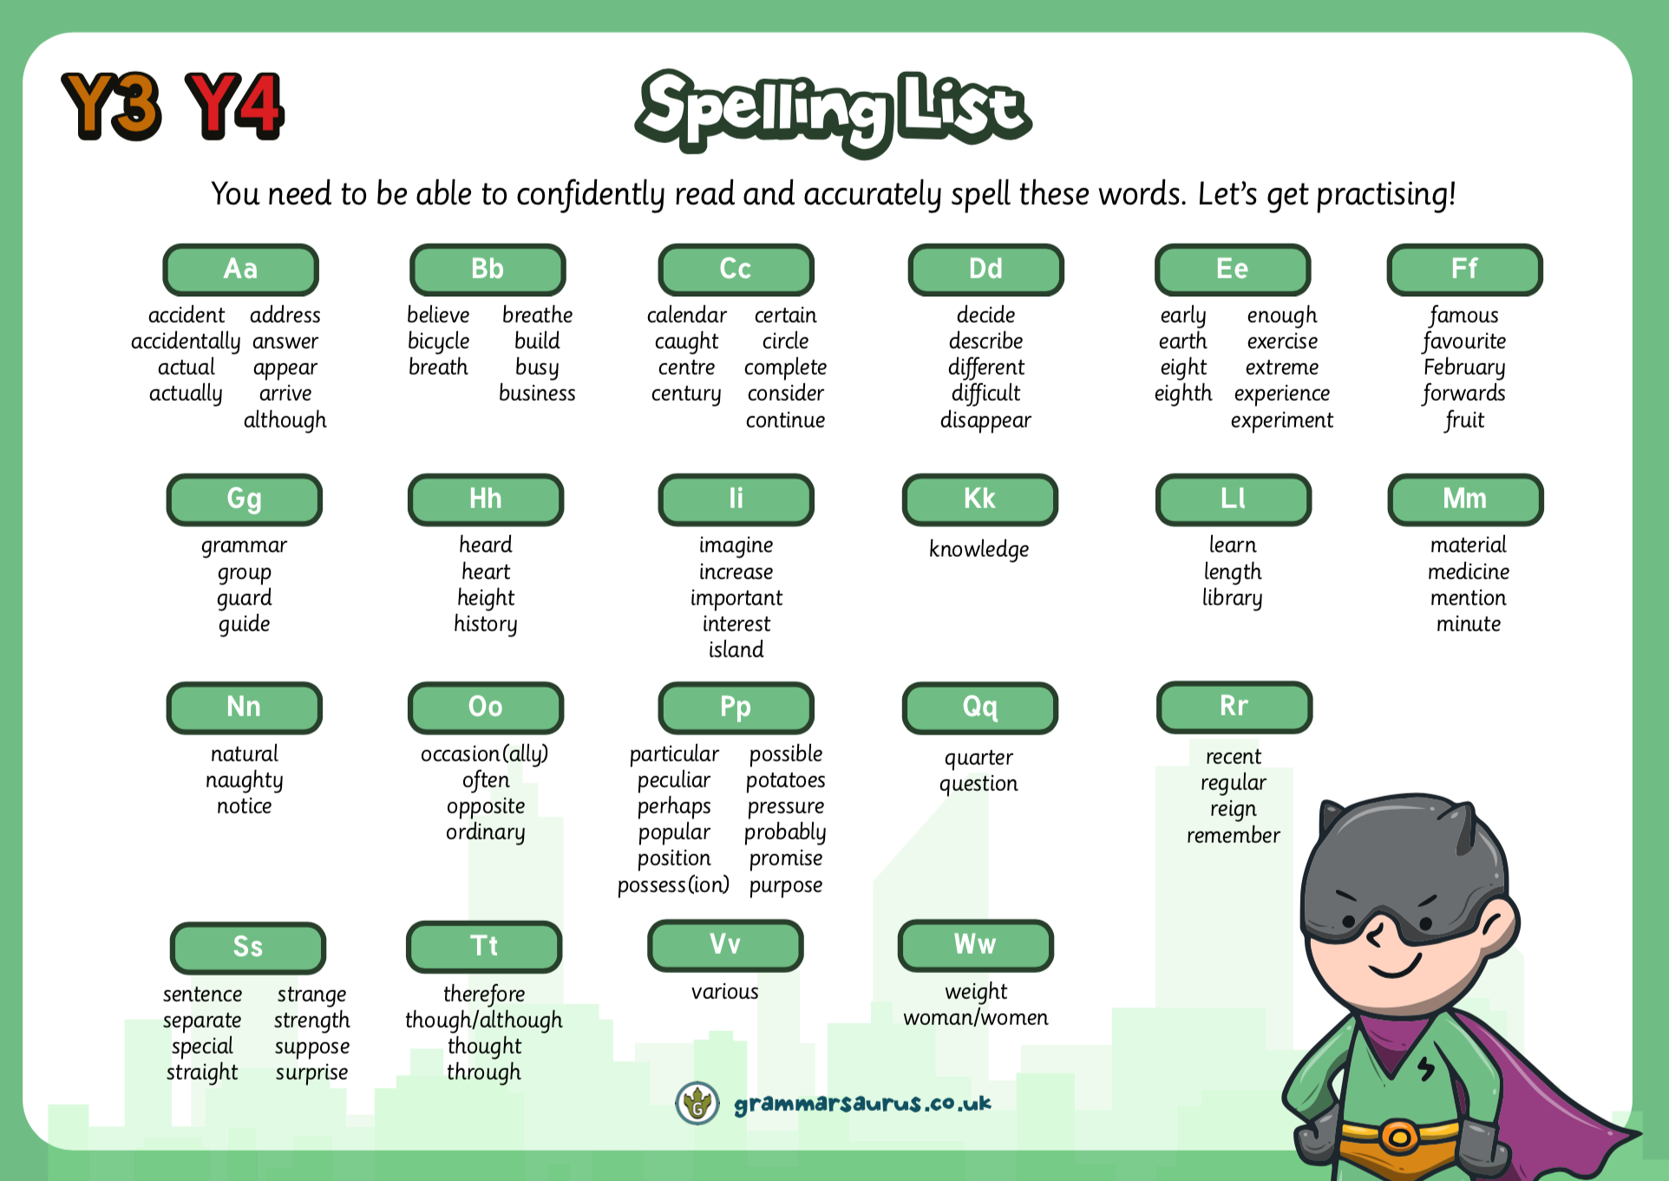
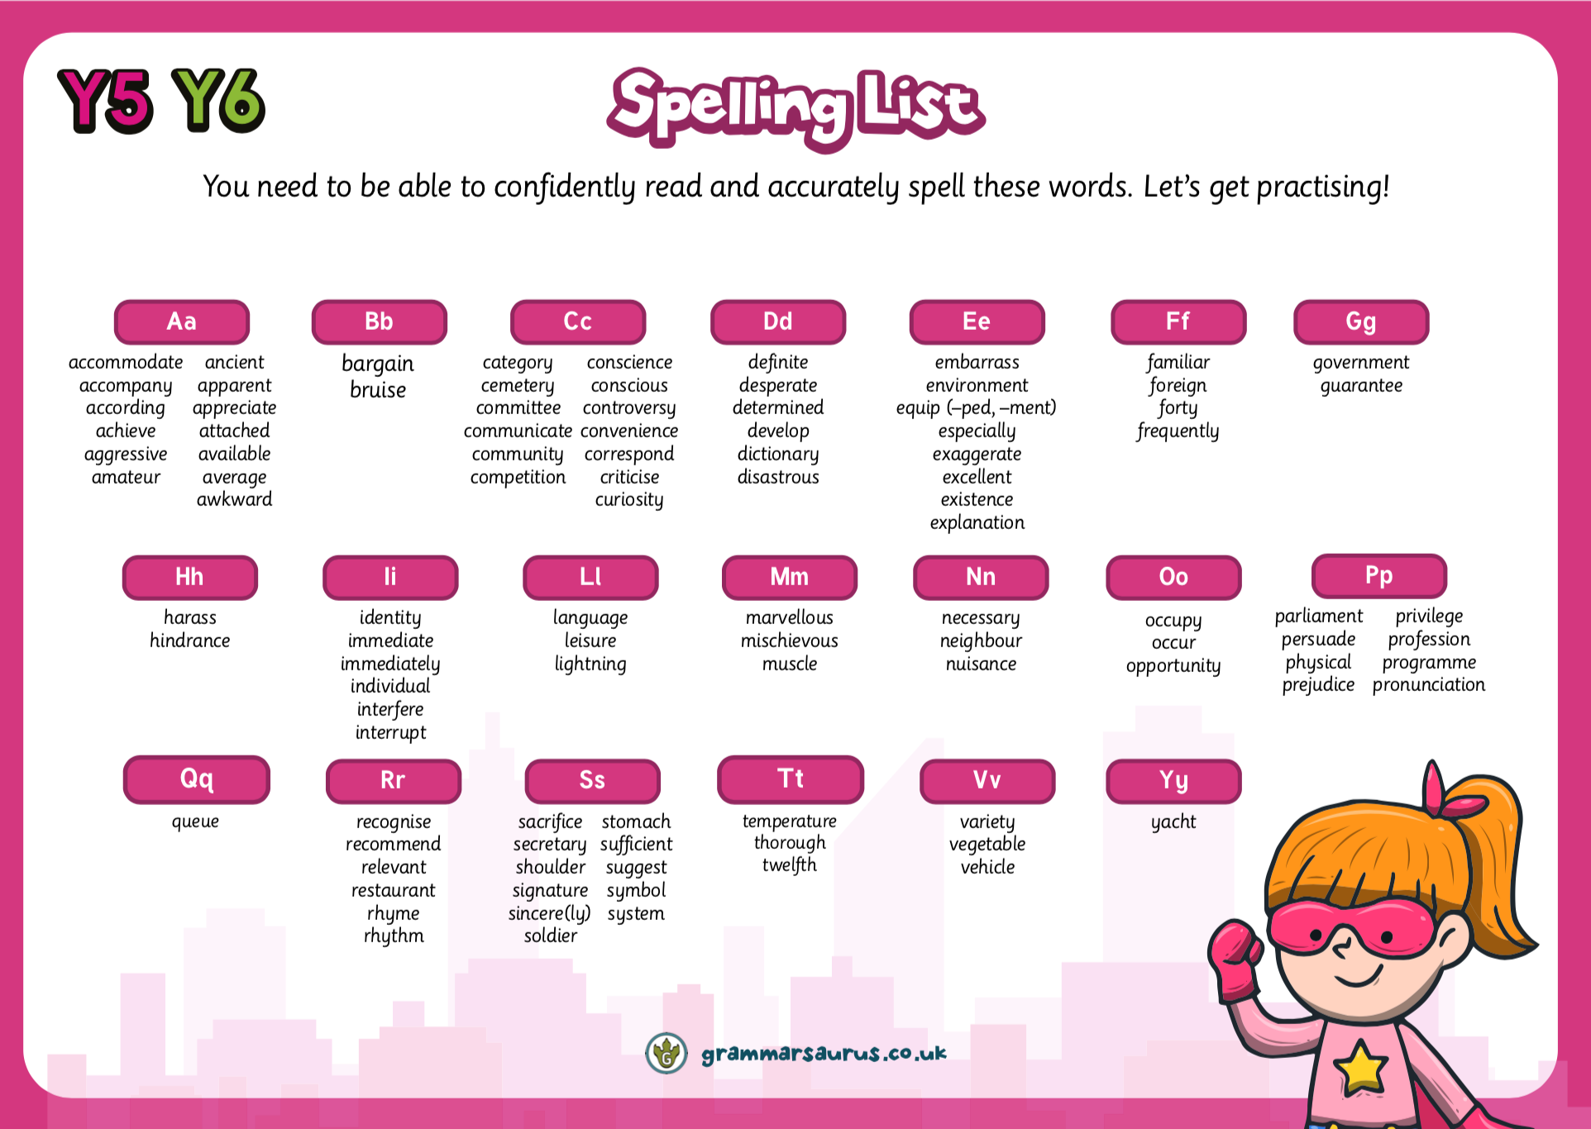
Reading
Daily Guided Reading sessions.
Children will all read with Mr Cook once a week
It is important for the children to read for 20 minutes daily at home.
It is not important what the children are reading, as long as they are reading!
Notes:
In the Upper school, we have daily guided reading sessions.
Carousel. Children to work with me on GR. LW on independent reading. Handwriting and a follow up – using the info from sessions with me and creating their own version or response. Children MUST have their reading log in school everyday.
All children are expected to read regularly at home and we ask that yellow reading diaries live in book bags so they can be accessed at school and at home.
In Year 3, it is expected that the children write their own comments on what they have read, and please do ensure these are signed regularly by you. These will be checked weekly.
It might be they are reading a magazine, comic, fiction, non-ficiton, the news. ANYTHING.

Slide 11



Spelling and Handwriting
Weekly spelling homework set on Purple Mash which the children will be tested on each Friday afternoon.
It is important for the children to be able to spell fluently for writing activities during lessons.
Use the diagonal and horizontal strokes that are needed to join letters and increase the legibility, consistency and quality of their handwriting. Handwriting practice every day this term.
Notes:
This term, our focus will be improving our confidence with spelling and using a wider range of vocabulary to ensure that our writing is the best it can be!
Every week, a set of spellings will be sent home and tested on a Friday
These spellings with either be from the 200 high frequency words, words from the Year3/4 curriculum or words that we are using during our topics.
The Year3/4 curriculum list all contain words the children need to be able to spell by the end of Y4, so do not worry too much if the children are struggling with these, there are 2 years for them to learn – but its nice to get a head start.
More importantly though is the childrens ability to spell these words during writing activities and especially when it comes to being fluent in writing.
We are also having a big push on handwriting this year. By the end of the year the children need to be using horizontal and diagonal strokes to join letters, we are having handwriting practise in our guided reading sesions and 2/3 times during the week.

Slide 12
Maths
This term we are covering:
  Place Value up to 1,000,000
  Adding and subtracting numbers with more than four digits
  Times tables – ALL Times Tables
    Practise at home.
  Multiplying and Dividing
  Fractions
  We will also be focusing on applying the knowledge and methods taught during Maths lessons, using word problems, challenges and setting up role plays.
Notes:
We will start the term by extending our knowledge and recapping place value and our number bonds. Understanding place value – the value of each digit in a number.
These are a key mathematical skill and plays an extremely important role in helping the children to understand and progress in other areas of number.
We will also be focusing on adding and subtracting numbers up to 200 mentally and using the inverse to check our answers.
Through the year, the children will continue to recap their 2, 5 and 10 times tables and will begin to learn their 3, 4 and 8 times tables. Please practise these at home. A multiplication grid will be stuck into the children’s homework books for their use.
New curriculum means there is a focus on applying the knowledge and methods taught during maths lessons, using word problems, challenges and setting up role plays; the children will be able to apply their learning to real life examples and explain how they know an answer is correct.
Fractions – looking at fractions are part of a number, adding and subtracting fractions and ordering fractions.

Slide 13
Maths
Throughout the year we will be looking at
  Fractions
  Shape
  Statistics
  Measure
Our calculation policy ensures the children are taught different methods, leading to a secure understanding of the formal written method.
If you have any questions please don’t hesitate to speak to us.
Notes:
We will start the term by extending our knowledge and recapping place value and our number bonds. Understanding place value – the value of each digit in a number.
These are a key mathematical skill and plays an extremely important role in helping the children to understand and progress in other areas of number.
We will also be focusing on adding and subtracting numbers up to 200 mentally and using the inverse to check our answers.
Through the year, the children will continue to recap their 2, 5 and 10 times tables and will begin to learn their 3, 4 and 8 times tables. Please practise these at home. A multiplication grid will be stuck into the children’s homework books for their use.
New curriculum means there is a focus on applying the knowledge and methods taught during maths lessons, using word problems, challenges and setting up role plays; the children will be able to apply their learning to real life examples and explain how they know an answer is correct.
Fractions – looking at fractions are part of a number, adding and subtracting fractions and ordering fractions.

Slide 14
R.E
Our first R.E unit this year will be ‘Who are the fearless women of faith?’. We shall be exploring, examining and comparing the different representations of women both in the Bible and different walks of life and in the church. This unit will allow us to consider the role of women in the Bible through exploring their stories, their actions and the examples they have set.
After half term, the children will be exploring the questions ‘Should every Christian go on a pilgrimage?’ and ‘How do art and the media convey Christmas to all people?’

Slide 15

P.E
The children will continue to come into school in their P.E Kit on their allocated P.E day. Year 5’s P.E day will be every Friday.
Here are the sports the children will be getting involved with this term:
  Rugy
  Handball
  Gymnastics
Notes:
Mr smith - I will hand over and collect the children at the end of the day on Wednesday.
All chidlren will get the oppourtunity to participate in district sport events if they want to – so don’t worry if your child isnt picked for something right away. Mr Smith is in charge of picking the children for this.

Slide 16
P.E Kit
A school jumper/fleece/cardigan can be worn during the colder months.
Blue/black jogging bottoms
On wetter days a coat can be word for P.E.
If your child is selected to go on a tournament they will be asked to wear the new Nutfield Sports Kit.
This must be washed and returned as soon as possible to ensure the next children have a chance of wearing it.
Earrings (studs only)
Hair tied back for (PE)
Navy blue/black shorts (cotton or nylon)
Yellow t-shirts with logo on
White, black or blue socks
Black or blue trainers
Notes:
Navy/blue tracksuit bottoms - important for the winter months
Trainers – not plimpsoles for outdoor PE
Spare socks – girls will not be allowed to do PE in their tights
Earrings – please encourage the girls to learn to take their earrings out on their own as much as possible, we advise that children do not do PE in their earrings, although we know this isnt always possible.
If anyone has any spare or old PE that they don’t need anymore, could they please bring it in to have as a class spare.

Slide 17
Wellbeing
We encourage our children to listen and respond with thoughtfulness and respect.
We will continue to teach Philosophy for Children (P4C)
These wellbeing lessons will also include The British Values, RSHE, Anti-Bullying, PSHE, Knife/Gun Crime, Outdoor learning, PE and Philosophy for Children.
Notes:
Through RE lessons, we will continue to teach Philosophy for Children to facilitate critical and deeper thinking and provide opportunities for children to practise these skills across the curriculum.

Slide 18
Science, Computing and Design and Technology
Science, Computing and Design and Technology are being taught together.
Tuesday afternoons are dedicated to this curriculum.
Computing will still be used for different subjects.
Animals including Humans
  The children will learn to identify that all animals need the right types and amount of nutrition, and that they cannot make their own food.
  They will also learn the function of skeletons and muscles.
Living things and their habitats
Describe the differences in the life cycles of a mammal, an amphibian, an insect and a bird.
Describe the life process of reproduction in some plants and animals.
Earth and space
Forces
Properties and changes of materials
Consolidation and application
Notes:
Animals inc - children have designed a character who doesn’t eat – but gets their energy and food from other sources.

Slide 19
Science, Computing and Design and Technology
Computing this year will be taught primarily through Science. However, there will be opportunities to use Computing throughout the curriculum.
Children will be able to use Purple Mash throughout the year for homework and in lessons.
Passwords for Purple Mash have not changed – all this information will be sent home.
We will focus on:
  Internet and E-Safety
  Using search technology effectively
  Adding images to Word, PowerPoint and Publisher documents

Slide 20
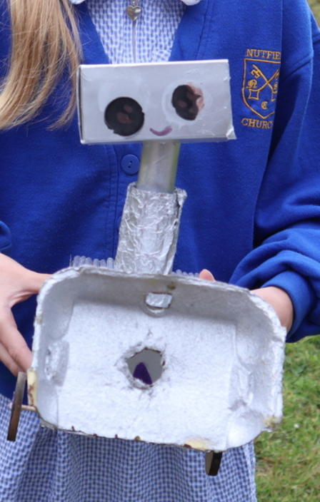
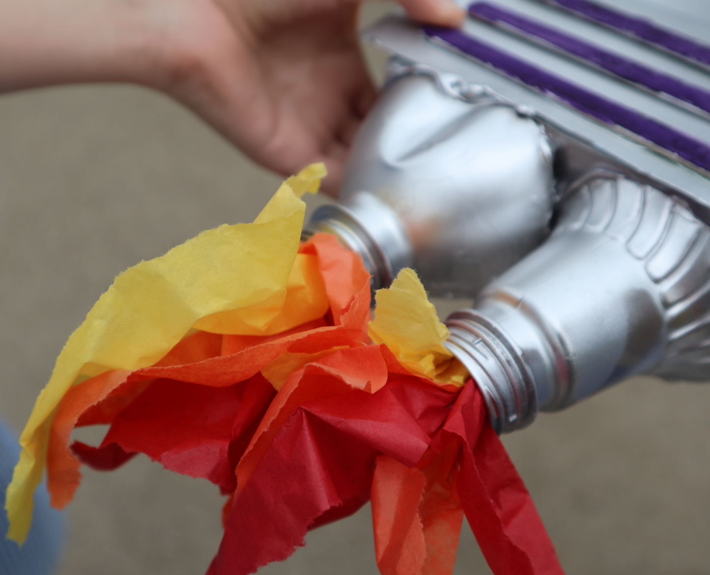
Science, Computing and Design and Technology
  Autumn
    Become competent in a range of cooking techniques.
  Spring
    Select from and use a wider range of materials and components, including construction materials, textiles and ingredients, according to their functional properties and aesthetic qualities.
      Mars Rovers/Moon Buggy project.
  Summer
    Use research and develop design criteria to inform the design of innovative, functional, appealing products that are fit for purpose, aimed at particular individuals or groups.
    Understand how key events and individuals in design and technology have helped shape the world.
      Dyson Foundation Project.

Slide 21
History
We will be teaching History at the start of each term. After half term, we will be teaching Georgraphy.
 | Autumn 2 | Spring 2 | Summer 2
History | The Anglo-Saxons | The Maya | A local history study

Slide 22
Geography
 | Autumn 1 | Spring 1 | Summer 1
Geography | Why on Earth? | Where does the water come from and go to? Water’s never ending journey! | Rivers
Notes:
If you have any special knowledge or expertise in any of these topics, please feel free to let me know!
They will also be learning about the discovery of Tutankhamun, creating their own version of his Death Mask and will learn to write sentences in Hieroglyphics.
In the next few weeks the children will be bringing home their own mummified apple, which we have started to mummify using similar techniques to the Egyptians. We will also be making bread using an Ancient Egyptian recipe.

Slide 23
Expressive Arts
Art - This term, we will be learning about Vincent Van Gogh, the Dutch Post-Impressionist painter. His work includes landscapes, still life, portraits, and self-portraits, most of which are characterised by bold colours and dramatic brushwork that contributed to the rise of expressionism in modern art.
French - the children will be learning key classroom vocabulary, how to ask and give the time and how to communicate their likes and dislikes
Music - using the famous rock anthem ‘Living on a Prayer’, we will be learning to recognise and play different musical instruments with a focus on pulse, rhythm, pitch and tempo.
Notes:
This year at Nutfield Church, our expressive arts program will be linked with our KUW topic. So this term we will be:
We will also be focusing on scultpure, collage, printing and textiles this year.

Slide 24
Last few notices

Slide 25
Online Safety at Nutfield Church Primary
At Nutfield Church School, we teach children in all classes how to stay safe in the online world, through regular Internet Safety lessons, using a mixture of videos and activities, aimed at their different ages and experiences.
As staying safe online straddles school and home, we encourage parent, family and wider school community involvement in our efforts to inform children about the digital world.
Please see our website for more information. https://nutfieldchurchprimary.co.uk/online-safety/

Slide 26
Online Safety at Nutfield Church Primary
In our school, we have a filtering and monitoring system which blocks key words and searches from coming up.
If a child searches something they shouldn’t an email will be sent to the school office at which point it is then investigated.
Online Safety is taught throughout the Science, Computing and Design and Technology curriculum in all year groups.
Key Stage 1 use Purple Mash’s Online Safety scheme.
Key Stage 2 use Google’s ‘Interland and Be Internet Kind’ Schemes.

Slide 27
Homework
Homework will be:
Weekly times tables on Purple Mash
Spellings – Purple Mash.
Reading for a minimum of 15 minutes a night.
Notes:
Please write comment in reading record book
Responsibitly – children responsible for taking books home – we are reminding them as getting ready to go home

Slide 28
Snacks and Water bottles
Please include a healthy snack for the children in their school bags.
All children will need a named water bottle. These are kept on the trolley during lesson times.
Notes:
In the Upper School, children are not provided with a snack for breaktime.
Please include a healthy snack for the children in their school bags.
We don’t have a water fountain in the Upper School, so all children will need a named water bottle.
There are a few cups if the children forget in the morning.

Slide 29
Uniform
Blue Nutfield Church jumper/cardigan
Nutfield Church Fleece
Yellow Nutfield Church polo shirt
Grey pinafore, skirt or trousers
Blue summer dress
White, Black or Grey socks
Black shoes
Hair bands and clips must be blue or navy
Spare trainers or wellies for all outdoor learning

Slide 30
Attendance
It is incredibly important for the children to attend school everyday.
We love seeing the children and teaching them everyday!
If they are unwell, telephone the Office to let us know if your child is unwell and will not be attending school.
Pick up and Drop off
Any information can be send either through a note with your child OR email the office.
Please let us know who is picking up your child if it is not you.
If there is a long-standing arrangement, please let the office know through sending an email.
Children need to be dropped off 8.40am– 8.50am and picked up at 3.15pm.
We start our learning at 8.50am.

Slide 31
Mobile Phones
Mobile Phones and other Tech should not be bought into school.
This includes:
  Smart Watches with cameras
  Cameras
  iPads
  iPods

Slide 32
Contact
Please do contact me if you have any questions either through the office, by note with the children or at the gate in the morning.
Do keep up-to-date with school newsletters and the Homework letters for information regarding changes in the school day.

Slide 33
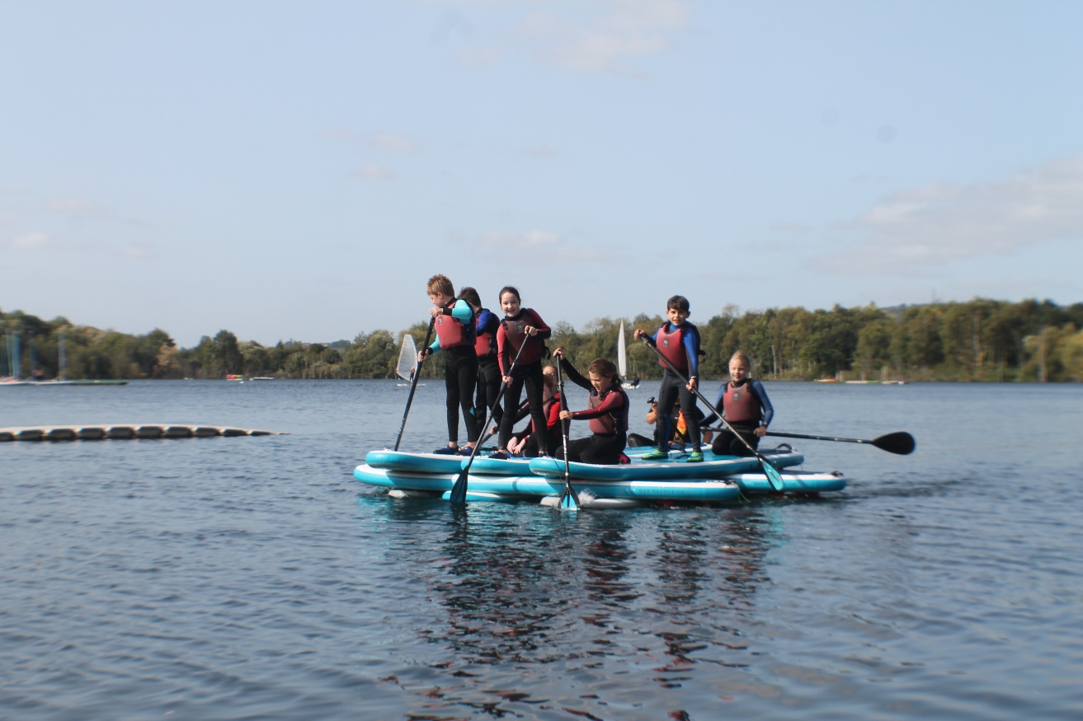
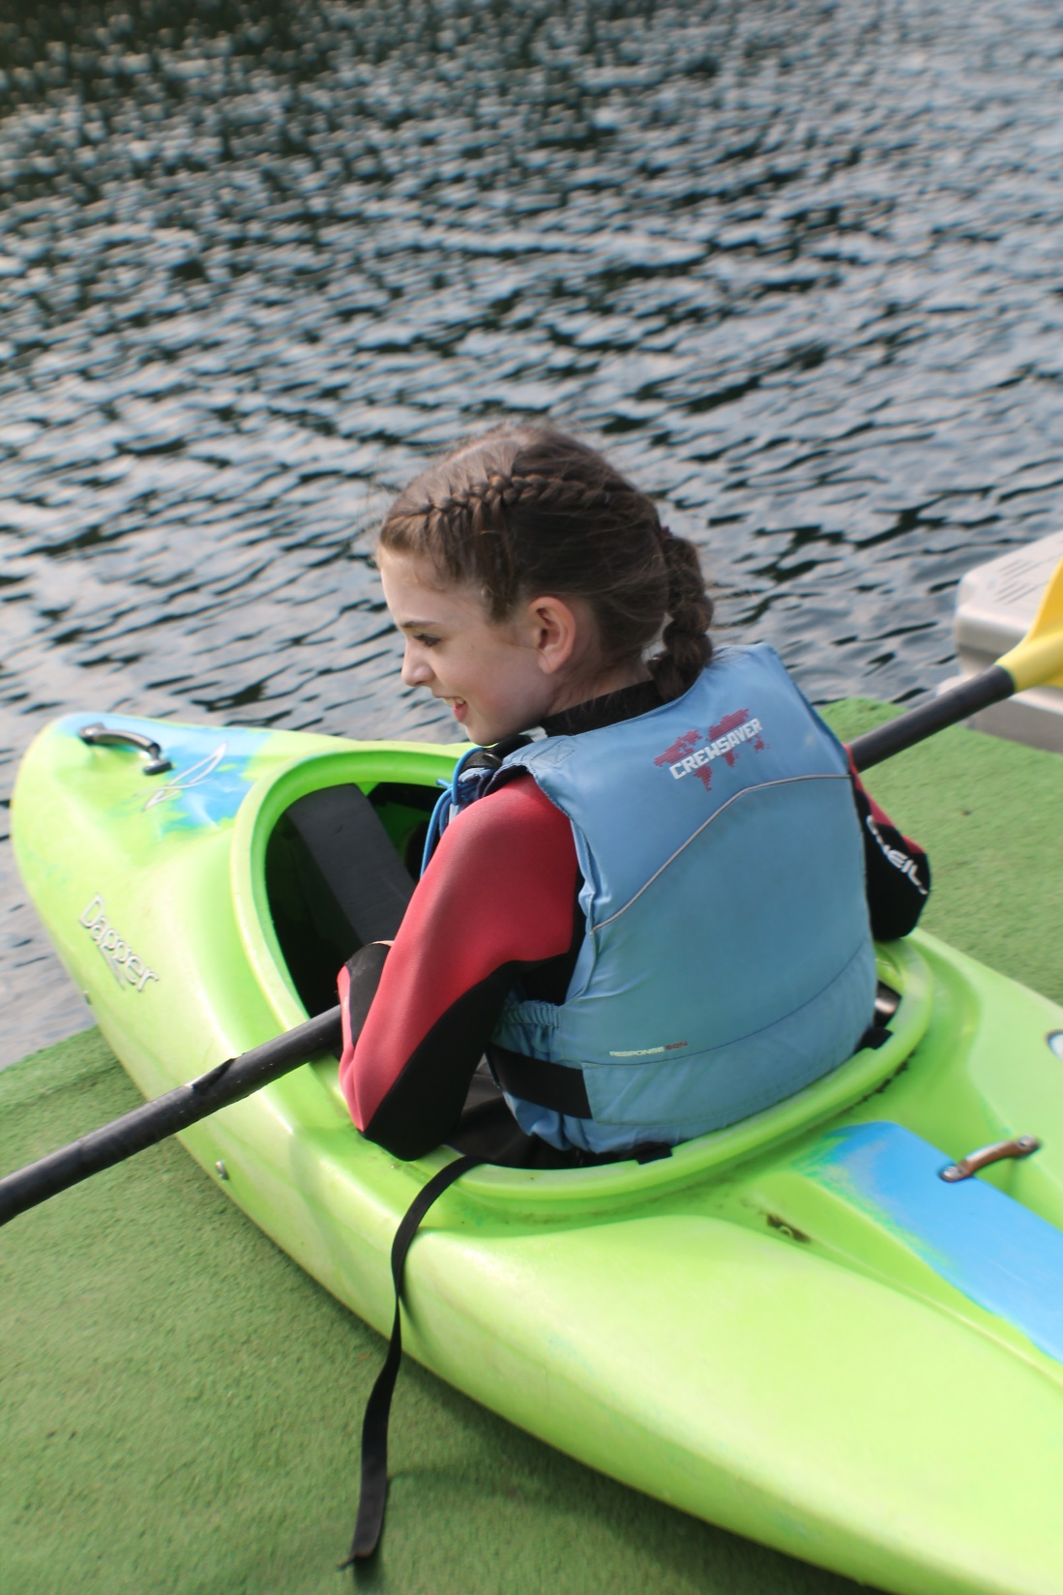
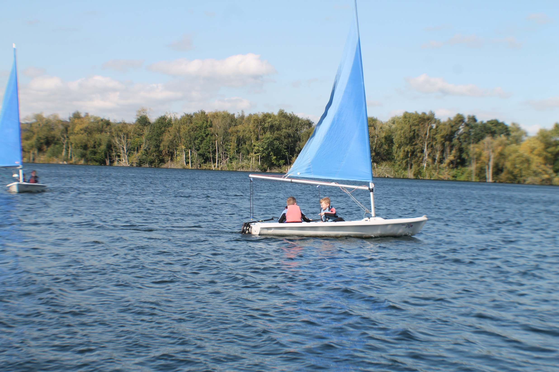
Aqua Sports
Mercers’ Lake
June 2027

Slide 34

Any Questions?

