Slide 1
Welcome to Year 6!
Please take a Year 6 help pack from the front
Mr Bowen
Mrs Cole
Miss Selby

Slide 2
Our Week
Daily Curriculum
English and Maths – Everyday
Handwriting – Everyday
Guided Reading and Spellings: Everyday
After Lunch Number club that will include multiplication or arithmetic practice.
Afternoon Curriculum
R.E
Science computing and Design Technology
Expressive Arts – Art, French, Music and Drama
History and Geography
Wellbeing including P.E (Wednesday Afternoon)

Slide 3

English
Every term we study a different book and this half term our book is “Romeo and Juliet.”
This year we are studying a variety of different books that explore different concepts and genre.
English lessons will be very grammar focused, with standards within writing increasing as the year progresses.
Guided reading.
Drama, role play and art.
Increased focus on handwriting and spellings.
Notes:
Our English lessons will centre around a variety of high quality texts, which will enable the children to explore a vast range of genres and concepts. We study a different book every half term.
I must stress that you don’t go and buy or read the books once it is revealed what they are – the scheme of work revolves around mystery and as a class we work through the book to enable the children to be creative as possible. For example, until Monday, we had only read 1 paragraph of The Pied Piper.
In addition to reading and writing, English will be taught through a range of different medias (drama, art and role play). There will be many an opportunity for the children to perform! The picture is of the children being told their was a rat running under their feet.
In addition, there will also be a focus on grammar and punctuation and applying this to reading and writing, this will be done during English lessons and through Guided Reading sessions.

Slide 4
Year 6 Grammar Terms
Simple Past Tense
  Usually ends in –ed e.g. played, cooked, stared.
  Except for irregular verbs ran, said, spoke etc. that need to be learned
Past progressive: (instead of simple past – I worked) action was happening.
  I was working
  You were working
  He/she was working etc.
Modal Verbs - Modal verbs add meaning to the main verb . You cannot make a modal verb plural. Some common modal verbs are
  Will
  Shall
  Should
  Could
  Can
  Must
Parenthesis – is used to add extra detail to a sentence which is already grammatically correct without it. We can use brackets (), dashes – or commas , to separate the parenthetical information from the rest.
  Mrs Jones (my teacher) works in Year 5.
  The product of four and nine – 36 - is a square number.
  Michael, who sits next to me, is brilliant at Art.
Notes:
Our English lessons will centre around a variety of high quality texts, which will enable the children to explore a vast range of genres and concepts. We study a different book every half term.
I must stress that you don’t go and buy or read the books once it is revealed what they are – the scheme of work revolves around mystery and as a class we work through the book to enable the children to be creative as possible. For example, until Monday, we had only read 1 paragraph of The Pied Piper.
In addition to reading and writing, English will be taught through a range of different medias (drama, art and role play). There will be many an opportunity for the children to perform! The picture is of the children being told their was a rat running under their feet.
In addition, there will also be a focus on grammar and punctuation and applying this to reading and writing, this will be done during English lessons and through Guided Reading sessions.

Slide 5
Year 6 Grammar Terms
Relative Clause – Is a special type of subordinate clause which adds extra information to another noun or clause.
  James, who never does his homework, is very lazy.
    The extra clause tells us more about James.
  All the chocolate pudding was gone by the time I got to lunch, which really annoyed me.
    This refers to the whole previous clause about chocolate pudding.
Relative pronoun – introduces a relative clause. They refer back to a noun or clause that we already know. They start with
  Who
  Which
  Where
  That
  When
Notes:
Our English lessons will centre around a variety of high quality texts, which will enable the children to explore a vast range of genres and concepts. We study a different book every half term.
I must stress that you don’t go and buy or read the books once it is revealed what they are – the scheme of work revolves around mystery and as a class we work through the book to enable the children to be creative as possible. For example, until Monday, we had only read 1 paragraph of The Pied Piper.
In addition to reading and writing, English will be taught through a range of different medias (drama, art and role play). There will be many an opportunity for the children to perform! The picture is of the children being told their was a rat running under their feet.
In addition, there will also be a focus on grammar and punctuation and applying this to reading and writing, this will be done during English lessons and through Guided Reading sessions.

Slide 6
Year 6 Grammar Terms
Noun phrases are groups of words that work together and contain a noun.
e.g. “The girl”
Expanded noun phrases give extra detail.
e.g. “The tall girl”
Active voice
  Zoe chased the elephant
  I cooked the spaghetti.
Passive voice
  The elephant was chased by Zoe.
  The Spaghetti was cooked by me.
    Quick rule of thumb – if the verb is followed with the word ‘by’ it’s normally a passive sentence.
Notes:
Our English lessons will centre around a variety of high quality texts, which will enable the children to explore a vast range of genres and concepts. We study a different book every half term.
I must stress that you don’t go and buy or read the books once it is revealed what they are – the scheme of work revolves around mystery and as a class we work through the book to enable the children to be creative as possible. For example, until Monday, we had only read 1 paragraph of The Pied Piper.
In addition to reading and writing, English will be taught through a range of different medias (drama, art and role play). There will be many an opportunity for the children to perform! The picture is of the children being told their was a rat running under their feet.
In addition, there will also be a focus on grammar and punctuation and applying this to reading and writing, this will be done during English lessons and through Guided Reading sessions.

Slide 7
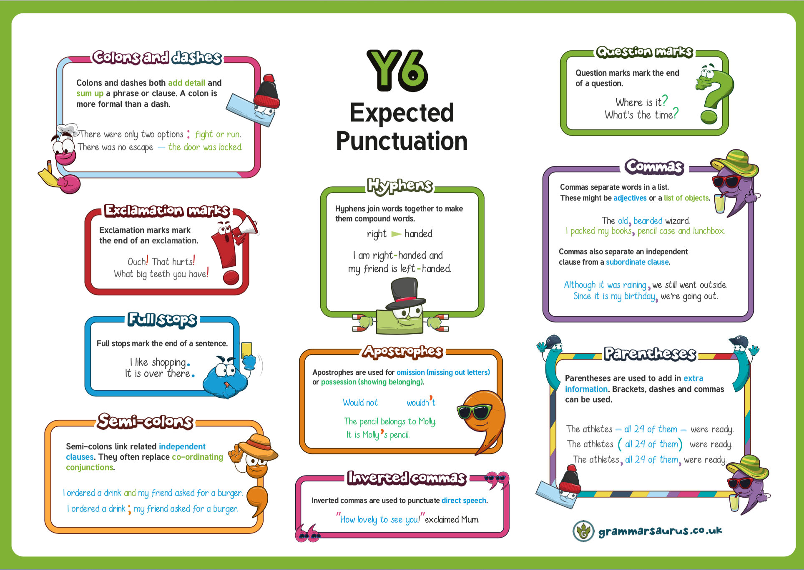

Slide 8



Spelling and Handwriting
Weekly spelling homework and spelling tests.
Children will be tested on random spellings from the Years 3-6 spellings.
It is important for the children to be able to spell fluently for writing activities during lessons.
Use the diagonal and horizontal strokes that are needed to join letters and increase the legibility, consistency and quality of their handwriting
Notes:
This term, our focus will be improving our confidence with spelling and using a wider range of vocabulary to ensure that our writing is the best it can be!
Every week, a set of spellings will be sent home and tested on a Friday
These spellings with either be from the 200 high frequency words, words from the Year3/4 curriculum or words that we are using during our topics.
The Year3/4 curriculum list all contain words the children need to be able to spell by the end of Y4, so do not worry too much if the children are struggling with these, there are 2 years for them to learn – but its nice to get a head start.
More importantly though is the childrens ability to spell these words during writing activities and especially when it comes to being fluent in writing.
We are also having a big push on handwriting this year. By the end of the year the children need to be using horizontal and diagonal strokes to join letters, we are having handwriting practise in our guided reading sesions and 2/3 times during the week.

Slide 9
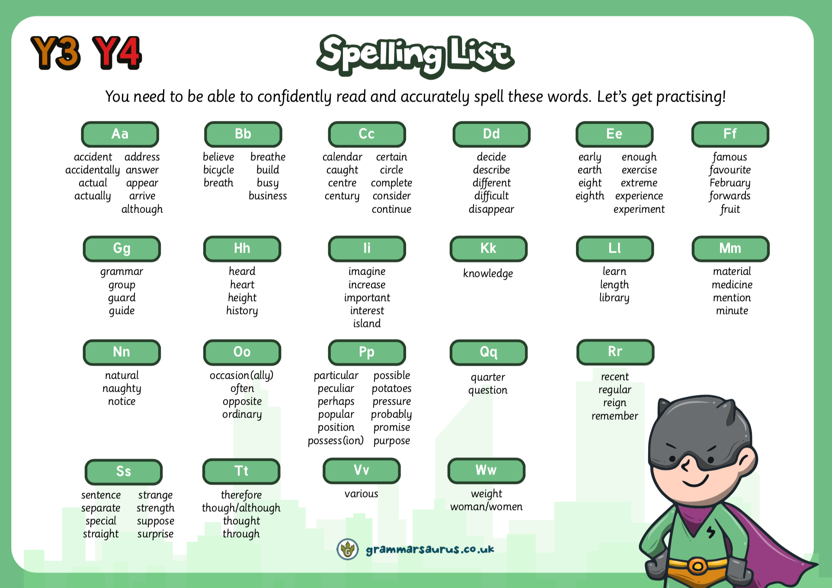
Reading
Daily Guided Reading sessions.
Children will all read with Mr Cook once a week
It is important for the children to read for 20 minutes daily at home.
It is not important what the children are reading, as long as they are reading!
Notes:
In the Upper school, we have daily guided reading sessions.
Carousel. Children to work with me on GR. LW on independent reading. Handwriting and a follow up – using the info from sessions with me and creating their own version or response. Children MUST have their reading log in school everyday.
All children are expected to read regularly at home and we ask that yellow reading diaries live in book bags so they can be accessed at school and at home.
In Year 3, it is expected that the children write their own comments on what they have read, and please do ensure these are signed regularly by you. These will be checked weekly.
It might be they are reading a magazine, comic, fiction, non-ficiton, the news. ANYTHING.

Slide 10
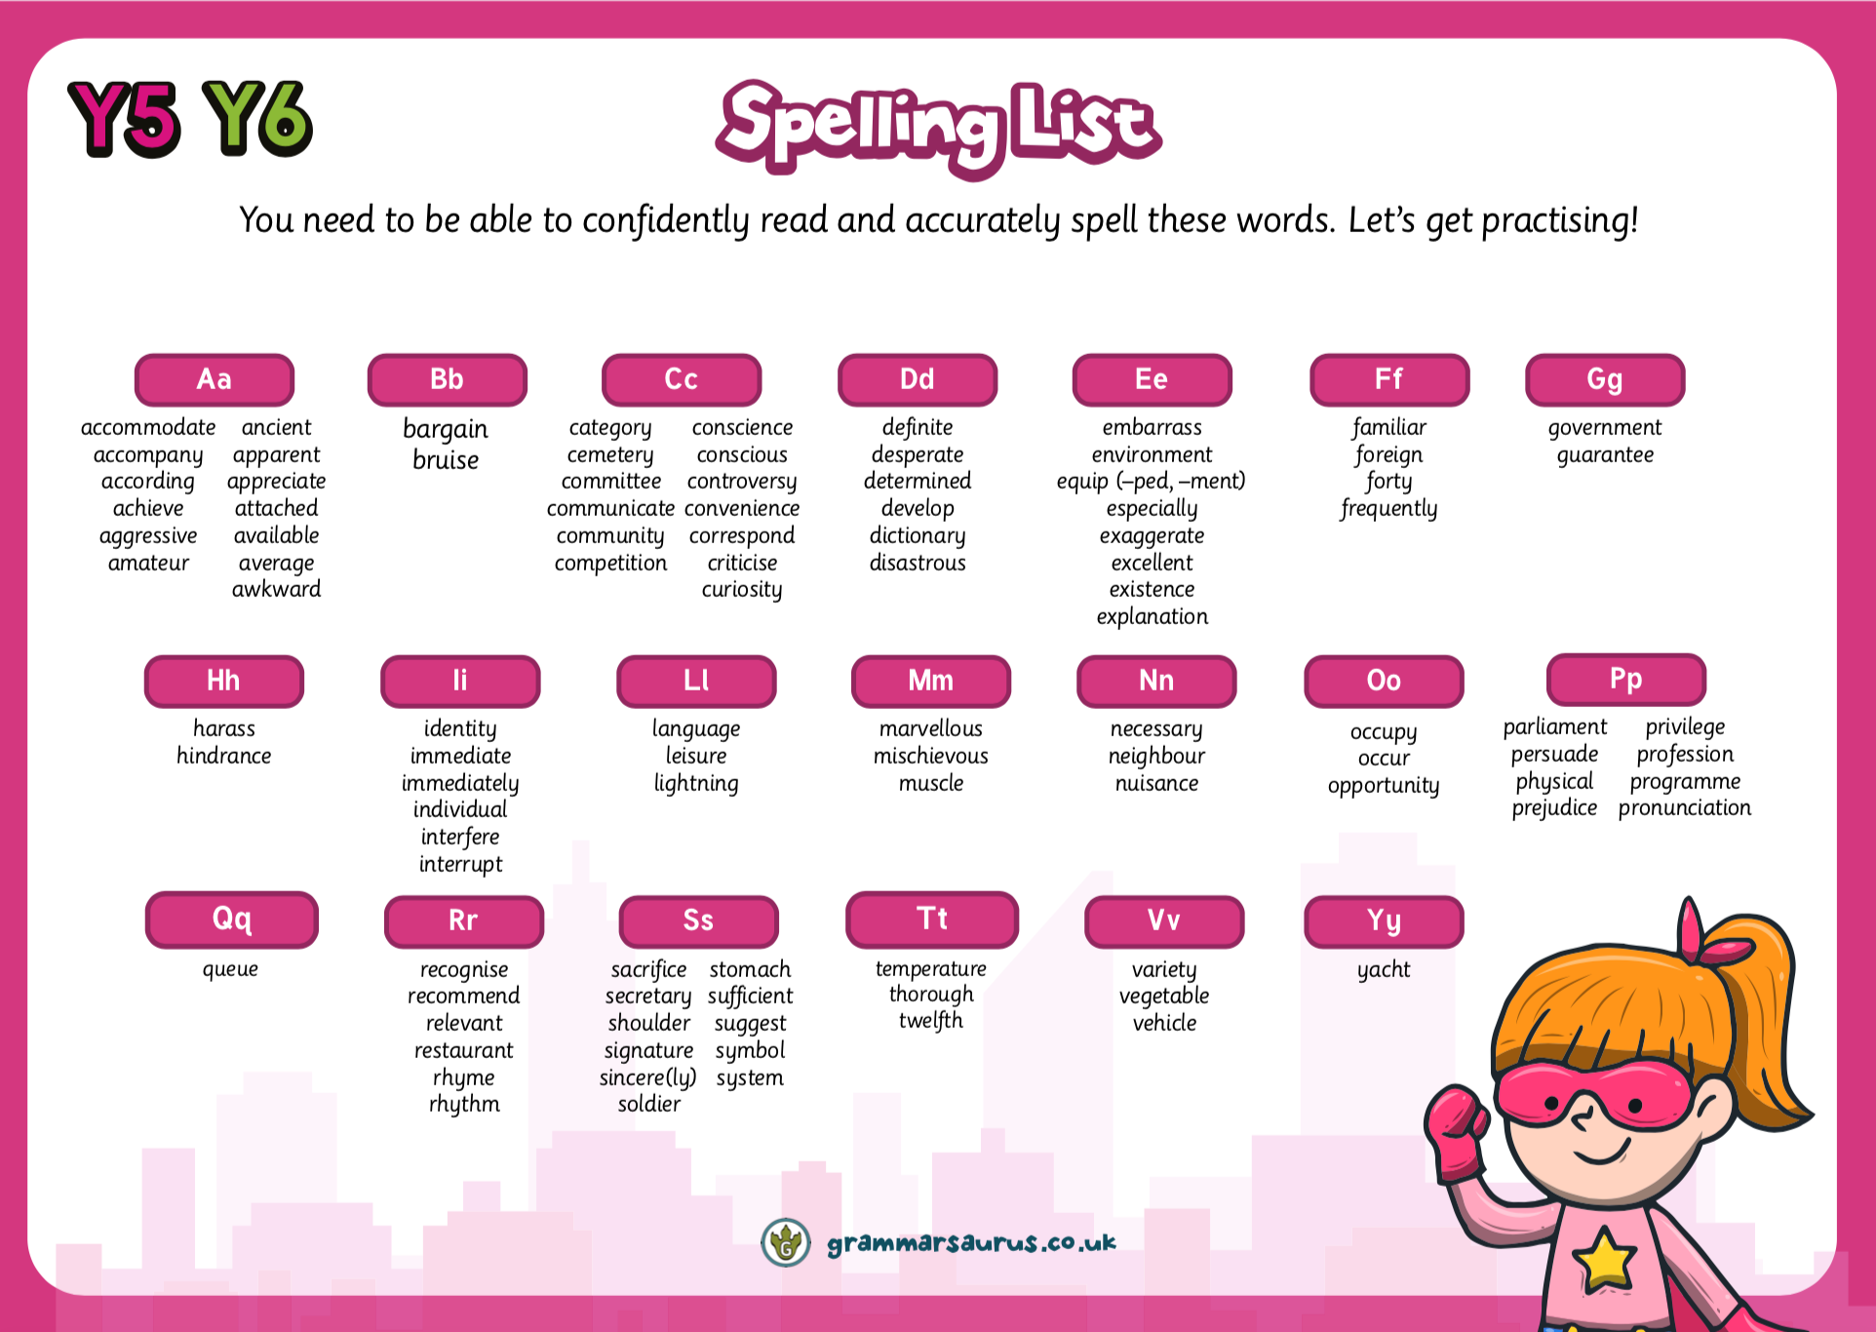
Reading
Daily Guided Reading sessions.
Children will all read with Mr Cook once a week
It is important for the children to read for 20 minutes daily at home.
It is not important what the children are reading, as long as they are reading!
Notes:
In the Upper school, we have daily guided reading sessions.
Carousel. Children to work with me on GR. LW on independent reading. Handwriting and a follow up – using the info from sessions with me and creating their own version or response. Children MUST have their reading log in school everyday.
All children are expected to read regularly at home and we ask that yellow reading diaries live in book bags so they can be accessed at school and at home.
In Year 3, it is expected that the children write their own comments on what they have read, and please do ensure these are signed regularly by you. These will be checked weekly.
It might be they are reading a magazine, comic, fiction, non-ficiton, the news. ANYTHING.

Slide 11

Reading
At Nutfield Church School, we want our pupils to love reading!
We recommended that the books chosen reflect their reading abilities. The children should be selecting a variety of chapter books, as good readers produce good writers.
We encourage our pupils to read every school day, for 20 minutes, or more, and it should be recorded in their reading record.
Children in Years 6 are encouraged to write neatly in their own reading logs.
Some children will still read daily with an adult in class.
Daily Guided Reading sessions with a focus on Reading Comprehension.
Revision Homework – Reading Comprehension.
Notes:
In the Upper school, we have daily guided reading sessions.
Carousel. Children to work with me on GR. LW on independent reading. Handwriting and a follow up – using the info from sessions with me and creating their own version or response. Children MUST have their reading log in school everyday.
All children are expected to read regularly at home and we ask that yellow reading diaries live in book bags so they can be accessed at school and at home.
In Year 3, it is expected that the children write their own comments on what they have read, and please do ensure these are signed regularly by you. These will be checked weekly.
It might be they are reading a magazine, comic, fiction, non-ficiton, the news. ANYTHING.

Slide 12
Maths
Place Value
Adding and subtracting numbers up to 99,999,999 using the formal written and column methods.
Times tables – ALL Times Tables
  Continue to practise at home.
Multiplying and dividing using the formal methods.
We will also be focusing on applying the knowledge and methods taught during maths lessons, using word problems, challenges and setting up role plays.
Fractions
Shape
Statistics
Measure
Algebra
Notes:
We will start the term by extending our knowledge and recapping place value and our number bonds. Understanding place value – the value of each digit in a number.
These are a key mathematical skill and plays an extremely important role in helping the children to understand and progress in other areas of number.
We will also be focusing on adding and subtracting numbers up to 200 mentally and using the inverse to check our answers.
Through the year, the children will continue to recap their 2, 5 and 10 times tables and will begin to learn their 3, 4 and 8 times tables. Please practise these at home. A multiplication grid will be stuck into the children’s homework books for their use.
New curriculum means there is a focus on applying the knowledge and methods taught during maths lessons, using word problems, challenges and setting up role plays; the children will be able to apply their learning to real life examples and explain how they know an answer is correct.
Fractions – looking at fractions are part of a number, adding and subtracting fractions and ordering fractions.

Slide 13
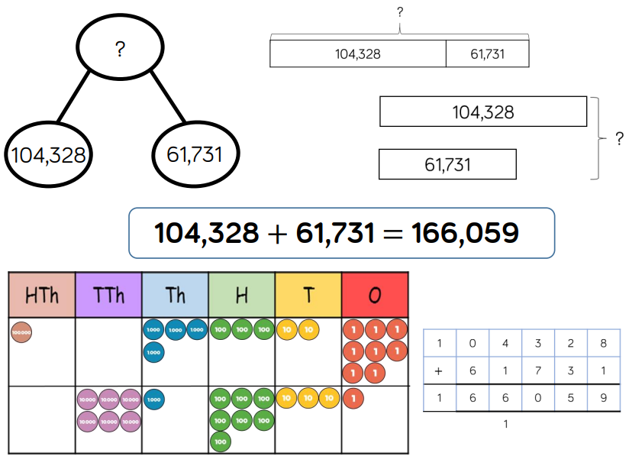
Addition
Addition in Year 6 - up to 3 decimal places.
Notes:
We will start the term by extending our knowledge and recapping place value and our number bonds. Understanding place value – the value of each digit in a number.
These are a key mathematical skill and plays an extremely important role in helping the children to understand and progress in other areas of number.
We will also be focusing on adding and subtracting numbers up to 200 mentally and using the inverse to check our answers.
Through the year, the children will continue to recap their 2, 5 and 10 times tables and will begin to learn their 3, 4 and 8 times tables. Please practise these at home. A multiplication grid will be stuck into the children’s homework books for their use.
New curriculum means there is a focus on applying the knowledge and methods taught during maths lessons, using word problems, challenges and setting up role plays; the children will be able to apply their learning to real life examples and explain how they know an answer is correct.
Fractions – looking at fractions are part of a number, adding and subtracting fractions and ordering fractions.

Slide 14
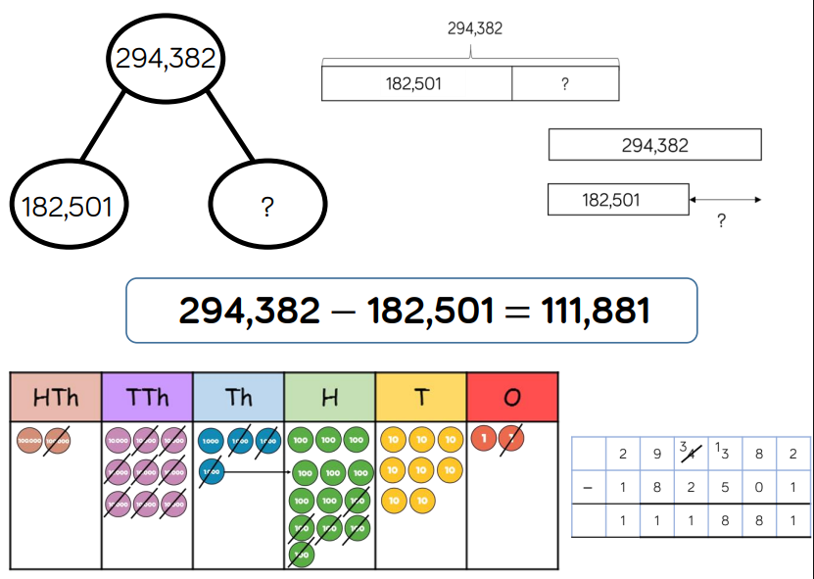
Subtraction
Subtraction in Year 6 -up to 3 decimal places.
Notes:
We will start the term by extending our knowledge and recapping place value and our number bonds. Understanding place value – the value of each digit in a number.
These are a key mathematical skill and plays an extremely important role in helping the children to understand and progress in other areas of number.
We will also be focusing on adding and subtracting numbers up to 200 mentally and using the inverse to check our answers.
Through the year, the children will continue to recap their 2, 5 and 10 times tables and will begin to learn their 3, 4 and 8 times tables. Please practise these at home. A multiplication grid will be stuck into the children’s homework books for their use.
New curriculum means there is a focus on applying the knowledge and methods taught during maths lessons, using word problems, challenges and setting up role plays; the children will be able to apply their learning to real life examples and explain how they know an answer is correct.
Fractions – looking at fractions are part of a number, adding and subtracting fractions and ordering fractions.

Slide 15
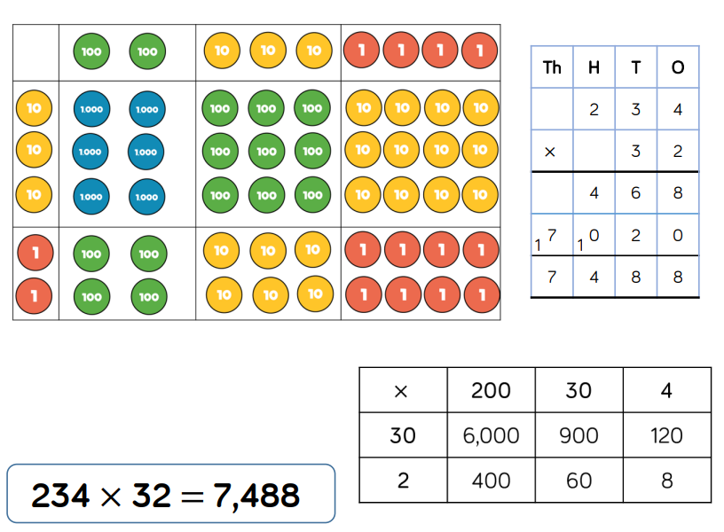
Multiplication
Notes:
We will start the term by extending our knowledge and recapping place value and our number bonds. Understanding place value – the value of each digit in a number.
These are a key mathematical skill and plays an extremely important role in helping the children to understand and progress in other areas of number.
We will also be focusing on adding and subtracting numbers up to 200 mentally and using the inverse to check our answers.
Through the year, the children will continue to recap their 2, 5 and 10 times tables and will begin to learn their 3, 4 and 8 times tables. Please practise these at home. A multiplication grid will be stuck into the children’s homework books for their use.
New curriculum means there is a focus on applying the knowledge and methods taught during maths lessons, using word problems, challenges and setting up role plays; the children will be able to apply their learning to real life examples and explain how they know an answer is correct.
Fractions – looking at fractions are part of a number, adding and subtracting fractions and ordering fractions.

Slide 16
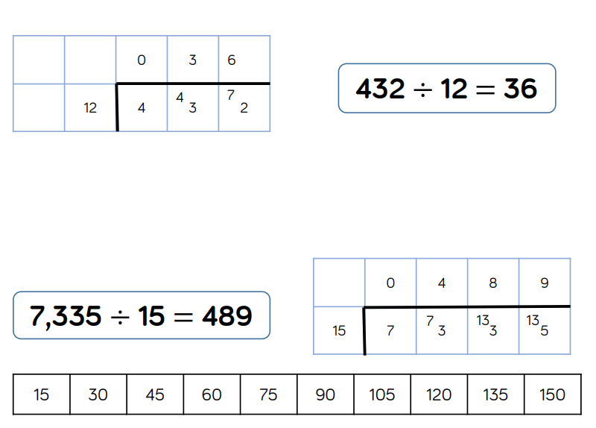
Division
Notes:
We will start the term by extending our knowledge and recapping place value and our number bonds. Understanding place value – the value of each digit in a number.
These are a key mathematical skill and plays an extremely important role in helping the children to understand and progress in other areas of number.
We will also be focusing on adding and subtracting numbers up to 200 mentally and using the inverse to check our answers.
Through the year, the children will continue to recap their 2, 5 and 10 times tables and will begin to learn their 3, 4 and 8 times tables. Please practise these at home. A multiplication grid will be stuck into the children’s homework books for their use.
New curriculum means there is a focus on applying the knowledge and methods taught during maths lessons, using word problems, challenges and setting up role plays; the children will be able to apply their learning to real life examples and explain how they know an answer is correct.
Fractions – looking at fractions are part of a number, adding and subtracting fractions and ordering fractions.

Slide 17
RE

Slide 18

PE
After parent consultation, children will now be coming into school in their P.E Kit on their allocated P.E day. Year 6’s P.E day will be every Wednesday.
P.E Uniform:
Yellow T-shirt
Blue/black sports shorts.
Plimsolls or trainers
A school jumper/fleece/cardigan can be worn during the colder months.
Blue/black jogging bottoms
On wetter days a coat can be worn for P.E.
Notes:
Mr smith - I will hand over and collect the children at the end of the day on Wednesday.
All chidlren will get the oppourtunity to participate in district sport events if they want to – so don’t worry if your child isnt picked for something right away. Mr Smith is in charge of picking the children for this.

Slide 19
PE
If your child is unable to access a P.E lesson due to injury or illness, please write a note to let us know.
Children will be required to remove earrings during P.E.
P.E. kits must be brought to school on Monday, and will be sent home on Friday to be washed.
Notes:
Mr smith - I will hand over and collect the children at the end of the day on Wednesday.
All chidlren will get the oppourtunity to participate in district sport events if they want to – so don’t worry if your child isnt picked for something right away. Mr Smith is in charge of picking the children for this.

Slide 20
PE Kit
Yellow PE top
Navy/blue shorts
Navy/blue tracksuit bottoms - important for the winter months
Navy/blue jumper - important for the winter months
Trainers
Spare socks – girls will not be allowed to do PE in their tights
Earrings – No earrings to do P.E
Long hair tied back
Notes:
Navy/blue tracksuit bottoms - important for the winter months
Trainers – not plimpsoles for outdoor PE
Spare socks – girls will not be allowed to do PE in their tights
Earrings – please encourage the girls to learn to take their earrings out on their own as much as possible, we advise that children do not do PE in their earrings, although we know this isnt always possible.
If anyone has any spare or old PE that they don’t need anymore, could they please bring it in to have as a class spare.

Slide 21
Science, Computing and D&T
Computing will include working on Purple Mash and Microsoft programs to publish Science work.
During computing we will also be looking at Online Safety.
In Science Year 6 will be studying the following:
Living Things and Habitiats
Evolution
Light
Electricity
Animals including Humans
Notes:
Animals inc - children have designed a character who doesn’t eat – but gets their energy and food from other sources.

Slide 22

Science, Computing and D&T
  Autumn
    Become competent in a range of cooking techniques.
  Spring
    Use research and develop design criteria to inform the design of innovative, functional, appealing products that are fit for purpose, aimed at particular individuals or groups.
        Creating a game using electricity; buzzers, lights and switches.
  Summer
    Use research and develop design criteria to inform the design of innovative, functional, appealing products that are fit for purpose, aimed at particular individuals or groups.
        Enterprise Project

Slide 23
History and Geography
History
Autumn 1 | Spring 1 | Summer 1
The Vikings | The Battle of Britain | Early Islamic civilisation
Geography
Autumn 2 | Spring 2 | Summer 2
How do I find out about our local area? | How on Earth? Our world from the International Space Station | How do we impact on our landscape?
Notes:
If you have any special knowledge or expertise in any of these topics, please feel free to let me know!
They will also be learning about the discovery of Tutankhamun, creating their own version of his Death Mask and will learn to write sentences in Hieroglyphics.
In the next few weeks the children will be bringing home their own mummified apple, which we have started to mummify using similar techniques to the Egyptians. We will also be making bread using an Ancient Egyptian recipe.

Slide 24
Expressive Arts
Art and Design will be taught every week.
  This term our focus is Painting
    Colour matching.
    Discuss colour likes and dislikes. Colour to convey mood.
    Warm/ cold colours, dark/ light. joy/
  After half term, our focus will be collage.
Music this term will focus on learning the song ‘I’ll be there’ and learning about Jazz.
In French, we will be learning how to say Actions.
  New language content: Using action verbs in the first person. Using action verbs in the third person singular. Using some adverbs. Naming craft materials. Using the perfect tense in the third person singular form.
Notes:
This year at Nutfield Church, our expressive arts program will be linked with our KUW topic. So this term we will be:
We will also be focusing on scultpure, collage, printing and textiles this year.

Slide 25
SATs – Monday 10th – Thursday 13th
May 2027
The 2020 SATs schedule is as follows:
Monday 10th May
English Grammar, Punctuation and Spelling Paper 1: questions (45 Mins)
English Grammar, Punctuation and Spelling Paper 2: spelling (20 Mins)
Tuesday 11th May
English reading (60 Mins)
Wednesday 12th May
Mathematics Paper 1: arithmetic
(30 Mins)
Mathematics Paper 2: reasoning
(40 Mins)
Thursday 13th May
Mathematics Paper 3: reasoning
(40 Mins)

Slide 26
Scaled Score
You will be given your child’s raw score (the actual number of marks they get), alongside their scaled score and whether they have reached the expected standard set by the Department for Education.
100 or above means your child is working at the national expectations.
Below 100 will mean your child is working towards the national expectations.
The range of scaled scores available for each KS2 test is:
  80 (the lowest scaled score that can be awarded)
  120 (the highest scaled score)
The Department for Education currently expects at least 65 per cent of children to reach the expected standard

Slide 27
Class assessment and groups
Children will complete practise SAT’s tests over the year for assessment purposes and revision.
The children’s groups may be changed regularly to ensure that any gaps in knowledge or understanding are filled and the children can achieve all the Year 6 objectives.

Slide 28
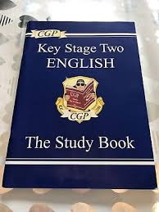


Revision at home
The old style revision guides are still useful.
If you choose to do practice SATs tests, please choose tests before 2010 and children should not use a calculator in either of the maths paper.

Slide 29


Revision at home
Key things to practice:
  Times tables
  Spellings (weekly spellings and Year 6 list)
  Reading comprehension
  Maths methods

Slide 30
Stationery
Children will need:
  Pencil
  A Blue Berol Pen
  Rubber
  Ruler
  Sharpener
  Glue stick
  Scissors
  Colouring Pencils
  All of this should be in a clear pencil case.
Notes:
Please write comment in reading record book
Responsibitly – children responsible for taking books home – we are reminding them as getting ready to go home

Slide 31
Last few notices

Slide 32
Homework
Homework is set on a Friday and must be in the following Wednesday.
Includes:
  20 Spellings or Grammar related tasks
  Reading
  Multiplications
  Revision
    Maths
    Reading comprehension
    Grammar Revision
    GCP Books
  Weekly spelling tests will occur on a Thursday/Friday

Slide 33
Snacks and Water bottles
Please include a healthy snack for the children in their school bags.
These must be NUT FREE.
All children will need a named water bottle. These are kept on the side during lesson times.
Notes:
In the Upper School, children are not provided with a snack for breaktime.
Please include a healthy snack for the children in their school bags.
We don’t have a water fountain in the Upper School, so all children will need a named water bottle.
There are a few cups if the children forget in the morning.

Slide 34
Uniform
Blue Nutfield Church jumper/cardigan
Nutfield Church Fleece
Yellow Nutfield Church polo shirt
Grey pinafore, skirt or trousers
Blue summer dress
Grey socks
Black shoes
Hair bands and clips must be blue or navy
No jewelry - one pair of studs is acceptable.

Slide 35
Absence
Please telephone the Office to let us know if your child is unwell and will not be attending school.
Please let us know when your child may be visiting secondary schools.
SATs week is timetabled from Monday 10th May to Thursday 13th May 2027. Please do not take holiday during this week.

Slide 36
Pick up and Drop off
Any information can be send either through the member of staff at the gates or a note with the pupil.
Please let us know who is picking up your child if it is not you. If there is a long-standing arrangement, please let the office or myself know.
Children in Year 6 can walk home on their own, at the parent’s discretion. We will need written permission from you.

Slide 37
Walking Home Alone
We need written permission for any child to walk home; an email or a letter.
We can only let children with parental permission walk home alone.
Children will not be allowed to walk home with friends if they do not have permission.

Slide 38
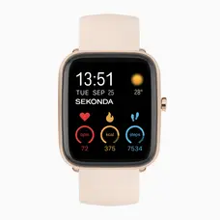
Mobile Phones
Mobile phones should only be brought to school by children that walk to/from school by themselves.
Every morning, phones are collected in a box and the box is locked away. They will not be allowed access to this during the school day.
At the end of the school day the phones are returned to their owners.
Phones MUST NOT be used on the playgrounds in the mornings before school or after school.
NO SMART WATCHES

Slide 39
Online Safety at Nutfield Church Primary
At Nutfield Church School, we teach children in all classes how to stay safe in the online world, through regular Internet Safety lessons, using a mixture of videos and activities, aimed at their different ages and experiences.
As staying safe online straddles school and home, we encourage parent, family and wider school community involvement in our efforts to inform children about the digital world.
Please see our website for more information. https://nutfieldchurchprimary.co.uk/online-safety/

Slide 40
Online Safety at Nutfield Church Primary
In our school, we have a filtering and monitoring system which blocks key words and searches from coming up.
If a child searches something they shouldn’t an email will be sent to the Office Team, it is then investigated by Miss Mitchell and Mrs Farray-Green (our Online Safety Lead).
Online Safety is taught throughout the Science, Computing and Design and Technology curriculum in all year groups.
Key Stage 1 use Purple Mash’s Online Safety scheme.
Key Stage 2 use Google’s ‘Interland and Be Internet Kind’ Schemes.

Slide 41

E-Safety KS2
If you are concerned or worried about online safety, do come and see me!
DOs
Talk to your child regularly about what they do online and on their phone. Who are they talking to and what about?
Keep your computer/tablet in an area of the house that is easy to supervise i.e. where you will walk past every now and again.
Reinforce the message of not talking to strangers, giving out any personal details and sending inappropriate words or images.
Subscribe to your internet service provider’s filter system.
Build this relationship/practice now while it is relatively easy in preparation for when your child is a teenager!
DON’Ts
Take an “it will never happen to us” attitude
Allow your child to join social media sites where they are under the age limit (age limits exist for a reason!)

Slide 42
Contact and Important Dates
If you have any quick questions or concerns please feel free to catch me in the playground at the end of the day.
If you would like to speak me more privately, please let me know or contact the school office to arrange an appointment.
  info@nutfield.surrey.sch.uk
Please do keep an eye on the school website which lists all the key dates for the Autumn term and class updates! Some of these up dates can also be found in my weekly newsletter.

Slide 43
High Ashurst Outdoor Learning Centre and Thames Young Mariners
Year 6 Residential 2026

Slide 44
Residential Reminders
The coach will leave the school at 8am on Monday 14th September. Please be here at 7.30am.
Travel sickness medication – please give to your child before and supply some for the journeys to and from Thames Mariners. (Give this to a member of staff on the day of departure).
ANY medication (including eczema creams) must be given to a member of staff in the morning, in a named bag and box. Add any instructions too.
Children will leave after lunch and will dismissed as usual at 3.15pm on Friday 18th September.
Pack a suitcase/bag with wheels.

Slide 45
Clothing
For High Ashurst, the children need enough clothes for 3 days and 2 nights. Extras are highly recommended.
T-shirts
Sweatshirts/fleeces
Trousers/Leggings/Tracksuit bottoms/shorts (not jeans)
Waterproof coat
Clothing to wear in the Centre
Hat and gloves/sun cream and sun hat (weather dependent)
Pyjamas
Plenty of spare underwear and socks
2 pairs of old trainers (one to get wet)
Please name all clothing.

Slide 46
Clothing for Thames Young Mariners
For The Thames Mariners, the children need enough clothes for 2 days and 2 nights and 3 sets of clothes they can get wet.
Children should wear a short sleeve top and shorts under their wetsuits. So 3xshort sleeve tops and shorts.
T-shirts
Sweatshirts/fleeces
Trousers/Leggings/shorts (not jeans)
Hat and gloves/sun cream and sun hat (weather dependent)
Warm coat (weather dependent)
Plenty of spare underwear – it will get wet
Please name all clothing.

Slide 47
Essentials
Sleeping bag, roll mat and pillow for Wednesday and Thursday nights.
Wash bag (soap & toothbrush etc.)
2 Large towels
Hairbrush
Torch & batteries – the campsite is dark
Plastic bottle for drinks
Sunscreen (Hot weather)
Small Bag/Rucksack
Plastic bags / bin liners (for wet and dirty items)
Please ensure any medication is given to us with instructions on that are to be handed to a teacher on the day we leave
No mobile phones, electronic devices or food items.
You can bring a cuddly toy or a book. These are however at your own risk.

Slide 48

Contact
Mr Bowen will check in with the school each day.
Please contact the school in an emergency (during school hours).
A daily Parent Mail will notify parents all is well.
Children should not have a mobile phone with them.
They will have a wonderful time – please don’t worry!
Notes:
Will phone school to say we have arrived on Wednesday
Text in IW and AM in the evening
Check in school on Thrusday Morn and Friday morn.

